Slide 1
Access Control and Operating System Security
CS 155
Spring 2010
John Mitchell

Slide 2
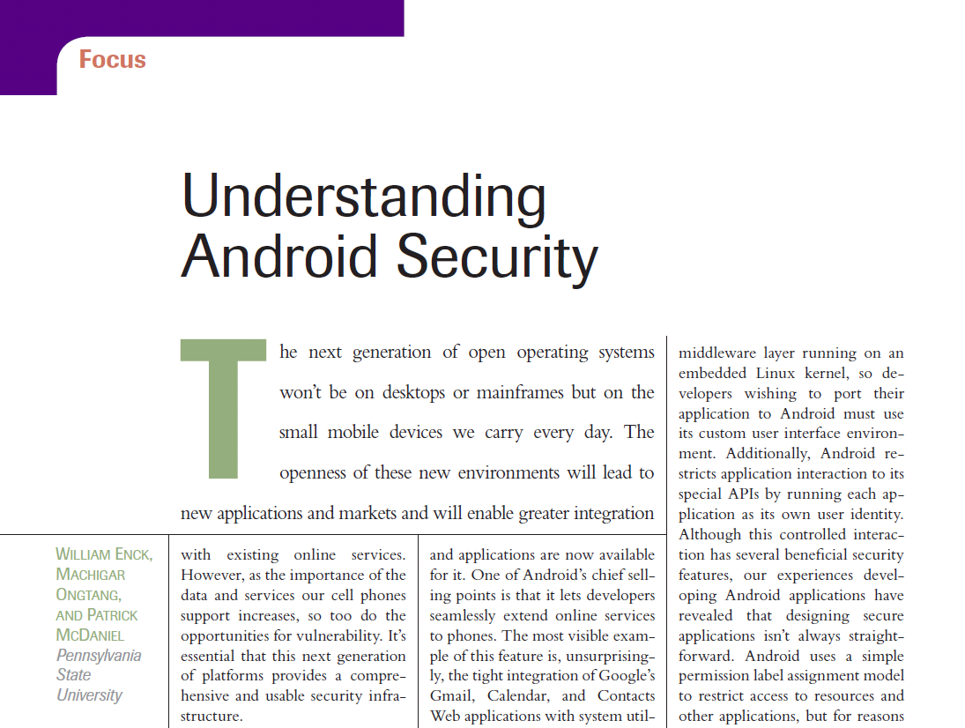
Lecture goal: Cover background and concepts used in Android security model
IEEE Security and Privacy, Jan.-Feb. 2009

Slide 3
Outline
Access Control Concepts
Matrix, ACL, Capabilities
OS Mechanisms
Multics
Ring structure
Amoeba
Distributed, capabilities
Unix
File system, Setuid
Windows
File system, Tokens, EFS
Web browser (briefly)
“OS of the future”
Protect content based on origins instead of user id
Android security model
OS user-isolation applied to applications
Reference monitor for inter-component communications

Slide 4
Access control
Assumptions
System knows who the user is
Authentication via name and password, other credential
Access requests pass through gatekeeper (reference monitor)
System must not allow monitor to be bypassed
Reference
monitor
?
Resource
User process
access request
policy

Slide 5
Access control matrix [Lampson]
Objects
 | File 1 | File 2 | File 3 | … | File n
User 1 | read | write | - | - | read
User 2 | write | write | write | - | -
User 3 | - | - | - | read | read
…
User m | read | write | read | write | read
Subjects

Slide 6
Two implementation concepts
Access control list (ACL)
Store column of matrix
with the resource
Capability
User holds a “ticket” for
each resource
Two variations
store row of matrix with user, under OS control
unforgeable ticket in user space
 | File 1 | File 2 | …
User 1 | read | write | -
User 2 | write | write | -
User 3 | - | - | read
…
User m | read | write | write
Access control lists are widely used, often with groups
Some aspects of capability concept are used in Kerberos, …

Slide 7
Capabilities
Operating system concept
“… of the future and always will be …”
Examples
Dennis and van Horn, MIT PDP-1 Timesharing
Hydra, StarOS, Intel iAPX 432, Eros, …
Amoeba: distributed, unforgeable tickets
References
Henry Levy, Capability-based Computer Systems
http://www.cs.washington.edu/homes/levy/capabook/
Tanenbaum, Amoeba papers

Slide 8
ACL vs Capabilities
Access control list
Associate list with each object
Check user/group against list
Relies on authentication: need to know user
Capabilities
Capability is unforgeable ticket
Random bit sequence, or managed by OS
Can be passed from one process to another
Reference monitor checks ticket
Does not need to know identify of user/process

Slide 9
ACL vs Capabilities
Process P
User U
Process P
Capabilty c,d
Process Q
User U
Process Q
Capabilty c
Process R
User U
Process R
Capabilty c

Slide 10
ACL vs Capabilities
Delegation
Cap: Process can pass capability at run time
ACL: Try to get owner to add permission to list?
More common: let other process act under current user
Revocation
ACL: Remove user or group from list
Cap: Try to get capability back from process?
Possible in some systems if appropriate bookkeeping
OS knows which data is capability
If capability is used for multiple resources, have to revoke all or none …
Indirection: capability points to pointer to resource
If C → P → R, then revoke capability C by setting P=0

Slide 11
Roles (also called Groups)
Role = set of users
Administrator, PowerUser, User, Guest
Assign permissions to roles; each user gets permission
Role hierarchy
Partial order of roles
Each role gets
permissions of roles below
List only new permissions
given to each role
Administrator
PowerUser
User
Guest

Slide 12
Role-Based Access Control
Individuals
Roles
Resources
engineering
Server 1
marketing
Server 2
Server 3
human res
Advantage: user’s change more frequently than roles

Slide 13
Multi-Level Security (MLS) Concepts
Military security policy
Classification involves sensitivity levels, compartments
Do not let classified information leak to unclassified files
Group individuals and resources
Use some form of hierarchy to organize policy
Other policy concepts
Separation of duty
“Chinese Wall” Policy

Slide 14
Military security policy
Sensitivity levels
Compartments
Satellite data
Afghanistan
Middle East
Israel
Top Secret
Secret
Confidential
Restricted
Unclassified

Slide 15
Military security policy
Classification of personnel and data
Class = ⟨rank, compartment⟩
Dominance relation
D₁ ≤ D₂ iff rank₁ ≤ rank₂
and compartment₁ ⊆ compartment₂
Example: ⟨Restricted, Israel⟩ ≤ ⟨Secret, Middle East⟩
Applies to
Subjects – users or processes
Objects – documents or resources

Slide 16
Commercial version
Product specifications
Discontinued
In production
OEM
Internal
Proprietary
Public

Slide 17
Bell-LaPadula Confidentiality Model
When is it OK to release information?
Two Properties (with silly names)
Simple security property
A subject S may read object O only if C(O) ≤ C(S)
*-Property
A subject S with read access to O may write object P only if C(O) ≤ C(P)
In words,
You may only read below your classification and
only write above your classification

Slide 18
Picture: Confidentiality
Read below, write above
Read above, write below
Proprietary
Proprietary
S
S
Public
Public

Slide 19
Biba Integrity Model
Rules that preserve integrity of information
Two Properties (with silly names)
Simple integrity property
A subject S may write object O only if C(S) ≥ C(O)
(Only trust S to modify O if S has higher rank …)
*-Property
A subject S with read access to O may write object P only if C(O) ≥ C(P)
(Only move info from O to P if O is more trusted than P)
In words,
You may only write below your classification and
only read above your classification

Slide 20
Picture: Integrity
Read above, write below
Read below, write above
Proprietary
Proprietary
S
S
Public
Public

Slide 21
Other policy concepts
Separation of duty
If amount is over $10,000, check is only valid if signed by two authorized people
Two people must be different
Policy involves role membership and ≠
Chinese Wall Policy
Lawyers L1, L2 in same firm
If company C1 sues C2,
L1 and L2 can each work for either C1 or C2
No lawyer can work for opposite sides in any case
Permission depends on use of other permissions
These policies cannot be represented using access matrix

Slide 22
Example OS Mechanisms
Multics
Amoeba
Unix
Windows

Slide 23
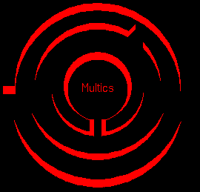
Multics
Operating System
Designed 1964-1967
MIT Project MAC, Bell Labs, GE
At peak, ~100 Multics sites
Last system, Canadian Department of Defense, Nova Scotia, shut down October, 2000
Extensive Security Mechanisms
Influenced many subsequent systems
http://www.multicians.org/security.html
E.I. Organick, The Multics System: An Examination of Its Structure, MIT Press, 1972

Slide 24
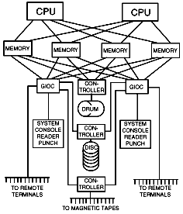
Multics time period
Timesharing was new concept
Serve Boston area with one 386-based PC
F.J. Corbato

Slide 25
Multics Innovations
Segmented, Virtual memory
Hardware translates virtual address to real address
High-level language implementation
Written in PL/1, only small part in assembly lang
Shared memory multiprocessor
Multiple CPUs share same physical memory
Relational database
Multics Relational Data Store (MRDS) in 1978
Security
Designed to be secure from the beginning
First B2 security rating (1980s), only one for years

Slide 26
Multics Access Model
Ring structure
A ring is a domain in which a process executes
Numbered 0, 1, 2, … ; Kernel is ring 0
Graduated privileges
Processes at ring i have privileges of every ring j > i
Segments
Each data area or procedure is called a segment
Segment protection ⟨b1, b2, b3⟩ with b1 ≤ b2 ≤ b3
Process/data can be accessed from rings b1 … b2
A process from rings b2 … b3 can only call segment at restricted entry points

Slide 27
Multics process
Multiple segments
Segments are dynamically linked
Linking process uses file system to find segment
A segment may be shared by several processes
Multiple rings
Procedure, data segments each in specific ring
Access depends on two mechanisms
Per-Segment Access Control
File author specifies the users that have access to it
Concentric Rings of Protection
Call or read/write segments in outer rings
To access inner ring, go through a “gatekeeper”
Interprocess communication through “channels”

Slide 28
Amoeba
Server port
Obj #
Rights
Check field
Distributed system
Multiple processors, connected by network
Process on A can start a new process on B
Location of processes designed to be transparent
Capability-based system
Each object resides on server
Invoke operation through message to server
Send message with capability and parameters
Sever uses object # to indentify object
Sever checks rights field to see if operation is allowed
Check field prevents processes from forging capabilities

Slide 29
Capabilities
Server port
Obj #
Rights
Check field
Owner capability
When server creates object, returns owner cap.
All rights bits are set to 1 (= allow operation)
Check field contains 48-bit rand number stored by server
Derived capability
Owner can set some rights bits to 0
Calculate new check field
XOR rights field with random number from check field
Apply one-way function to calculate new check field
Server can verify rights and check field
Without owner capability, cannot forge derived capability
Protection by user-process at server; no special OS support needed

Slide 30
Unix file security
Each file has owner and group
Permissions set by owner
Read, write, execute
Owner, group, other
Represented by vector of
four octal values
Only owner, root can change permissions
This privilege cannot be delegated or shared
Setid bits – Discuss in a few slides
setid
-
rwx
rwx
rwx
ownr
grp
othr

Slide 31
Question
Owner can have fewer privileges than other
What happens?
Owner gets access?
Owner does not?
Prioritized resolution of differences
if user = owner then owner permission
else if user in group then group permission
else other permission

Slide 32
Effective user id (EUID)
Each process has three Ids (+ more under Linux)
Real user ID (RUID)
same as the user ID of parent (unless changed)
used to determine which user started the process
Effective user ID (EUID)
from set user ID bit on the file being executed, or sys call
determines the permissions for process
file access and port binding
Saved user ID (SUID)
So previous EUID can be restored
Real group ID, effective group ID, used similarly

Slide 33
Process Operations and IDs
Root
ID=0 for superuser root; can access any file
Fork and Exec
Inherit three IDs, except exec of file with setuid bit
Setuid system calls
seteuid(newid) can set EUID to
Real ID or saved ID, regardless of current EUID
Any ID, if EUID=0
Details are actually more complicated
Several different calls: setuid, seteuid, setreuid

Slide 34
Setid bits on executable Unix file
Three setid bits
Setuid – set EUID of process to ID of file owner
Setgid – set EGID of process to GID of file
Sticky
Off: if user has write permission on directory, can rename or remove files, even if not owner
On: only file owner, directory owner, and root can rename or remove file in the directory

Slide 35
Example
Owner 18
RUID 25
SetUID
…;
…;
exec( );
program
Owner 18
…;
…;
i=getruid()
setuid(i);
…;
…;
-rw-r--r--
file
read/write
RUID 25
EUID 18
Owner 25
-rw-r--r--
read/write
RUID 25
file
EUID 25

Slide 36
Setuid programming
Be Careful!
Root can do anything; don’ t get tricked
Principle of least privilege – change EUID when root privileges no longer needed
Setuid scripts
This is a bad idea
Historically, race conditions
Begin executing setuid program; change contents of program before it loads and is executed

Slide 37
Unix summary
Good things
Some protection from most users
Flexible enough to make things possible
Main bad thing
Too tempting to use root privileges
No way to assume some root privileges without all root privileges

Slide 38
Access control in Windows (NTFS)
Some basic functionality similar to Unix
Specify access for groups and users
Read, modify, change owner, delete
Some additional concepts
Tokens
Security attributes
Generally
More flexibility than Unix
Can define new permissions
Can give some but not all administrator privileges

Slide 39
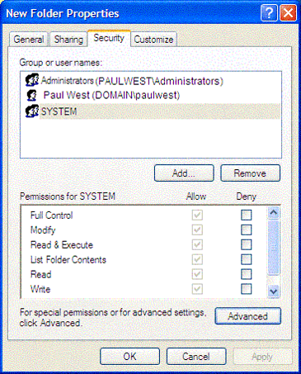
Sample permission options
Security ID (SID)
Identity (replaces UID)
SID revision number
48-bit authority value
variable number of Relative Identifiers (RIDs), for uniqueness
Users, groups, computers, domains, domain members all have SIDs

Slide 40
Permission Inheritance
Static permission inheritance (Win NT)
Initially, subfolders inherit permissions of folder
Folder, subfolder changed independently
Replace Permissions on Subdirectories command
Eliminates any differences in permissions
Dynamic permission inheritance (Win 2000)
Child inherits parent permission, remains linked
Parent changes are inherited, except explicit settings
Inherited and explicitly-set permissions may conflict
Resolution rules
Positive permissions are additive
Negative permission (deny access) takes priority

Slide 41
Tokens
Security Reference Monitor
uses tokens to identify the security context of a process or thread
Security context
privileges, accounts, and groups associated with the process or thread
Impersonation token
thread uses temporarily to adopt a different security context, usually of another user

Slide 42
Security Descriptor
Information associated with an object
who can perform what actions on the object
Several fields
Header
Descriptor revision number
Control flags, attributes of the descriptor
E.g., memory layout of the descriptor
SID of the object's owner
SID of the primary group of the object
Two attached optional lists:
Discretionary Access Control List (DACL) – users, groups, …
System Access Control List (SACL) – system logs, ..

Slide 43
Example access request
Access token
User: Mark
Group1: Administrators
Group2: Writers
Access request: write
Action: denied
Revision Number
Control flags
Owner SID
User Mark requests write permission
Descriptor denies permission to group
Reference Monitor denies request
Group SID
DACL Pointer
Security descriptor
SACL Pointer
Deny
Writers
Read, Write
Allow
Mark
Read, Write

Slide 44
Impersonation Tokens (=setuid?)
Process uses security attributes of another
Client passes impersonation token to server
Client specifies impersonation level of server
Anonymous
Token has no information about the client
Identification
server obtain the SIDs of client and client's privileges, but server cannot impersonate the client
Impersonation
server identify and impersonate the client
Delegation
lets server impersonate client on local, remote systems

Slide 45
SELinux Security Policy Abstractions
Type enforcement
Each process has an associated domain
Each object has an associated type
Configuration files specify
How domains are allowed to access types
Allowable interactions and transitions between domains
Role-based access control
Each process has an associated role
Separate system and user processes
Configuration files specify
Set of domains that may be entered by each role

Slide 46
An Analogy
Operating system
Web browser
Primitives
System calls
Processes
Disk
Principals: Users
Discretionary access control
Vulnerabilities
Buffer overflow
Root exploit
Primitives
Document object model
Frames
Cookies / localStorage
Principals: “Origins”
Mandatory access control
Vulnerabilities
Cross-site scripting
Universal scripting

Slide 47
Components of browser security policy
Frame-Frame relationships
canScript(A,B)
Can Frame A execute a script that manipulates arbitrary/nontrivial DOM elements of Frame B?
canNavigate(A,B)
Can Frame A change the origin of content for Frame B?
Frame-principal relationships
readCookie(A,S), writeCookie(A,S)
Can Frame A read/write cookies from site S?

Slide 48
Principles of secure design
Compartmentalization
Principle of least privilege
Minimize trust relationships
Defense in depth
Use more than one security mechanism
Secure the weakest link
Fail securely
Keep it simple
Consult experts
Don’t build what you can easily borrow/steal
Open review is effective and informative

Slide 49
Compartmentalization
Divide system into modules
Each module serves a specific purpose
Assign different access rights to different modules
Read/write access to files
Read user or network input
Execute privileged instructions (e.g., Unix root)
Principle of least privilege
Give each module only the rights it needs

Slide 50
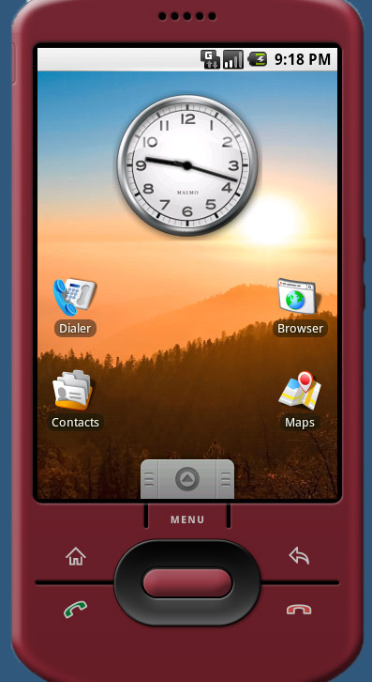
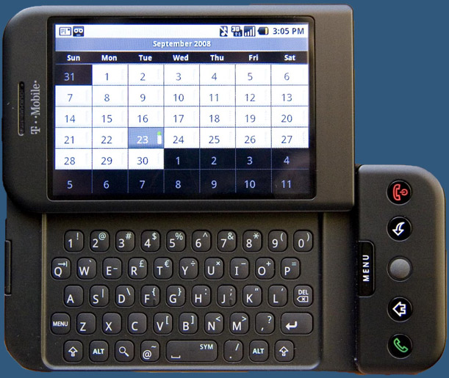
This slide borrowed from Selley, Shinde, et al., Vulnerability Study of the Android

Slide 51
Android security resources
Cannings talk (Android team)
http://www.usenix.org/events/sec09/tech/
Understanding Android Security (PennState):
http://ieeexplore.ieee.org/search/srchabstract.jsp?tp=&arnumber=4768655 (posted on CourseWare, Stanford-only)
Earlier tutorial at CCS (PennState)
http://siis.cse.psu.edu/android_sec_tutorial.html
Unlock flaw
Can unlock phone using back button, when called
http://www.youtube.com/watch?v=CcQz1yZ5cj8

Slide 52
Android
Open-source platform (Open Handset Alliance)
Native development, Java development
Phones carried by 32+ carriers, 20+ countries
Platform outline:
Linux kernel
Webkit- based browser
SQL-lite
Open SSL, Bouncy Castle crypto API and Java library
Bionic LibC (small code, good performance, no GPL)
Apache Harmony libraries (open source Java impl)
Many others: video stuff, Bluetooth, vibrate phone, etc.

Slide 53
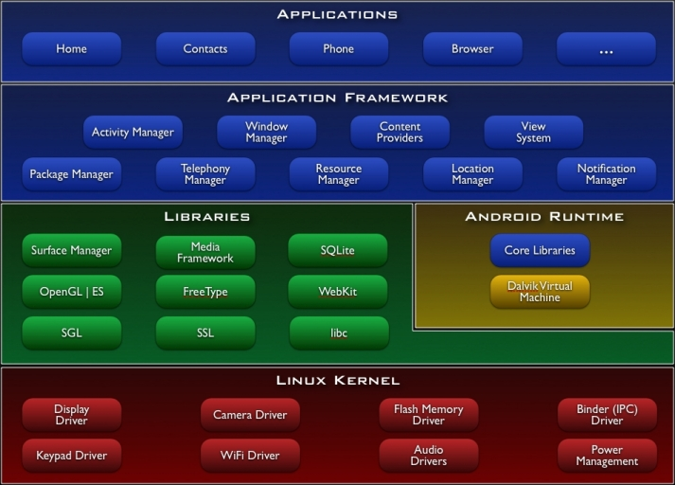

Slide 54
Android challenges
Battery life
Developers must conserve power
Applications store state so they can be stopped (to save power) and restarted – helps with DoS
Most foreground activity is never killed
Android market
Not reviewed by Google (diff from Apple)
No way of stopping bad applications from showing up on market
Malware writers may be able to get code onto platform: shifts focus from remote exploit to privilege escalation

Slide 55
Application development concepts
Activity – one-user task
Example: scroll through your inbox
Email client comprises many activities
Service – Java daemon that runs in background
Example: application that streams an mp3 in background
Intents – asynchronous messaging system
Fire an intent to switch from one activity to another
Example: email app has inbox, compose activity, viewer activity
User click on inbox entry fires an intent to the viewer activity, which then allows user to view that email
Content provider
Store and share data using a relational database interface
Broadcast receiver
“mailboxes” for messages from other applications

Slide 56
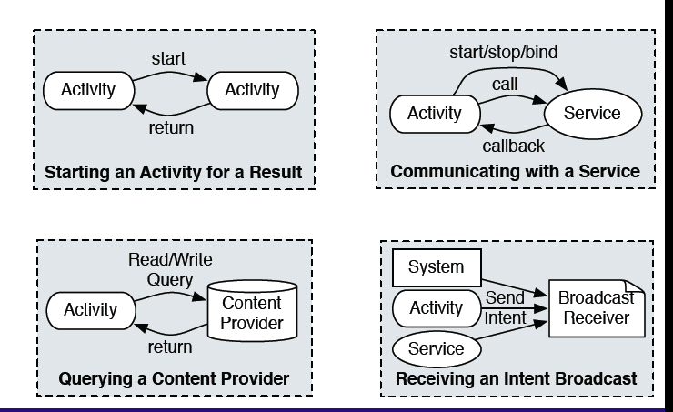
Source: Penn State group, Android security tutorial

Slide 57
Signing
Developers sign applications
Self-signed certificates
Not form of identity
Used to allow developer who built application to update application
Based on Java key tools and jar signer

Slide 58
Exploit prevention
100 open source libraries + 500 million lines new code
Open source -> no obscurity
Goals
Prevent remote attacks
Secure drivers, media codecs, new and custom features
Overflow prevention
ProPolice stack protection (like Dan’s last lecture)
First on the ARM architecture; some nasty gcc bugs …
Some heap overflow protections
Chunk consolidation in DL malloc (from OpenBSD)
Decided against (in initial release)
stack and heap non-execute protections (time-to-market, battery life)
ASLR – performance impact
Many pre-linked images for performance
Can’t install different images on different devices in the factory
Later developed and contributed by Bojinov, Boneh (Stanford)

Slide 59
dlmalloc (Doug Lea)
Stores meta data in band
Heap consolidation attack
Heap overflow can overwrite pointers to previous and next unconsolidated chunks
Overwriting these pointers allows remote code execution
Change to improve security
Check integrity of forward and backward pointers
Simply check that back-forward-back = back, f-b-f=f
Team believes this increases the difficulty of heap overflow

Slide 60
Application sandbox
Application sandbox
Each application runs with its UID in its own Dalvik virtual machine
Provides CPU protection, memory protection
Authenticated communication protection using Unix domain sockets
Only ping, zygote (spawn another process) run as root
Applications announces permission requirement
Create a whitelist model – user grants access
But don’t want to ask user often – all questions asked as install time
Inter-component communication reference monitor checks permissions

Slide 61
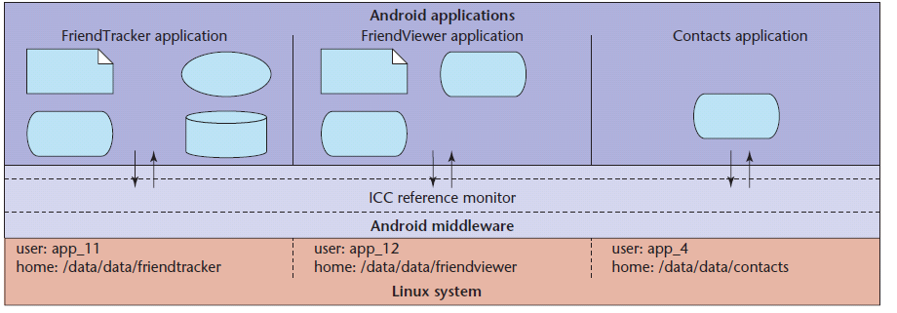
Two forms of security enforcement
Each application executes as its own user identity
Android middleware has reference monitor that mediates the establishment of inter-component communication (ICC)
First is straightforward to implement, second requires careful consideration of mechanism, policy
Source: Penn State group Android security paper

Slide 62
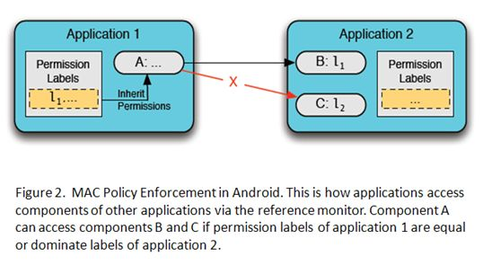
Source: Penn State group, Android security tutorial

Slide 63
Android manifest
Manifest files describing the contents of an application package
Each Android application has AndroidManifest.xml file
describes the contained components
Components cannot execute unless they are listed
specifies rules for “auto-resolution”
specifies access rules
describes runtime dependencies
optional runtime libraries
required system permissions

Slide 64
Permission categories
Permissions can be:
normal - always granted
dangerous - requires user approval
signature - matching signature key
signature or system - same as signature, but also system apps

Slide 65
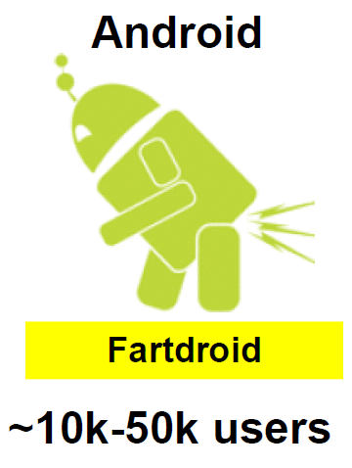
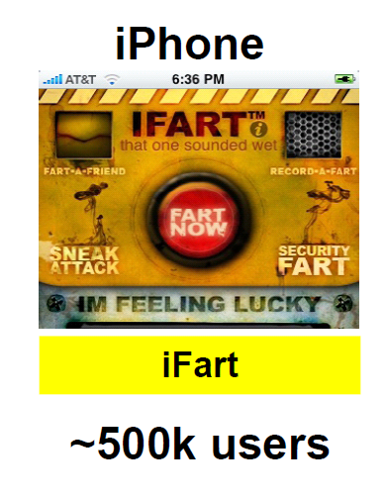
Users are always careful about downloads
Source: Jon Oberheide, CanSecWest presentation

Slide 66
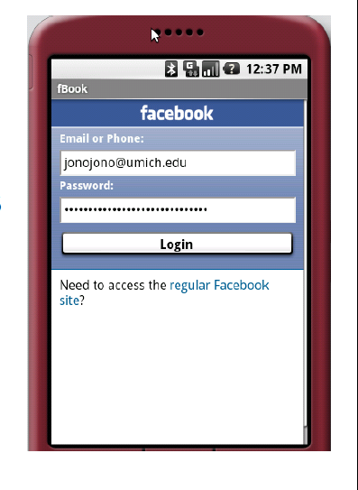
Permission granularity
fBook app example
Asks for permission to access network
User grants this assuming network is used to reach Facebook
Also “phones home” to another site
Source: Jon Oberheide, CanSecWest presentation

Slide 67
Intent Broadcast Permissions
Additional issues
Addition to basic model
Code broadcasting Intent set access permission restricting Broadcast Receivers access the Intent
Why: Define applications to read broadcasts
e.g., FRIEND_NEAR msg in PennState example
Caution
If no permission label is set on a broadcast, any unprivileged application can read it.
Recommendation
Always specify an access permission on Intent broadcasts (unless explicit destination).

Slide 68
Summary
Access Control Concepts
Matrix, ACL, Capabilities
OS Mechanisms
Multics
Ring structure
Amoeba
Distributed, capabilities
Unix
File system, Setuid
Windows
File system, Tokens, EFS
Web browser (briefly)
“OS of the future”
Protect content based on origins instead of user id
Android security model
OS user-isolation applied to applications
Reference monitor for inter-component communications
Starts out seeming simple but gets more complicated…

Slide 70
Security framework
protect
NSA:
hunt
defend
Realization
Most developers and users do not understand security
Goal
Security model that user and developers can use
Mandatory and transparent
Philosophy
Prevent breaches from occurring
Minimize security issues/minimize impact of malware
Detect compromise
prevent
Goog:
react
minimize
detect

Slide 71
Security Failures (in spite of effort)
Android shipped with heap overflow
Charlie Miller and John Herring: WebKit heap overflow
How did this happen?
Due to problems, had to rollback version before shipped
Crash dump in IDA after fuzzing
Crashing on back-forward-back = back conditions
Attacker could use heap fung xue technique (alex sodorov?) to adjust already allocated memory (bypassing DL malloc checks) and execute code
Fixed this problem in about 8 days
“hopefully defensive techniques sent attackers to find lower-hanging fruit on other platforms”

Slide 72
Minimize
Assume system will have flaws (“def in depth”)
“no such thing as full-features unbreakablke system”
Even if system is good, users will install malware and vulnerable third-pary code
Interesting insight
Vulnerability in one web app (e.g., Hotmail or Gmail) does not lead to vulnerability on another web app (e.g. banking). Why can’t downloaded apps be similarly isolated?
Why does downloaded malware have access to all info?
Solution: (i) sandboxing, (ii) same-origin policy => extend web security model to host
Traditional OS vs Android
Traditional: focus on user separation (“same-user policy”)
Andriod: application separation rather than user separation
Privilege separation - separation (“same-application policy”)
SolarDesigner ???

Slide 73
Access control model
Lots of permissions
184 permissions – from Internet to camera flash
Example of permission checks
Example: OpenCore
Media codec library
Insecure class of sofware because of complexity and performance constraints
Runs in separate UID
Charlie Miller found vulnerability in mp3 parser
Crashed media server process, therefore only access to media server UID. Browser is in separate UID
Android team considered this a success…
Canning talk: 41:00

Slide 74
Does this material fit?
Refinements to MAC Model
Delegation
Public and Private Components
Provision - No Security Access to Public Elements
Permission Granting Using User's Confirmation

Slide 75
Detection
Canning talk: 43:00
Secure coding ideas
Tried to encourage developers to hack each other’s code
Code audits
Fuzzing by Google team, ISEC partners, …

