Slide 1
Defending against
Return-Oriented Programming
Vasilis Pappas
Columbia University

Slide 2
Machine code level attacks
Code injection
DEP/NX
Code reuse
code
static data
dynamic data
(stack/heap)
code
static data
dynamic data
(stack/heap)
R-X
✖
R-X
✖
R-X
R--
RWX
RW-
exec. code
ctrl. data
Attacker
controlled
✖
Control flow
vulnerability
Control
transfer
Indirect
use of data

Slide 3
Invariants & characteristics
Knowledge of code layout
  Need to know in order to re-use
Unrestricted indirect branches
  Use them to synthesize code fragments
Goal: Break them!

Slide 4
Overview
Background
In-place code randomization
Indirect branch tracing
Combination
Summary

Slide 5
History of code-reuse attacks
1997, Solar Designer
First ret2lib exploit
2007, Shacham*
Return-oriented programming
2001, Nergal
Advanced ret2lib
1995 2000 2005 2010
1999, McDonald
ret2lib on Sparc
2005, Stealth
Borrowed code chunks
2010, Shacham*
ROP without returns
* Academic work

Slide 6
Return-Oriented Programming
Stack
Code
Actions
0xb8800000
0x00000001
0xb8800010
0x00000002
0xb8800020
0xb8800010
0x00400000
0xb8800030
0xb8800000:
pop eax
ret
...
0xb8800010:
pop ebx
ret
...
0xb8800020:
add eax, ebx
ret
...
0xb8800030:
mov [ebx], eax
ret
esp
eax = 1
ebx = 2
eax += ebx
ebx = 0x400000
*ebx = eax
Notes:
Define gadgets. Attackers can use them, may correspond to intended or unintended instruction sequences. Turing complete! Emphasis on invariants/characteristics.

Slide 7

ROP Defenses
ROPdefender
[DSW11]
DROP++
[CXH+11]
DROP
[CXS+09]
Bin. Stirring
[WMH+12]
Performance Overhead
Low High
Orp
[PPK12]
ILR
[HTC+12]
Return-less
[LWJ+10]
G-Free
[OBL+10]
CFI-COTS
[ZS13]
CCFIR
[ZWC+13]
CFL
[BJF11]
Source code Disassembly No modification
Requires
Program binary Source code
Requires

Slide 8
In-Place Code Randomization [S&P ’12]
Extend ASLR to a finer-grained level
Applicable on third-party applications
(Practically) Zero performance overhead
Source code (Python):
  http://nsl.cs.columbia.edu/projects/orp

Slide 9
Why in-place?
Randomization usually changes the code size
  Need to update the control-flow graph (CFG)
But, accurate static disassembly of stripped binaries is hard
  Incomplete CFG (data vs. code)
  Code resize not an option
Must randomize in-place!

Slide 10
Randomizations
Instruction Substitution
Instruction Reordering
  Intra Basic Block
  Register Preservation Code
Register Reassignment

Slide 11
Instruction Substitution
add [edx],edi
ret
B0 | 01 | 3A | C3 | 8D | 45 | 80 | 50 | 68
mov al,0x1
cmp al,bl
lea eax,[ebp-0x80]
add [eax],edi
fmul [ebp+0x68508045]
B0 | 01 | 38 | D8 | 8D | 45 | 80 | 50 | 68
mov al,0x1
cmp bl,al
lea eax,[ebp-0x80]
Notes:
Mention that this is part of the original code!

Slide 12
Instruction Reordering (Intra BBL)
8B 41 10 mov eax,[ecx+0x10]
53 push ebx
8B 59 0C mov ebx,[ecx+0xC]
3B C3 cmp eax,ebx
89 41 08 mov [ecx+0x8],eax
7E 4E jle 0x5c
59 push ebx
0C 3B or al,0x3B
C3 ret

Slide 13
Instruction Reordering (Intra BBL)
8B 41 10 mov eax,[ecx+0x10]
53 push ebx
8B 59 0C mov ebx,[ecx+0xC]
3B C3 cmp eax,ebx
89 41 08 mov [ecx+0x8],eax
7E 4E jle 0x5c
41 inc ecx
10 89 41 08 3B C3
adc [ecx-0x3CC4F7BF],cl

Slide 14
Register Preservation Code Reordering
push ebx
push esi
mov ebx,ecx
push edi
mov esi,edx
.
.
.
pop edi
pop esi
pop ebx
ret
push edi
push ebx
push esi
mov ebx,ecx
mov esi,edx
.
.
.
pop esi
pop ebx
pop edi
ret
Prolog
Epilog

Slide 15
Register reassignment
Live regions
function:
push esi
push edi
mov edi,[ebp+0x8]
mov eax,[edi+0x14]
test eax,eax
jz 0x4A80640B
mov ebx,[ebp+0x10]
push ebx
lea ecx,[ebp-0x4]
push ecx
push edi
call eax
...
eax
edi
function:
push esi
push edi
mov eax,[ebp+0x8]
mov edi,[edi+0x14]
test edi,edi
jz 0x4A80640B
mov ebx,[ebp+0x10]
push ebx
lea ecx,[ebp-0x4]
push ecx
push eax
call edi
...

Slide 16
Evaluation
Correctness and performance
  Execute Wine’s test suite using randomized versions of Windows DLLs
Randomization coverage
Effectiveness against real-world exploits
Robustness against ROP compilers
Notes:
After explaining wine test, mention that this is where we also measured performance

Slide 17
Randomization Coverage
Dataset: 5,235 PE files (~0.5GB code) from Windows, Firefox, iTunes and Reader

Slide 18
Real-World Exploits
Exploit/Reusable Payload | Unique Gadgets | Modifiable
Adobe Reader v9.3.4 | 11 | 6
Integard Pro v2.2.0 | 16 | 10
Mplayer Lite r33064 | 18 | 7
msvcr71.dll (White Phosphorus) | 14 | 9
msvcr71.dll (Corelan) | 16 | 8
mscorie.dll (White Phosphorus) | 10 | 4
mfc71u.dll (Corelan) | 11 | 6
Modifiable gadgets were not always directly replaceable!

Slide 19
ROP Compilers
Is it possible to create a randomization-resistant payload?
mona.py constructs DEP+ASLR bypassing code
  Allocate a WX buffer, copy shellcode and jump
Q is the state-of-the-art ROP compiler [SAB11]
  Designed to be robust against small gadget sets

Slide 20
ROP Compilers Results
Non-ASLR Code Base | Mona Orig. Rand. |  | Q Orig. Rand.
Adobe Reader v9.3.4 | ✓ | ✗ | ✓ | ✗
Integard Pro v2.2.0 | ✗ | ✗ | ✓ | ✗
Mplayer Lite r33064 | ✓ | ✗ | ✓ | ✗
msvcr71.dll | ✗ | ✗ | ✓ | ✗
mscorie.dll | ✗ | ✗ | ✗ | ✗
mfc71u.dll | ✓ | ✗ | ✓ | ✗
Both failed to construct payloads from non-randomized code!

Slide 21
Indirect branch tracing [Usenix S. ’13]
Detect and prevent ROP code execution by monitoring executed indirect branches
Transparent
  Applicable on third-party applications
  Compatible with code signing, self-modifying code, JIT, …
Lightweight
  Up to 4% overhead when artificially stressed, practically zero
Effective
  Prevents real-world exploits

Slide 22
ROP Code Runtime Properties
Illegal ret instructions that target locations not preceded by call sites
  Abnormal condition for legitimate program code
Sequences of relatively short code fragments “chained” through any kind of indirect branch
  Always holds for any kind of ROP code

Slide 23
Illegal Returns
Legitimate code:
  ret transfers control to the instruction right after the corresponding call ➔ legitimate call site
ROP code:
  ret transfers control to the first instruction of the next gadget ➔ arbitrary locations
Main idea:
  Runtime monitoring of ret instructions’ targets

Slide 25
Gadget Chaining
Advanced ROP code may avoid illegal returns
  Rely only on call-preceded gadgets
  (just 6% of all ret gadgets in our experiments)
  “Jump-Oriented” Programming (non-ret gadgets)
Look for a second ROP attribute:
Several short instruction sequences chained through (any kind of) indirect branches

Slide 26
Gadget Chaining
Look for consecutive indirect branch targets that point to gadget locations
Conservative gadget definition: up to 20 instructions
  Typically 1-5
mov eax,ebx
add ebx,100
ret
pop edi
mov esi,edi
ret
sub esi,8
push esi
call esi
pop edi
pop esi
ret

Slide 27
Last Branch Record (LBR)
Introduced in the Intel Nehalem architecture
Stores the last 16 executed branches in a set of model-specific registers (MSR)
  Can filter certain types of branches (relative/indirect calls/jumps, returns, ...)
Multiple advantages
  Zero overhead for recording the branches
  Fully transparent to the running application
  Does not require source code or debug symbols
  Can be dynamically enabled for any running application

Slide 28
Monitoring Granularity
Non-zero overhead for reading the LBR stack (accessible only from kernel level)
  Lower frequency ➔ lower overhead
ROP code can run at any point
  Higher frequency ➔ higher accuracy

Slide 29
Monitoring Granularity
Meaningful ROP code will eventually interact with the OS through system calls
  Check for abnormal control transfers on system call entry

Slide 30
Gadget Chaining: Legitimate Code
detection
threshold
* Dataset from: Internet Explorer, Adobe Reader, Flash Player, Microsoft Office (Word, Excel and PowerPoint)
Notes:
Relevant for JOP/ call-preceded ROP (if any gadget is ret, that’s it)
Large dataset using common applications
80K vs. 100M

Slide 31
Runtime Overhead
1% avg.
4% max
Wine test suite
Notes:
100K vs. 80K for all the other programs

Slide 32
Effectiveness
Successfully prevented real-world exploits in
  Adobe Reader XI (zero-day!)
  Adobe Reader 9
  Mplayer Lite
  Internet Explorer 9
  Adobe Flash 11.3
  …

Slide 33
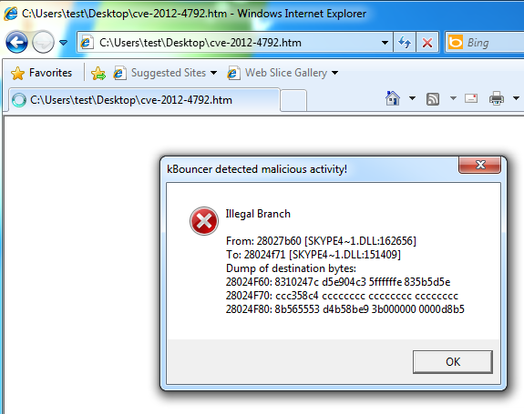
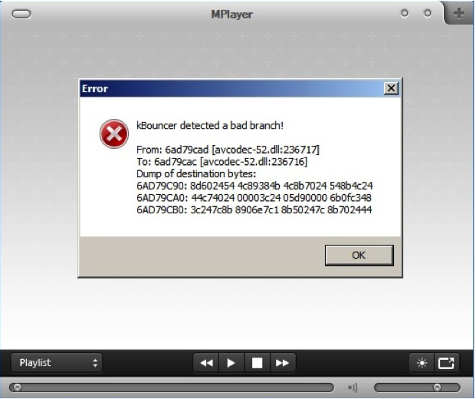
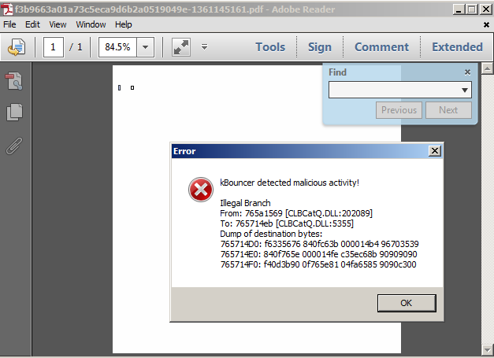
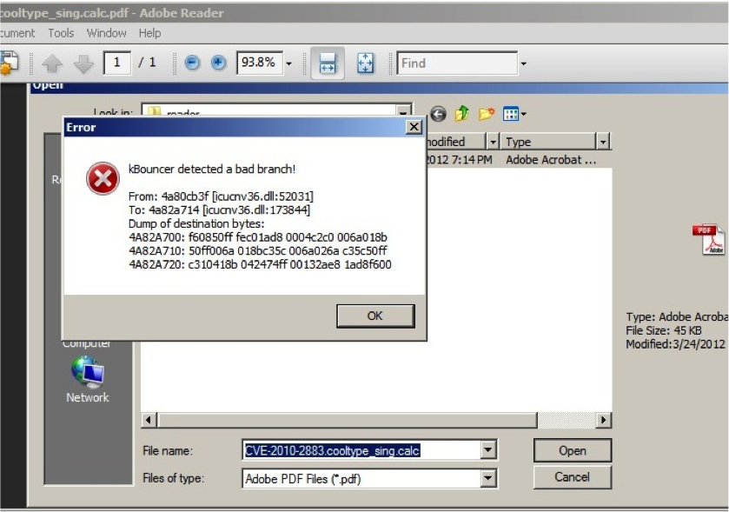

Slide 34
Limitations
In-place code randomization misses ~20% of the gadgets
  Still possible to construct a ROP payload
Indirect branch tracing only checks the last 16 gadgets, up to 20 instructions
  Still possible to find longer call-preceded or non-return gadgets

Slide 35
Combination
In-place code
randomization
breaks
Knowledge of
code layout
Indirect branch
tracing
breaks
Unrestricted indirect
branches
+
=
Break longer gadgets
more easily
Detect non-randomized
gadgets

Slide 36
Randomizing long gadgets
Software | 1-5 Instr. Gadgets Total Modifiable (%) |  | 20-50 Instr. Gadgets Total Modifiable (%)
Adobe Reader | 1,207K | 943K (78.1) | 101K | 99K (98.1)
Firefox | 455K | 381K (83.7) | 46K | 45K (98.7)
iTunes | 373K | 293K (78.5) | 43K | 42K (97.4)
Windows XP | 7,897K | 6,452K (81.7) | 636K | 627K (98.5)
Windows 7 | 15,703K | 12,970K (82.6) | 1,583K | 1,551K (98.0)
Total | 25,636K | 21,041K (82.1) | 2,412K | 2,366K (98.1)

Slide 37
Summary
Designed, developed and evaluated techniques against ROP
Their combination maximizes protection coverage, while complementing each other
Although not perfect, significantly raise the bar at almost no cost!

Slide 38
Backup

Slide 39
Publications
Vasilis Pappas, Fernando Krell, Binh Vo, Vladimir Kolesnikov, Tal Malkin, Seung Geol Choi, Wesley George, Angelos D. Keromytis, and Steven M. Bellovin. Blind Seer: A scalable private DBMS. In Proceedings of the 35rd IEEE Symposium on Security & Privacy (S&P), May 2014.
Vasilis Pappas, Vasileios P. Kemerlis, Angeliki Zavou, Michalis Polychronakis, and Angelos D. Keromytis. CloudFence: Data flow tracking as a cloud service. In Proceedings of the 16th International Symposium on Research in Attacks, Intrusions and Defenses (RAID), October 2013.
Marco V. Barbera, Vasileios P. Kemerlis, Vasilis Pappas, and Angelos D. Keromytis. CellFlood: Attacking tor onion routers on the cheap. In Proceedings of the 18th European Symposium on Research in Computer Security (ESORICS), September 2013.
Vasilis Pappas, Michalis Polychronakis, and Angelos D. Keromytis. Transparent ROP exploit mitigation using indirect branch tracing. In Proceedings of the 22nd USENIX Security Symposium, August 2013.
Angeliki Zavou, Vasilis Pappas, Vasileios P. Kemerlis, Michalis Polychronakis, Georgios Portokalidis, and Angelos D. Keromytis. Cloudopsy: an autopsy of data flows in the cloud. In Proceedings of the 15th International Conference on Human-Computer Interaction (HCI), July 2013.
Eleni Gessiou, Vasilis Pappas, Elias Athanasopoulos, Angelos D. Keromytis, and Sotiris Ioannidis. Towards a universal data provenance framework using dynamic instrumentation. In Proceedings of the 27th IFIP International Information Security and Privacy Conference (SEC), June 2012.
Vasilis Pappas, Michalis Polychronakis, and Angelos D. Keromytis. Smashing the gadgets: Hindering return-oriented programming using in-place code randomization. In Proceedings of the 33rd IEEE Symposium on Security & Privacy (S&P), May 2012.
Vasilis Pappas, Mariana Raykova, Binh Vo, Steven M. Bellovin, and Tal Malkin. Private search in the real world. In Proceedings of the 27th Annual Computer Security Applications Conference (ACSAC), December 2011.
Vasilis Pappas and Angelos D. Keromytis. Measuring the deployment hiccups of dnssec. In Proceedings of the 1st International Conference on Advances in Computing and Communications (ACC), July 2011.
Vasilis Pappas, Brian M. Bowen, and Angelos D. Keromytis. Evaluation of a spyware detection system using thin client computing. In Proceedings of the 13th International Conference on Information Security and Cryptology (ICISC), November 2010.
Vasilis Pappas, Brian M. Bowen, and Angelos D. Keromytis. Crimeware swindling without virtual machines. In Proceedings of the 13th Information Security Conference (ISC), October 2010.
Vasileios P. Kemerlis, Vasilis Pappas, Georgios Portokalidis, and Angelos D. Keromytis. iLeak: A lightweight system for detecting inadvertent information leaks. In Proceedings of the 6th European Conference on Computer Network Defense (EC2ND), October 2010.

Slide 40
Future directions
Extend work to other architectures
  ARM, MIPS, etc.
Add more randomization schemes
  E.g., basic block shuffling
Restrict and add more indirect branching rules
  Check ret targets of directly-only called functions
  Check indirect call/jump targets

Slide 41
Illegal Returns
Ensure that ret instructions target valid call sites
  Even those of non-intended call instructions
  More relaxed constraint compared to call-ret pairing (e.g., using a shadow stack)
Compatible with constructs that break call-ret pairing
  setjmp/longjmp
  PIE call/pop getPC code
  Tail call optimizations
  Windows fibers
Simple implementation
  Just check whether the target is preceded by a call instruction
  No need to track call instructions or keep state

Slide 42
Implementation
Working prototype for Windows 7 x64 SP1
  API interception using Detours instead of syscall interposition
  Uses only the Windows SDK and DDK (no third-party code)

Slide 43
Flow chart

Slide 44
Allowed ret gadgets

Slide 45
System vs. API Call

Slide 46
Refined Checking

Slide 47
Jump-Oriented Programming
* Figure copied from: Tyler Bletsch et al., Jump-oriented programming: a new class of code-reuse attack.

Slide 48
Dynamic relocations reconstruction
Binaries without relocation information can only be loaded in their preferred base
Relocations enable address space layout randomization and improve disassembly accuracy
0xc0000000
New
Handle accesses and branches
transparently at runtime by
manipulating the page table
0x00400000
Original
Original
0x00000000

Slide 49
LBR example: Adobe Flash exploit

Slide 50
Extending the LBR: “Push Back”
The LBR size is limited (currently, 16 entries)
Virtually extend the LBR stack
  Whenever a checkpoint is triggered, add a new one as far back on the execution path as possible
Prevents the reuse of long execution paths that lead to system calls
Validate “known” execution paths

Slide 51
Pushing Back Checkpoints
✓
= LBR
= branch
✓
= checkpoint
✓
✓
✓
✓
✓
✓
✓
✓
kernel
✓
Notes:
Extend LBR, or validate execution paths. The new mode of LBR might be helpful here.

