Slide 1
Bug Finding Techniques
Tim Newsham and Alex Stamos
Stanford CS155
April 6, 2010

Slide 2
Your Humble Narrators
Tim Newsham
Security Researcher
ISS, SNI, NAI, Guardent, @stake, iSEC
U of Hawaii BSEE, U of Arizona MSCS
Alex Stamos
Co-Founder and Partner
LBNL, Loudcloud, @stake
UC Berkeley BS EECS

Slide 3
Agenda
Why are you finding bugs?
Overview of common techniques
Fuzzing
Debugging and Process Stalking
Reverse Engineering
Demo
Discussion

Slide 4
Why are you finding bugs?
Black Hat
Researcher
Security Engineer
Stolen Source Review
Disassembly
Fuzzing
Static Analysis
Debugging
Source Review

Slide 5
Bertha the Black Hat of Ill Repute
Goal
Dependable Exploitation
Stealthy
Thoroughness
Usually only need one bug
No need to document coverage
Access
Often no source

Slide 6
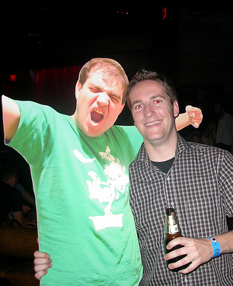
Marvin the Megalomaniacal Researcher
Goal
Column inches from press, props from friends
Preferably in a trendy platform
Make money from ZDI/Pwn2Own
Thoroughness
Don’t need to be perfect, don’t want to be embarrassed
Access
Casual access to engineers
Source == Lawyers

Slide 7
Sally the Stressed Security Engineer
Goal
Find as many flaws as possible
Reduce incidence of exploitation*
Thoroughness
Must have coverage metrics
Should at least find low-hanging fruit
Access
Source code, debug symbols, engineers
Money for tools and staff

Slide 8
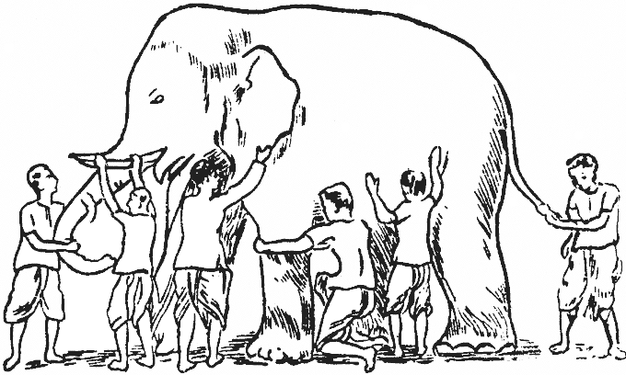
The Difficulty of Defense
So, oft in theologic wars The disputants, I ween, Rail on in utter ignorance Of what each other mean, And prate about an Elephant Not one of them has seen!

Slide 9
The Difficulty of Defense
Asymmetric Warfare
Defenders always have to be perfect
Attackers can be good and lucky
Knowing this, is bug finding an efficient defense strategy?

Slide 10
Limitations of Today’s Lecture
The most important flaws we find are NOT implementation flaws
Common problems:
Trusting untrusted components
Poor use of cryptography
Overreliance on DRM
Forgotten or cut security features

Slide 11
Black Box Bug Finding
Basic goal is to exercise all states of software while watching for a response that indicates vulnerability
Exercise
Manual manipulation
Fuzzing
Process hooking
Watch for response
Process stalking
Debugging
Emulation
Determine exploitability
Disassembly
Debugging

Slide 12
Fuzzing

Slide 13
“Smarter Fuzzing”
Record or implement path through gating functions
Utilize knowledge of protocol or file format
Use process hooking

Slide 14
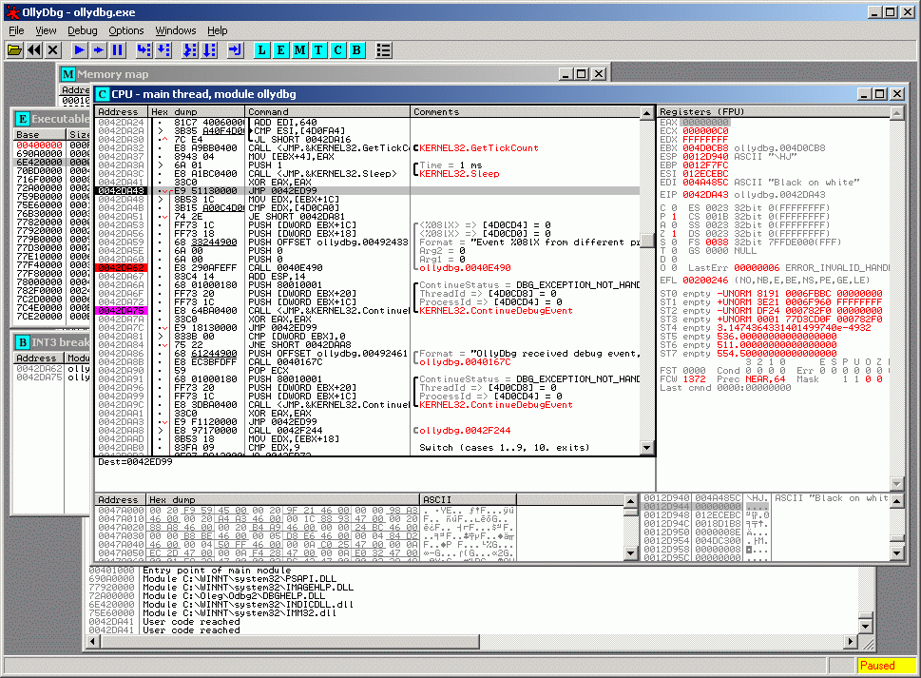
Debugging

Slide 15
Reverse Engineering
Decompilation
Often used for semi-compiled code
.Net CLR
Java
Flash
Can work with C++ w/ symbols
Disassembly
1:1 matching with machine code
Modern disassemblers allow for highly automated analysis process
Protocol Reverse Engineering

Slide 16
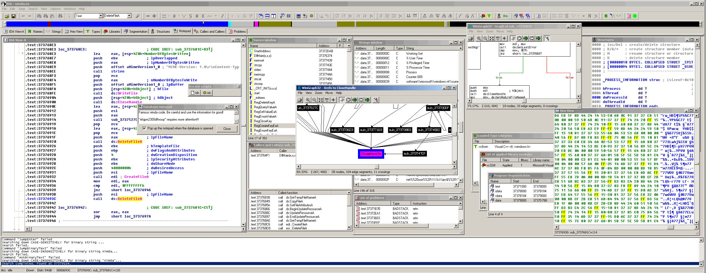
Disassembly - IDA Pro

Slide 17
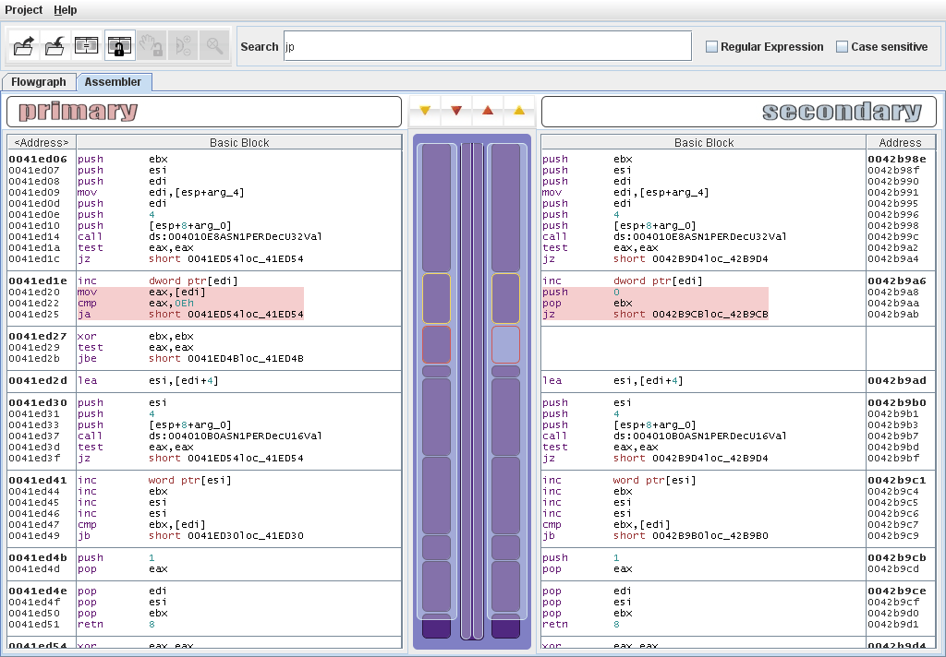
Reversing Patches - BinDiff

Slide 18
Defeating Black Box Bug Analysis
Many programs include anti-debug functionality
Check PDB
System calls, monitor process space
Throw INTs, test for catch
Timing tests
Anti-Reversing
Dynamic Unpacking
Pointer Arithmetic
Encrypted and obfuscated function calls

Slide 19
Anti-Anti-Debug - Snitch

Slide 20
Snitch Output on WMP
Potential break-point debugger check at 0x4bf9f889 (blackbox.dll)
Exception handler 1 is at 0x4bf9fe71 (blackbox.dll)
Exception handler 2 is at 0x7c839ac0 (kernel32.dll)
Potential break-point debugger check at 0x4bf9f9fc (blackbox.dll)
Exception handler 1 is at 0x4bf9fe71 (blackbox.dll)
Exception handler 2 is at 0x7c839ac0 (kernel32.dll)
Potential break-point debugger check at 0x4bf9f889 (blackbox.dll)
Exception handler 1 is at 0x4bf9fe71 (blackbox.dll)
Exception handler 2 is at 0x7c839ac0 (kernel32.dll)
Potential break-point debugger check at 0x4bf9f889 (blackbox.dll)
Exception handler 1 is at 0x4bf9fe71 (blackbox.dll)
Exception handler 2 is at 0x7c839ac0 (kernel32.dll)
Potential break-point debugger check at 0x4bf9f889 (blackbox.dll)
Exception handler 1 is at 0x4bf9fe71 (blackbox.dll)
Exception handler 2 is at 0x7c839ac0 (kernel32.dll)
Potential OutputDebugString debugger check at 0x7c812aeb
Module: \Device\HarddiskVolume1\WINDOWS\system32\kernel32.dll
Potential break-point debugger check at 0x4df75f36 (drmv2clt.dll)
Exception handler 1 is at 0x4dfda68e (drmv2clt.dll)
Exception handler 2 is at 0x7c839ac0 (kernel32.dll)

Slide 21
White Box Bug Finding
Black Box techniques always work better with more context
More quickly triage flaws
Patch flaws much faster
Analysis can start with source code
Look at sensitive areas
Use lexical analysis to give pointers
Flawfinder
RATS
Use semantic analysis
Coverity
Fortify
Most White Box techniques also increase false positive count

Slide 22
Hard to Find Bugs
MS10-002 – Remote Code Execution in IE 5-8
function window :: onload ()
{
var SourceElement = document.createElement ("div");
document.body.appendChild (SourceElement);
var SavedEvent = null;
SourceElement.onclick = function () {
SavedEvent = document.createEventObject (event);
document.body.removeChild (event.srcElement);
}
SourceElement.fireEvent ("onclick");
SourceElement = SavedEvent.srcElement;
}

Slide 23
Hard to Find Bugs
How does this become a reliable exploit?
Heap spraying allows for predictable control of memory space
IE Small Block Manager Reuses Pages
Asynchronous Garbage Collection can be synchronized by attacker: CollectGarbage()
How about on more modern OSes?
ASLR and DEP defeated with Flash JIT
Return Oriented Programming
http://cseweb.ucsd.edu/~hovav/talks/blackhat08.html
Good analyses of Aurora Exploit:
http://www.geoffchappell.com/viewer.htm?doc=notes/security/aurora/index.htm
http://www.hbgary.com/wp-content/themes/blackhat/images/hbgthreatreport_aurora.pdf

Slide 24
Future of Bug Finding
How could you find this bug?
Requires understanding of IE code
Difficult to triage
Low-Hanging Fruit is Gone
This bug has existed since IE5
Initial flaw can be found by smart fuzzing. How would you do that?
Exploitation should require 2-3 flaws for reliability

Slide 25
More Reading
http://www.openrce.org/articles/
Shellcoder’s Handbook
http://www.Rootkits.com
http://peachfuzzer.com/

Slide 26
Thank you for coming! alex@isecpartners.com
newsham@lava.net

