Slide 1
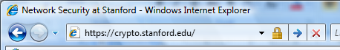
HTTPS and the Lock Icon
Dan Boneh

Slide 2
Goals for this lecture
Brief overview of HTTPS:
    How the SSL/TLS protocol works (very briefly)
    How to use HTTPS
Integrating HTTPS into the browser
    Lots of user interface problems to watch for

Slide 3
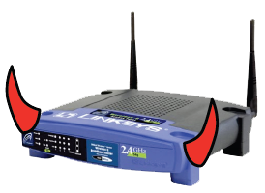
Threat Model: Network Attacker
Network Attacker:
  Controls network infrastructure: Routers, DNS
    Passive attacker: only eavesdrops on net traffic
    Active attacker: eavesdrops, injects, blocks, and modifies packets
Examples:
  Wireless network at Internet Café
  Internet access at hotels (untrusted ISP)

Slide 4
SSL/TLS overview
Public-key encryption:
Alice
Bob
m
Enc
c
c
Dec
m
PK_{Bob}
SK_{Bob}
Bob generates (SK_{Bob} , PK_{Bob} )
Alice: using PK_{Bob} encrypts messages
and only Bob can decrypt

Slide 5

Certificates
How does Alice (browser) obtain PK_{Bob} ?
Browser
Alice
Server Bob
CA
choose
(SK,PK)
PK and
proof “I am Bob”
check
proof
PK_{CA}
PK_{CA}
SK_{CA}
issue Cert with SK_{CA} :
verify
Cert
Bob’s
key is PK
Bob’s
key is PK
Bob uses Cert for an extended period (e.g. one year)

Slide 6
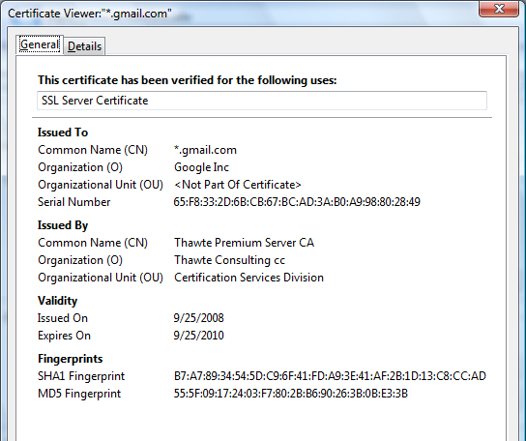
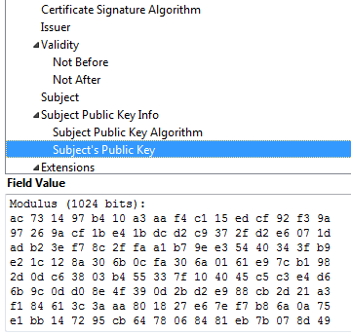
Certificates: example
Important fields:

Slide 7
Certificates on the web
Subject’s CommonName can be:
An explicit name, e.g. cs.stanford.edu , or
A name with a wildcard character, e.g.
*.stanford.edu or cs*.stanford.edu
matching rules:
IE7: “*” must occur in leftmost component, does not match “.”
example: *.a.com matches x.a.com but not y.x.a.com
FF3: “*” matches anything

Slide 8
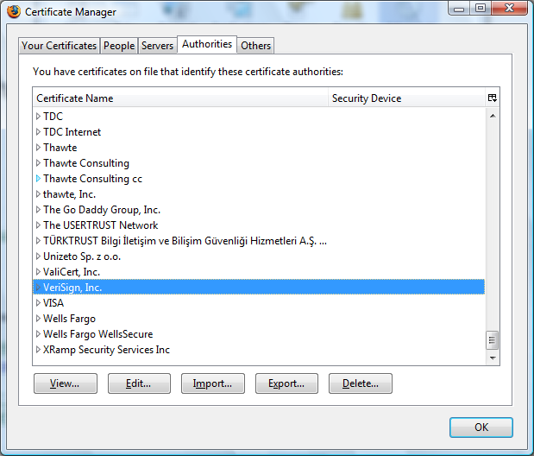
Certificate Authorities
Browsers accept
certificates from a
large number of CAs

Slide 9
Brief overview of SSL/TLS
browser
server
client-hello
cert
server-hello + server-cert (PK)
SK
key exchange (several options)
rand. k
client-key-exchange: E(PK, k)
k
Finished
HTTP data encrypted with KDF(k)
Most common: server authentication only

Slide 10
Integrating SSL/TLS with HTTP ⇒ HTTPS
web
proxy
Two complications
Web proxies
solution: browser sends
CONNECT domain-name
before client-hello (dropped by proxy)
Virtual hosting:
two sites hosted at same IP address.
solution in TLS 1.1 (RFC 4366)
client_hello_extension: server_name=cnn.com
implemented in FF2 and IE7 (vista)
web
server
corporate network
web
server
client-hello
server-cert ???
cert_{CNN}
cert_{FOX}

Slide 11
Why is HTTPS not used for all web traffic?
Slows down web servers
Breaks Internet caching
    ISPs cannot cache HTTPS traffic
    Results in increased traffic at web site
Incompatible with virtual hosting (older browsers)

Slide 12
HTTPS in the Browser

Slide 13
The lock icon: SSL indicator
Intended goal:
  Provide user with identity of page origin
  Indicate to user that page contents were not
  viewed or modified by a network attacker
In reality:
  Origin ID is not always helpful
    example: Stanford HR is hosted at BenefitsCenter.com
  Many other problems (next few slides)
Notes:
Network attacker: controls routers, DNS; can inject, delete, and modify packets

Slide 14
When is the (basic) lock icon displayed
All elements on the page fetched using HTTPS
(with some exceptions)
For all elements:
    HTTPS cert issued by a CA trusted by browser
    HTTPS cert is valid (e.g. not expired)
    CommonName in cert matches domain in URL

Slide 15
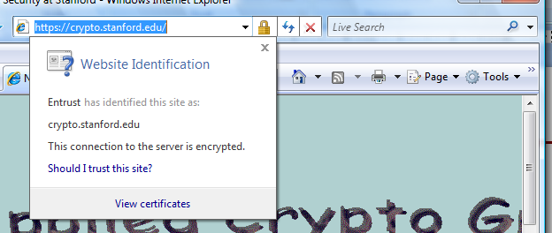
The lock UI: help users authenticate site
IE7:

Slide 16
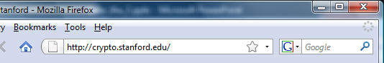
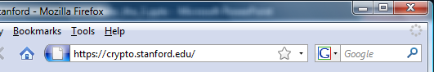
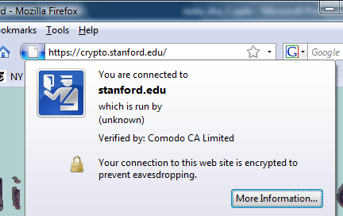
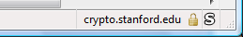
The lock UI: help users authenticate site
Firefox 3:
(no SSL)
(SSL)
Notes:
Click on fav icon gives pop-up on bottom.

Slide 17
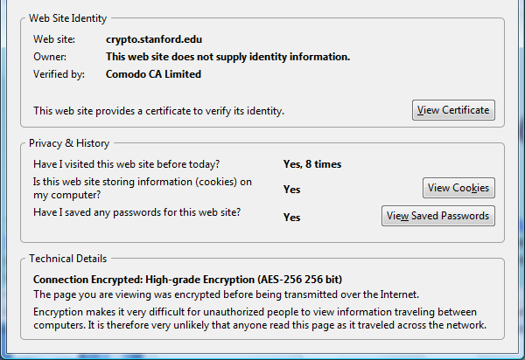
The lock UI: help users authenticate site
Firefox 3: clicking on bottom lock icon gives

Slide 18
The lock UI: Extended Validation (EV) Certs
Harder to obtain than regular certs
      requires human lawyer at CA to approve cert request
Designed for banks and large e-commerce sites
Helps block “semantic attacks”: www.bankofthevvest.com

Slide 19
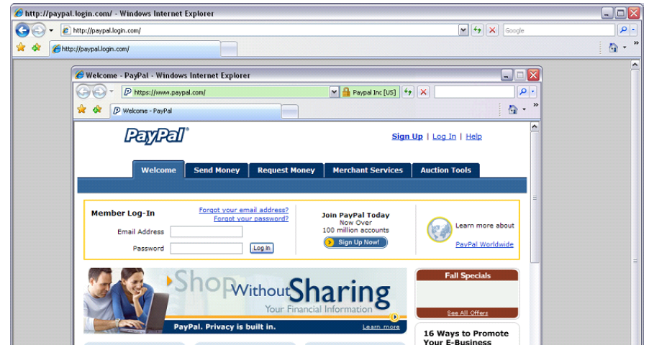
A general UI attack: picture-in-picture
Trained users are more likely to fall victim to this [JSTB’07]
Notes:
Both inner and outer windows are focused

Slide 20
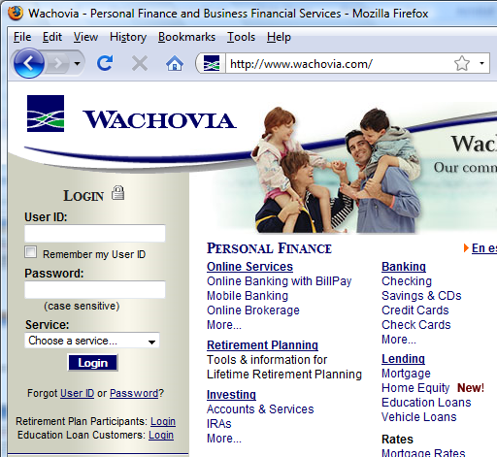
HTTPS and login pages: incorrect version
Users often land on login page over HTTP:
    Type site’s HTTP URL
    into address bar, or
Google links to the HTTP page
View source:
<form method="post"
action="https://onlineservices.wachovia.com/..."
Notes:
User has no way to tell that his password is sent over HTTPS to site.
Also has no way to tell that page wasn’t modified enroute (e.g. change form action).
Note the confusing lock next to “LOGIN” that suggests this is HTTPS.

Slide 21
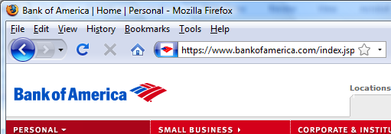
HTTPS and login pages: guidelines
General guideline:
    Response to http://login.site.com
    should be Redirect: https://login.site.com

Slide 22
Problems with HTTPS and the Lock Icon

Slide 23
Problems with HTTPS and the Lock Icon
Upgrade from HTTP to HTTPS
Semantic attacks on certs
Invalid certs
Mixed content
      HTTP and HTTPS on the same page
Origin contamination
      Weak HTTPS page contaminates stronger HTTPS page

Slide 24
1. HTTP → HTTPS upgrade
Common use pattern:
    browse site over HTTP; move to HTTPS for checkout
    connect to bank over HTTP; move to HTTPS for login
Easy attack: prevent the upgrade (ssl_strip) [Moxie’08]
<a href=https://…> ⇒ <a href=http://…>
Location: https://... ⇒ Location: http://... (redirect)
<form action=https://… > ⇒ <form action=http://…>
HTTP
SSL
attacker
web
server
Notes:
ssl_strip: prevents browser from upgrading, but does the SSL upgrade when communicating with the server. Server has no idea this is taking place.

Slide 25
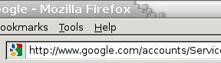
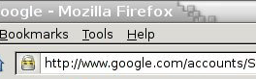
Tricks and Details
Tricks: drop-in a clever fav icon
Details:
Erase existing session and force user to login:
ssl_strip injects “Set-cookie” headers to delete existing session cookies in browser.
Number of users who detected HTTP downgrade: 0
⇒

Slide 26
2. Semantic attacks on certs
International domains: xyz.cn
Rendered using international character set
Observation: chinese character set contains chars
that look like “/” and “?” and “.” and “=”
Attack: buy domain cert for *.badguy.cn
setup domain called:
www.bank.com/accounts/login.php?q=me.baguy.cn
note: single cert *.badguy.cn works for all sites
Extended validation (EV) certs may help defeat this

Slide 27
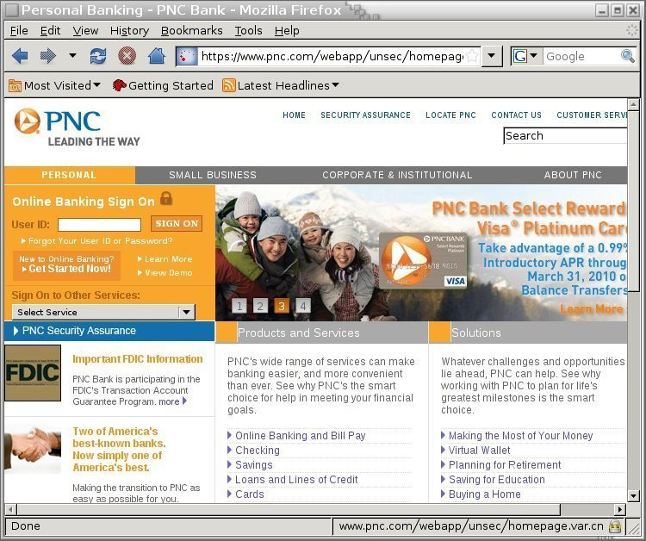
[Moxie’08]

Slide 28
3. Invalid certs
Examples of invalid certificates:
  expired: current-date > date-in-cert
  CommonName in cert does not match domain in URL
  unknown CA (e.g. self signed certs)
      Small sites may not want to pay for cert
  Users often ignore warning:
    Is it a misconfiguration or an attack? User can’t tell.
Accepting invalid cert enables man-in-middle attacks
(see http://crypto.stanford.edu/ssl-mitm )

Slide 29
Man in the middle attack using invalid certs
GET https://bank.com
BadguyCert
BankCert
attacker
ClientHello
ClientHello
bank
ServerCert (Badguy)
ServerCert (Bank)
bad cert
warning!
SSL key exchange
SSL key exchange
k₁
k₁
k₂
k₂
HTTP data enc with k₁
HTTP data enc with k₂
Attacker proxies data between user and bank.
Sees all traffic and can modify data at will.

Slide 30
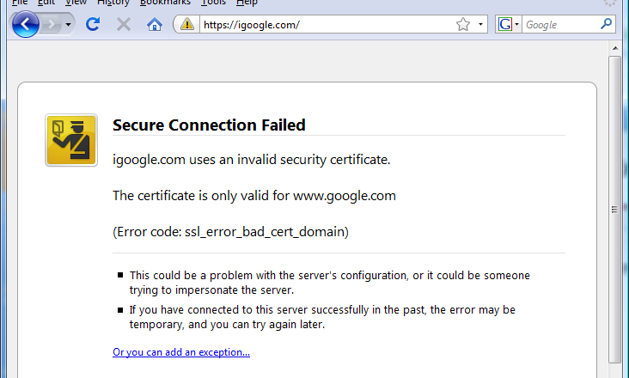
Firefox: Invalid cert dialog
Firefox 3.0: Four clicks to get firefox to accept cert
    page is displayed with full HTTPS indicators

Slide 31
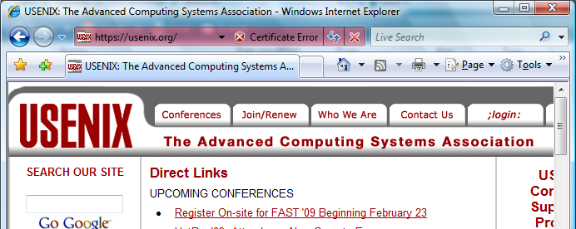
IE: invalid cert URL bar

Slide 32
Commercial Tools to Forge Certs
PacketForensis: SSL MiTM for law enforcement
Scenario [SS’10]: (browsers on windows trust 264 root CAs)
User in country X wishes to access web site in country Y
Country X compels its local CA to issue cert for web site
➔ country X can eavesdrop on all traffic to web site
(no cert warning in user’s browser)
SS’10 solution: browser extension that rejects certs where issuing country ≠ web-site country
Notes:
SS’10: Soghoian and Stamm

Slide 33
4. Mixed Content: HTTP and HTTPS
Page loads over HTTPS, but contains content over HTTP
(e.g. <script src=“http://.../script.js> )
IE7: displays mixed-content dialog and no SSL lock
Firefox 3.0: displays `!’ over lock icon (no dialog by default)
Both browsers:
  Flash swf file over HTTP does not trigger warning !!
  note: Flash can script the embedding page
Safari: does not attempt to detect mixed content

Slide 34
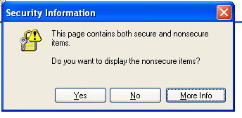
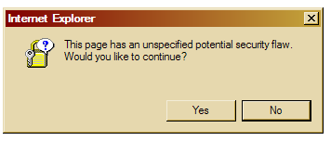
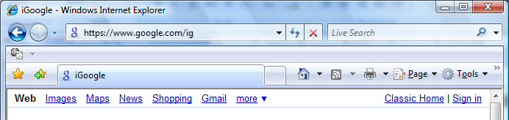
Mixed Content: HTTP and HTTPS
silly dialogs
IE7:
No SSL lock in address bar:

Slide 35
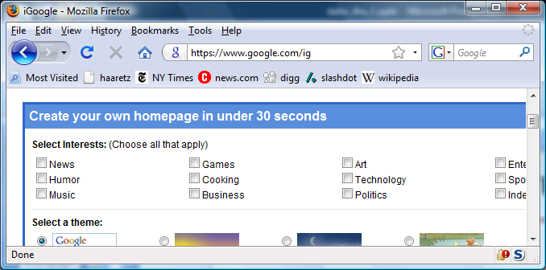
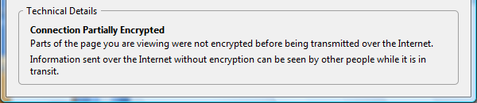
Mixed Content: HTTP and HTTPS
Firefox 3.0:
No SSL indicator in address bar
Clicking on bottom lock gives:

Slide 36
Mixed content and network attacks
banks: after login all content served over HTTPS
Developer error: somewhere on bank site write
  <embed src=http://www.site.com/flash.swf>
Active network attacker can now hijack session
Better way to include content:
<embed src=//www.site.com/flash.swf>
served over the same protocol as embedding page

Slide 37
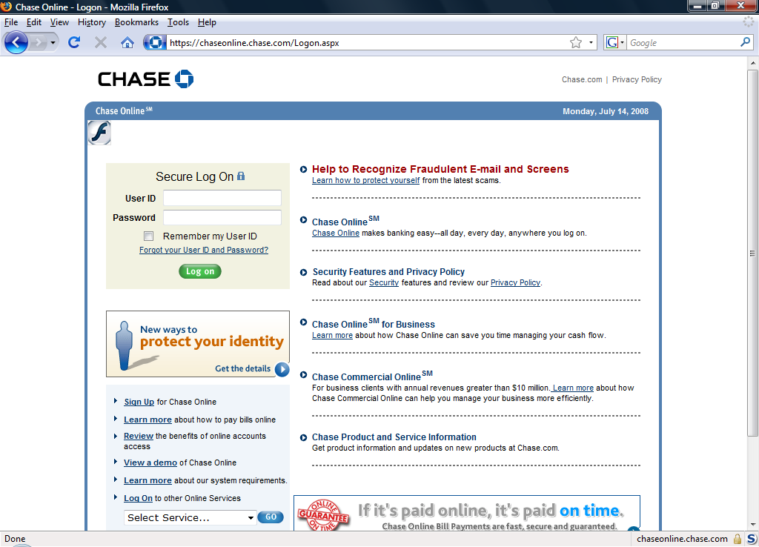
An Example From an Online Bank
…
var so = new SWFObject("http://mfasa.chase.com/auth/device.swf", ...
network attacker can modify SWF file and hijack session
(the site has been fixed)

Slide 38
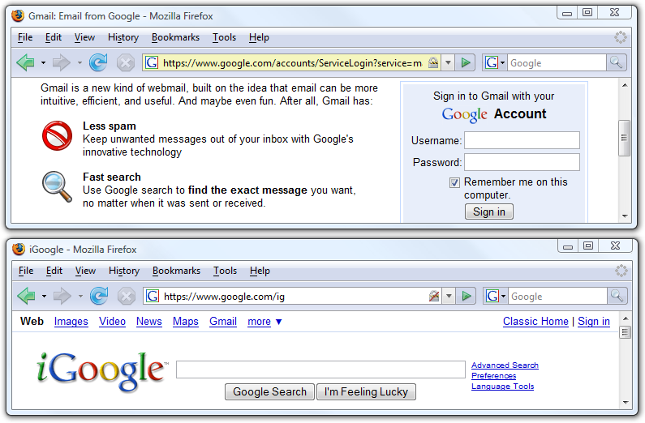
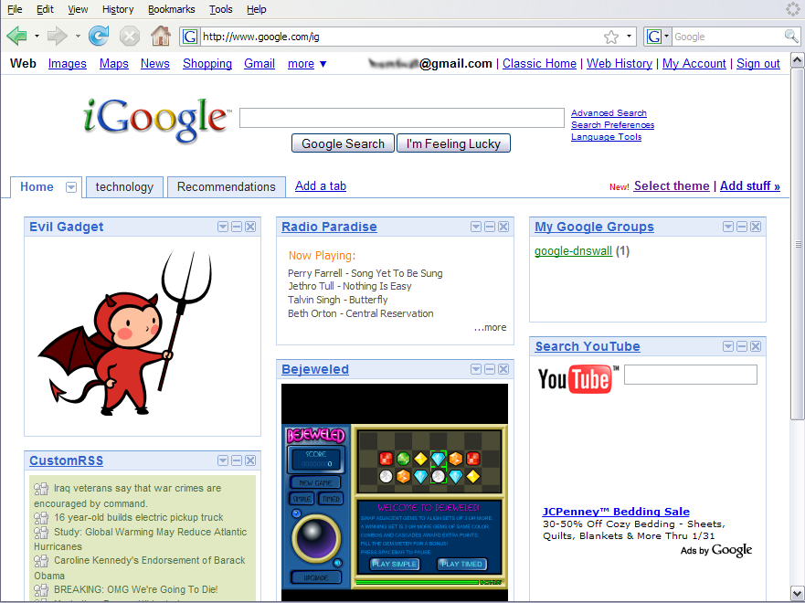
5. Origin Contamination: an example
safeLock: removes lock from top page after loading bottom page
Notes:
Broken SSL page can be used to take over a good SSL page: both are in the same origin.
Similar problem with EV certs: non-EV page can take over EV page: both are in the same origin.

Slide 39
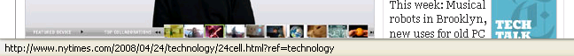
Final note: the status Bar
Trivially spoofable
  <a href=“http://www.paypal.com/”
  onclick=“this.href = ‘http://www.evil.com/’;”>
  PayPal</a>

Slide 40
THE END

