Slide 1
Mobile Malware
CS 155
Spring 2015
John Mitchell

Slide 2
Outline
Mobile malware
  Common cases involve command and control, information theft
Identifying malware
  Detect at app store rather than on platform
Classification study of mobile web apps
  Entire Google Play market as of 2014
  85% of approx 1 million apps use web interface

Slide 3
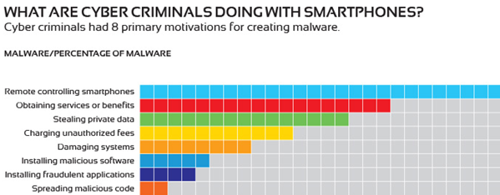
Mobile Malware

Slide 4
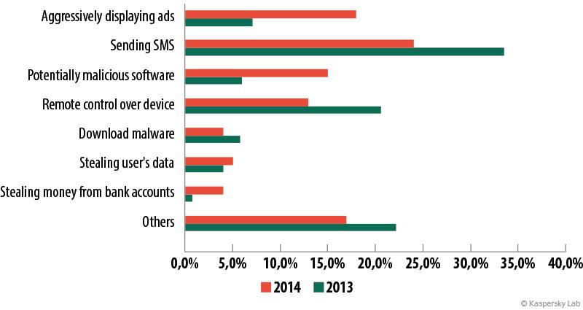
Some Trends

Slide 5
iPhone: Operation Pawn Storm
blog.trendmicro.com/.../pawn-storm-update-ios-espionage-app-found/
Trend Micro:
  “an active economic and political cyber-espionage operation that targets … military, governments, defense industries, and the media.”
  Infects individuals to get to organizations
Xagent
  iOS 7: app icon is hidden, runs in background, restarts if terminated
  iOS 8: app icon is visible; doesn’t automatically restart
Apparently, iOS device needs to be jailbroken
  Exact install process unknown
  May require social engineering.

Slide 6
XAgent app
Collects user information
  Collect text messages
  Access contact lists, pictures, geo-location data
  Start voice recording, read WiFi status
  Get a list of installed apps, list of processes
Command and Control (C&C) Communication
  HTTP POST request to send messages
  GET request to receive commands

Slide 7
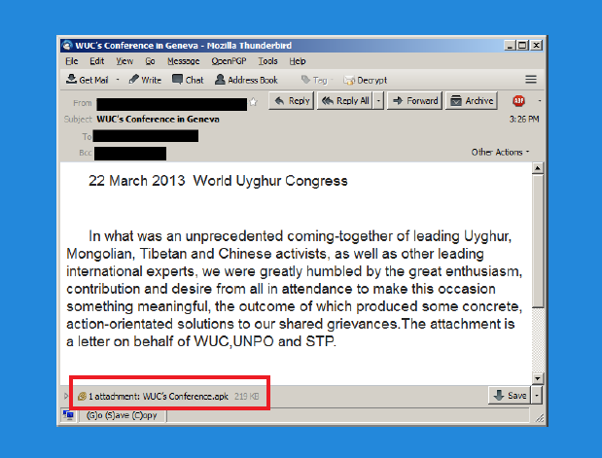
Android malware example

Slide 8
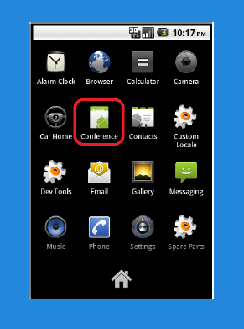

Install malicious “conference app”

Slide 9
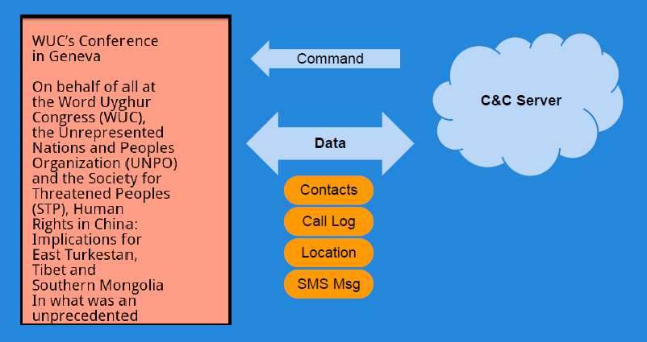
Malware behavior triggered by C&C server (Chuli)

Slide 10
Outline
Mobile malware
  Common cases involve command and control, information theft
Identifying malware
  Detect at app store rather than on platform
Classification study of mobile web apps
  Entire Google Play market as of 2014
  85% of approx 1 million apps use web interface

Slide 11
STAMP Admission System
Static Analysis
More behaviors, fewer details
Static
STAMP
Dynamic
Alex Aiken,
John Mitchell,
Saswat Anand,
Jason Franklin
Osbert Bastani,
Lazaro Clapp,
Patrick Mutchler,
Manolis Papadakis
Dynamic Analysis
Fewer behaviors, more details

Slide 12
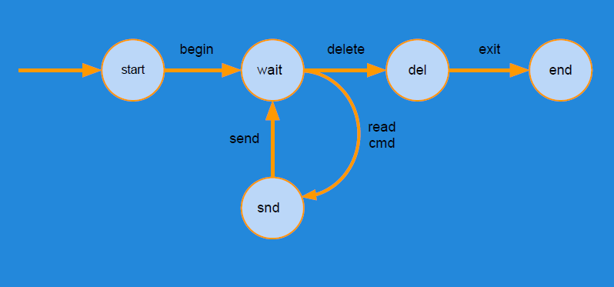
Abstract program execution
States: mapping of variable names to values
Transitions: relation on pairs of states
Traces: sequence of states or state, transition pairs

Slide 13
Analysis
Convert bytecode to intermediate format (called Quads)
Step 1
Compute call graph using Class Hierarchy Analysis
Step 2
Build an edge-labeled graph G by processing Quads of each class
Step 3
Add new edges to G as per a set of rules until no rules apply
Step 4

Slide 14
Data Flow Analysis
getLoc()
Source: Location
sendSMS()
Sink: SMS
sendInet()
Sink: Internet
Location
SMS
Location
Internet
Source-to-sink flows
  Sources: Location, Calendar, Contacts, Device ID etc.
  Sinks: Internet, SMS, Disk, etc.

Slide 15
Data Flow Analysis in Action
Malware/Greyware Analysis
  Data flow summaries enable enterprise-specific policies
API Misuse and Data Theft Detection
FB API
Source: FB_Data
Send Internet
Sink: Internet
Automatic Generation of App Privacy Policies
  Avoid liability, protect consumer privacy
Privacy Policy
This app collects your:
Contacts
Phone Number
Address
Vulnerability Discovery
Web
Source: Untrusted_Data
SQL Stmt
Sink: SQL

Slide 16
Challenges
Android is 3.4M+ lines of complex code
  Uses reflection, callbacks, native code
Scalability: Whole system analysis impractical
Soundness: Avoid missing flows
Precision: Minimize false positives

Slide 17
STAMP Approach
Too expensive!
App
App
Model Android/Java
  Sources and sinks
  Data structures
  Callbacks
  500+ models
Whole-program analysis
  Context sensitive
Android
Models
STAMP
OS
HW

Slide 18
Building Models
30k+ methods in Java/Android API
  5 mins x 30k = 2500 hours
Follow the permissions
  20 permissions for sensitive sources
    ACCESS_FINE_LOCATION (8 methods with source annotations)
    READ_PHONE_STATE - (9 methods)
  4 permissions for sensitive sinks
    INTERNET, SEND_SMS, etc.

Slide 19
Identifying Sensitive Data
android.Telephony.TelephonyManager: String getDeviceId()
Returns device IMEI in String
Requires permission GET_PHONE_STATE
@STAMP(
SRC ="$GET_PHONE_STATE.deviceid",
SINK ="@return"
)

Slide 20
Data We Track (Sources)
Account data
Audio
Calendar
Call log
Camera
Contacts
Device Id
Location
Photos (Geotags)
SD card data
SMS
30+ types of sensitive data

Slide 21
Data Destinations (Sinks)
Internet (socket)
SMS
Email
System Logs
Webview/Browser
File System
Broadcast Message
10+ types of exit points

Slide 22
Currently Detectable Flow Types
396 Flow Types
Unique Flow Types = Sources x Sink

Slide 23
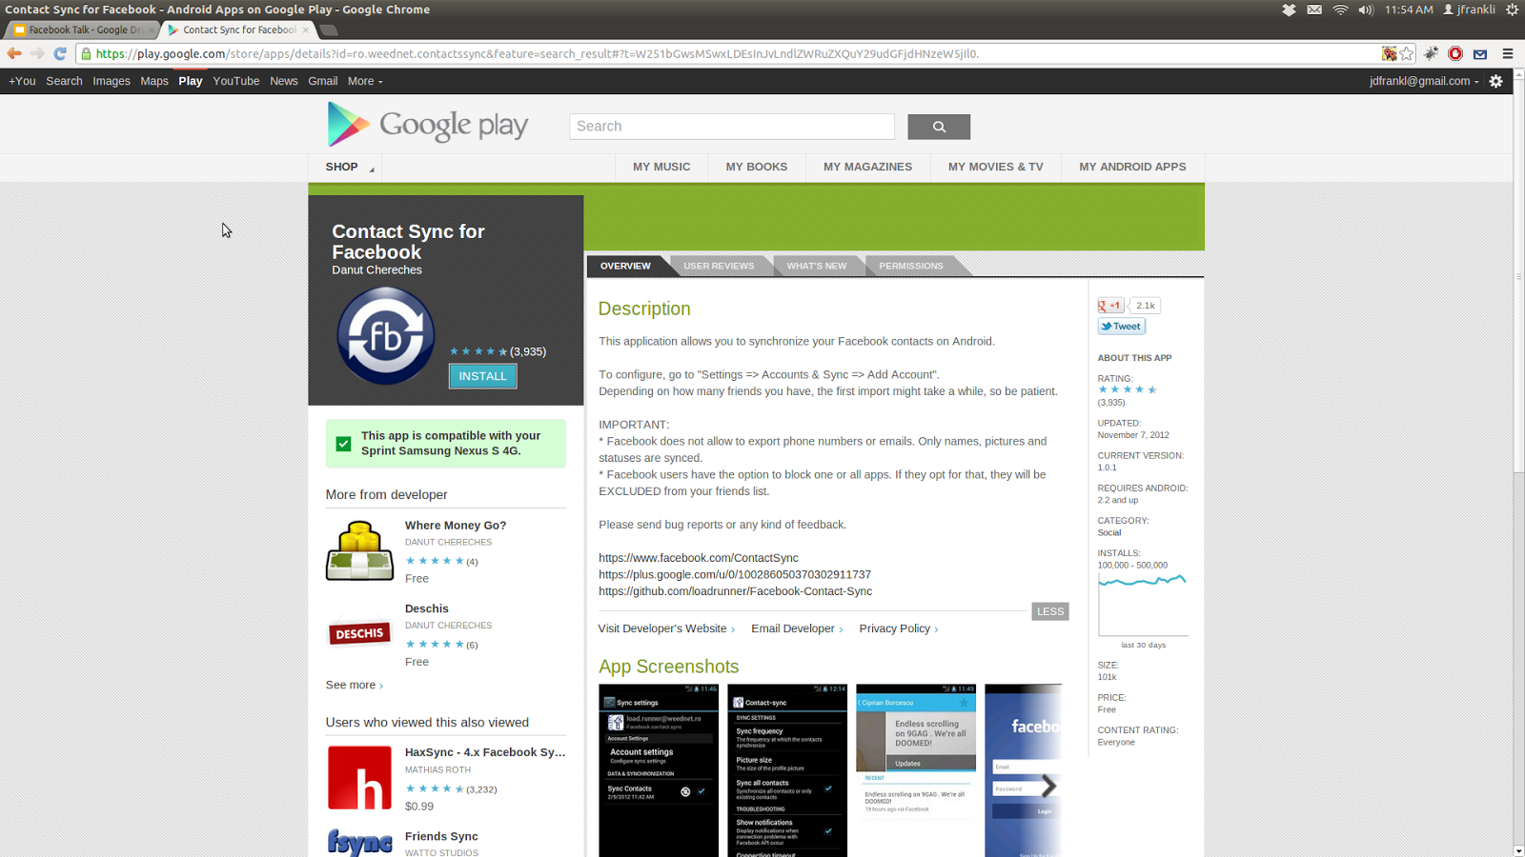
Example Analysis
Contact Sync for Facebook (unofficial)
Description:
This application allows you to synchronize your Facebook contacts on Android.
IMPORTANT:
* "Facebook does not allow [sic] to export phone numbers or emails. Only names, pictures and statuses are synced."
* "Facebook users have the option to block one or all apps. If they opt for that, they will be EXCLUDED from your friends list."
Privacy Policy: (page not found)

Slide 24
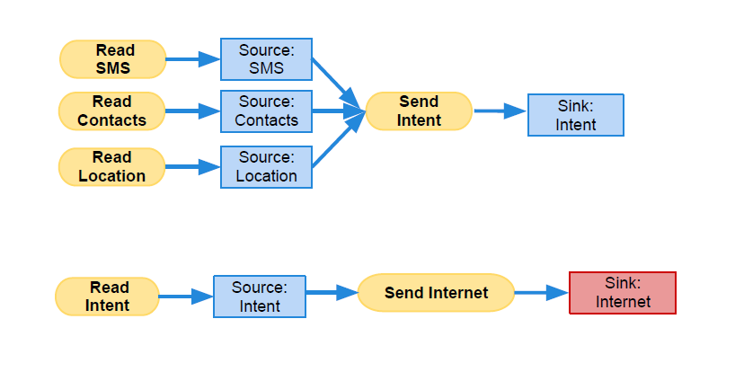
Chuli source-to-sink flows

Slide 25
Contact Sync Permissions
Category | Permission | Description
Your Accounts | AUTHENTICATE_ACCOUNTS | Act as an account authenticator
 | MANAGE_ACCOUNTS | Manage accounts list
 | USE_CREDENTIALS | Use authentication credentials
Network Communication | INTERNET | Full Internet access
 | ACCESS_NETWORK_STATE | View network state
Your Personal Information | READ_CONTACTS | Read contact data
 | WRITE_CONTACTS | Write contact data
System Tools | WRITE_SETTINGS | Modify global system settings
 | WRITE_SYNC_SETTINGS | Write sync settings (e.g. Contact sync)
 | READ_SYNC_SETTINGS | Read whether sync is enabled
 | READ_SYNC_STATS | Read history of syncs
Your Accounts | GET_ACCOUNTS | Discover known accounts
Extra/Custom | WRITE_SECURE_SETTINGS | Modify secure system settings

Slide 26
Possible Flows from Permissions
Sources
Sinks
READ_CONTACTS
INTERNET
READ_SYNC_SETTINGS
WRITE_SETTINGS
READ_SYNC_STATS
WRITE_CONTACTS
GET_ACCOUNTS
WRITE_SECURE_SETTINGS
INTERNET
WRITE_SETTINGS

Slide 27
Expected Flows
Sources
Sinks
READ_CONTACTS
INTERNET
READ_SYNC_SETTINGS
WRITE_SETTINGS
READ_SYNC_STATS
WRITE_CONTACTS
GET_ACCOUNTS
WRITE_SECURE_SETTINGS
INTERNET
WRITE_SETTINGS

Slide 28
Observed Flows
FB API
Source: FB_Data
Write Contacts
Sink: Contact_Book
Read Contacts
Source: Contacts
Send Internet
Sink: Internet

Slide 29
Outline
Mobile malware
  Common cases involve command and control, information theft
Identifying malware
  Detect at app store rather than on platform
Classification study of mobile web apps
  Entire Google Play market as of 2014
  85% of approx 1 million apps use web interface
  28% have at least one vulnerability

Slide 30



A Large-Scale Study of
Mobile Web App Security
Patrick Mutchler, Adam Doupe,
John Mitchell, Chris Kruegel, Giovanni Vigna
Notes:
30 seconds

Slide 31

Mobile Apps

Slide 32
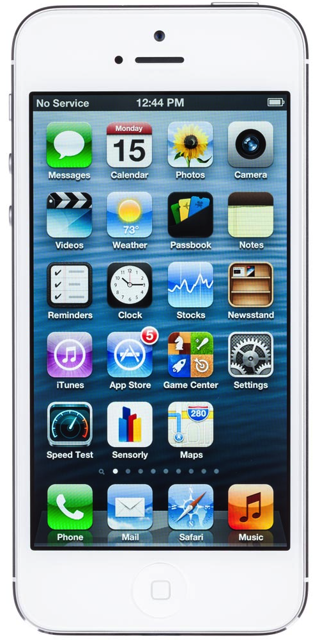
Mobile Apps

Slide 33
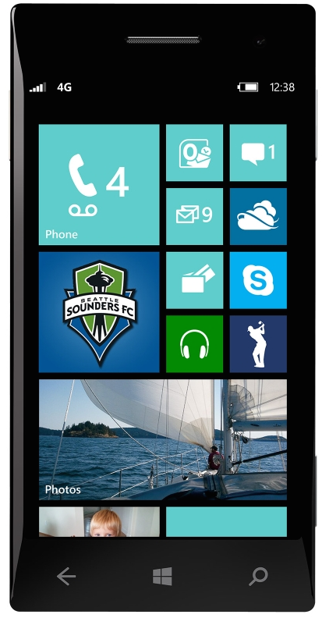
Mobile Apps

Slide 34
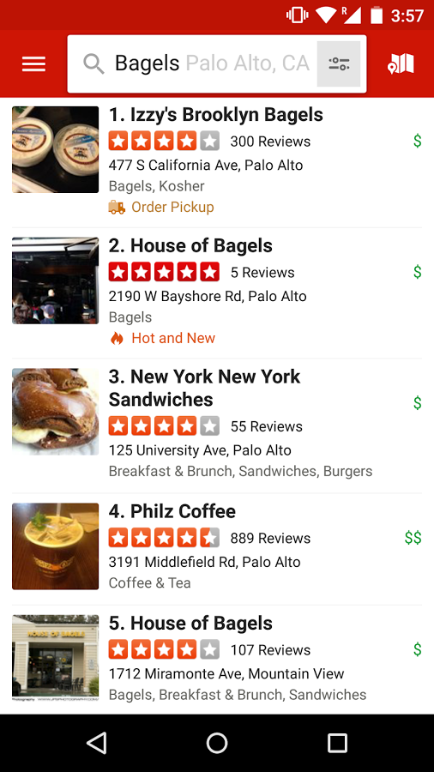
Mobile Web Apps
Mobile web app: embeds a fully functional web browser as a UI element

Slide 35


JavaScript Bridge
Obj foo = new Object();
addJavascriptInterface(foo, ‘f’);
Java
JavaScript

Slide 36
JavaScript Bridge
f.bar();
Java
JavaScript

Slide 37
Why?
Full-featured mobile web apps
Expose phone functionality to JavaScript

Slide 38
Security Concerns
Who can access the bridge?
  Everyone

Slide 39

Complete Isolation

Slide 40

f.bar();
Java
JavaScript

Slide 41
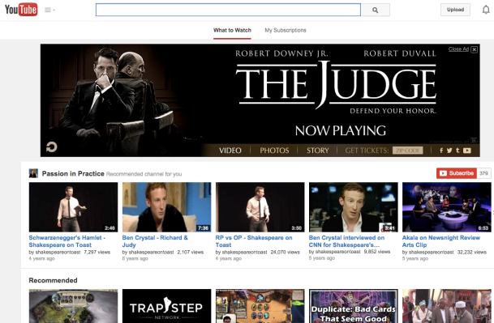
f.bar();
Java
JavaScript

Slide 42
Static Analysis
How many mobile web apps?
How many use JavaScript Bridge?
How many vulnerable?

Slide 43
Experimental Results
737,828 free apps from Google Play (Oct ’13)
563,109 apps embed a browser
219,404 use the JavaScript Bridge
107,974 have at least one security violation

Slide 44
Most significant vulnerabilities
Loading untrusted web content
Leaking URLs to foreign apps
Exposing state changing navigation to foreign apps

Slide 45
Loading untrusted web content
Leaking URLs to foreign apps
Exposing state changing navigation to foreign apps

Slide 46
“You should restrict the web-pages that can load inside your WebView with a whitelist.”
- Facebook

Slide 47
“…only loading content from trusted sources into WebView will help protect users.”
- Adrian Ludwig, Google

Slide 48
1. Navigate to untrusted content
Notes:
5 minutes

Slide 49
// In app code
myWebView.loadUrl(“foo.com”);

Slide 50
// In app code
myWebView.load(“foo.com”);
<!-- In HTML -->
<a href=“foo.com”>click!</a>

Slide 51
// In app code
myWebView.load(“foo.com”);
<!-- In HTML -->
<a href=“foo.com”>click!</a>
<!-- More HTML -->
<iframe src=“foo.com”/>

Slide 52
// In app code
myWebView.loadUrl(“foo.com”);
<!-- In HTML -->
<a href=“foo.com”>click!</a>
<!-- More HTML -->
<iframe src=“foo.com”/>
// In JavaScript
window.location = “foo.com”;

Slide 53
public boolean shouldOverrideUrlLoading(
WebView view, String url){
// False -> Load URL in WebView
// True -> Prevent the URL load
}

Slide 54
public boolean shouldOverrideUrlLoading(
WebView view, String url){
String host = new URL(url).getHost();
if(host.equals(“stanford.edu”))
return false;
log(“Overrode URL: ” + url);
return true;
}

Slide 55
public boolean shouldOverrideUrlLoading(
WebView view, String url){
String host = new URL(url).getHost();
if(host.equals(“stanford.edu”))
return false;
log(“Overrode URL: ” + url);
return true;
}

Slide 56
Reach Untrusted Content?
40,084 apps with full URLs and use JavaScript Bridge
13,683 apps (34%) can reach untrusted content

Slide 57
What does untrusted mean?
Notes:
30 seconds

Slide 58
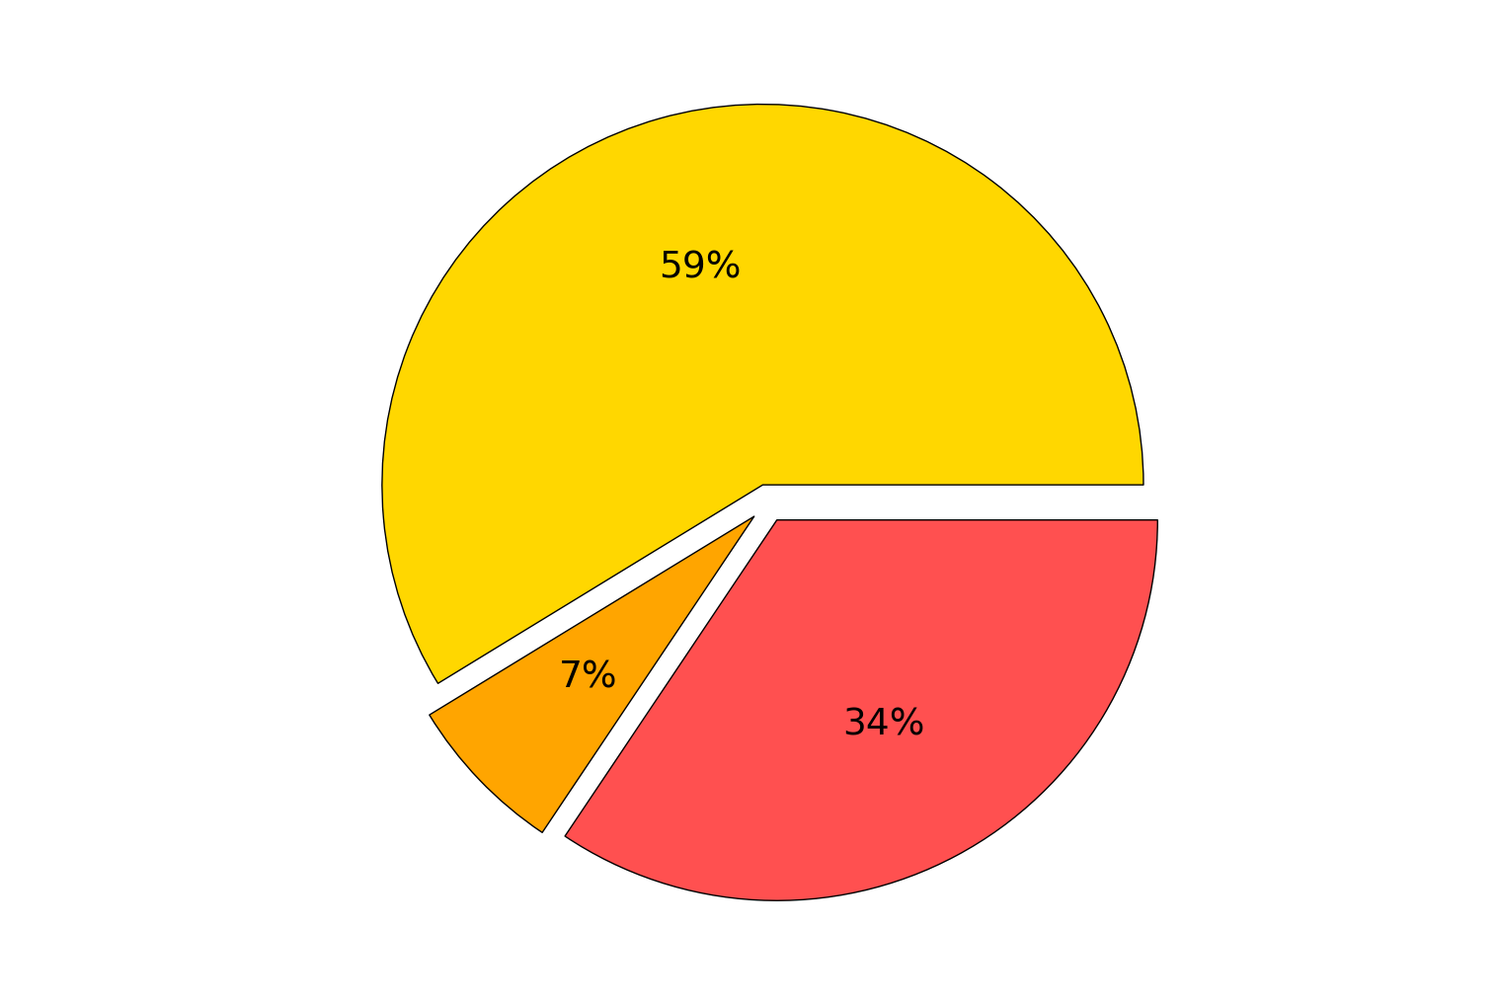
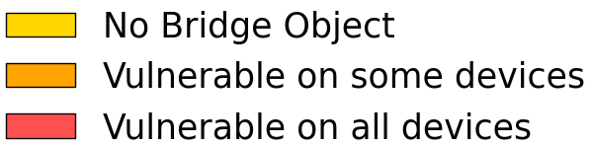
Use HTTPS?
152,706 apps with partially computed URLs
87,968 apps (57%) with HTTP URLs

Slide 59
Handling SSL Errors
onReceivedSslError
1. handler.proceed()
2. handler.cancel()
3. view.loadUrl(...)

Slide 60
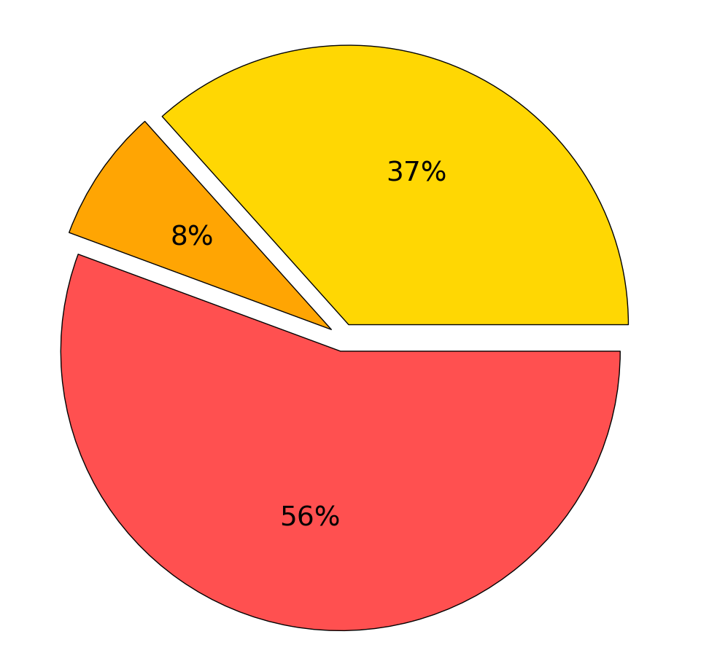
Mishandling SSL Errors
117,974 apps implement onReceivedSslError
29,652 apps (25%) must ignore errors

Slide 61
Results
Notes:
1:30

Slide 62
Primary results
Vulnerability | % Relevant | % Vulnerable
Unsafe Nav | 15 | 34
HTTP | 40 | 56
Unsafe HTTPS | 27 | 29

Slide 63
Popularity

Slide 64
Outdated Apps

Slide 65
29% unsafe nav
Libraries
51%
HTTP
53%
unsafe HTTPS
Notes:
29% unsafe nav
51% http
53% https

Slide 66
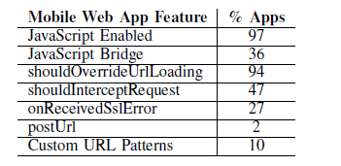
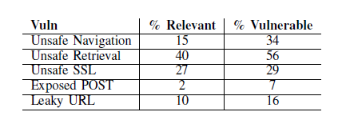
Additional security issues
Analyze 998,286 free web apps from June 2014

Slide 67
Takeaways
Apps must not load untrusted content into WebViews
Able to identify violating apps using static analysis
Vulnerabilities are present in the entire app ecosystem

Slide 68
Outline
Mobile malware
  Common cases involve command and control, information theft
Identifying malware
  Detect at app store rather than on platform
Classification study of mobile web apps
  Entire Google Play market as of 2014
  85% of approx 1 million apps use web interface
  28% have at least one vulnerability

Slide 70
Summary
Analyze a dataset of 737,828 Android apps
Found large number of apps contain severe vulnerabilities
37,418 apps are vulnerable to a remote code execution exploit when run on any Android device, because of security oversight in older versions and slow adoption of safe versions
45,689 apps are vulnerable to a remote code execution exploit when run on 73% of the in-use Android devices.
Offer recommendations for developers who wish to avoid these vulnerabilities.

