Slide 1
Mobile Malware
CS 155
Spring 2016
John Mitchell

Slide 2
Outline
Mobile malware
Identifying malware
  Detect at app store rather than on platform
Classification study of mobile web apps
  Entire Google Play market as of 2014
  85% of approx 1 million apps use web interface
Target fragmentation in Android
  Out-of-date Apps may disable more recent security platform patches

Slide 3
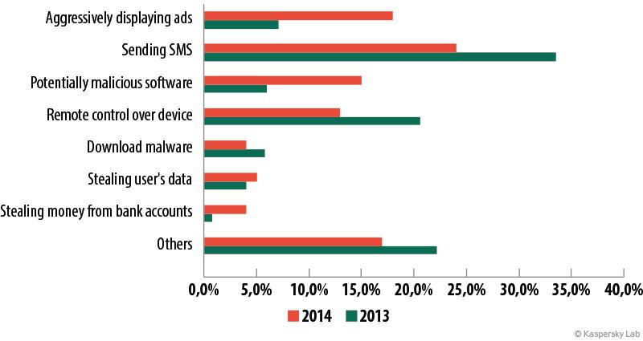
Malware Trends

Slide 4
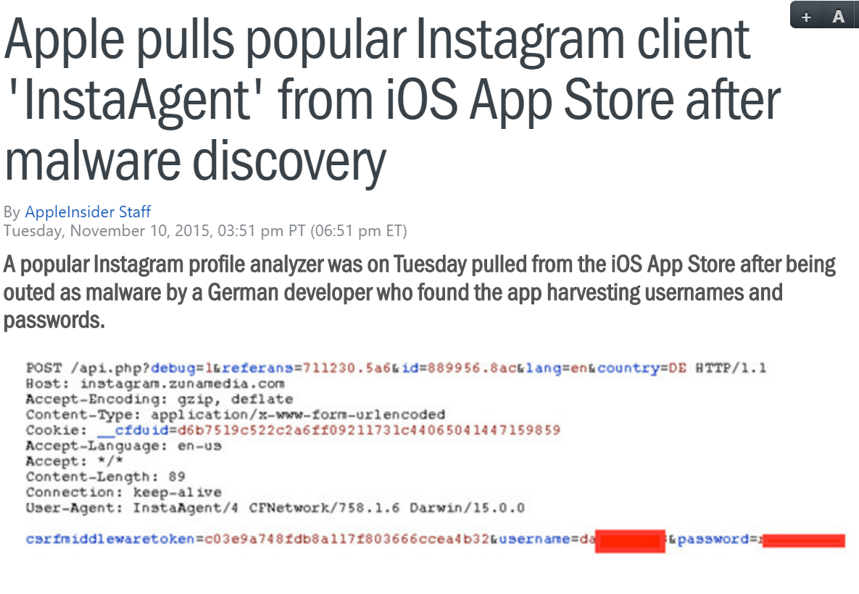
W

Slide 5
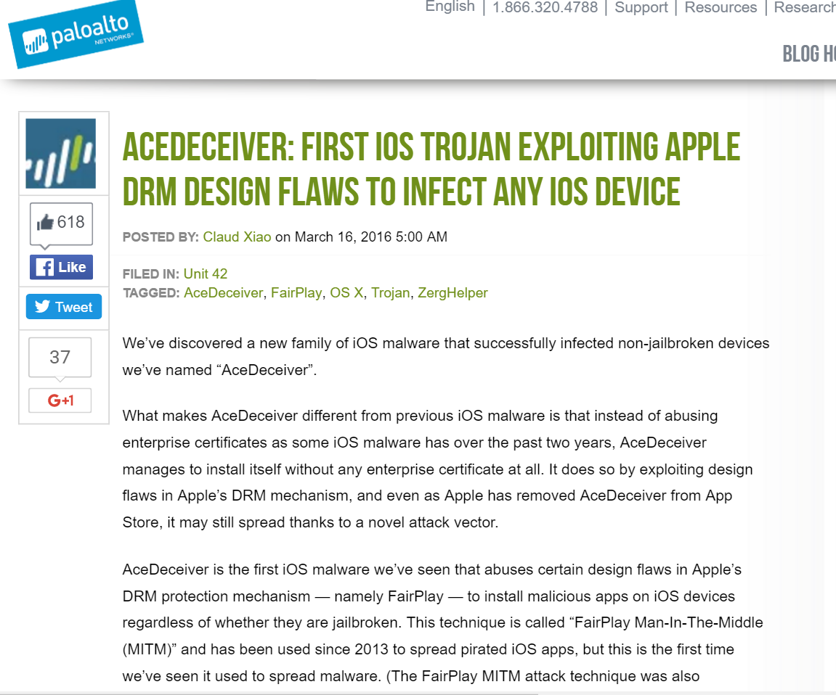

Slide 6
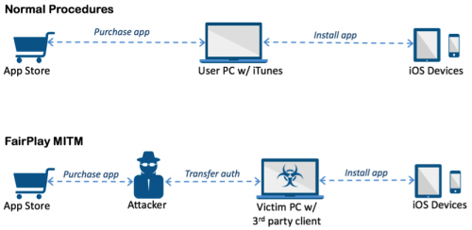
Based on FairPlay vulnerability
Requires malware on user PC, installation of malicious app in App Store
Continues to work after app removed from store
Silently installs app on phone

Slide 7
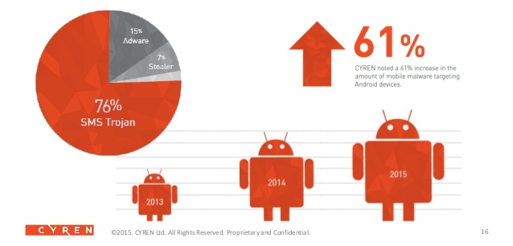
Android malware 2015

Slide 8
Current Android Malware
Description
AccuTrack This application turns an Android smartphone into a GPS tracker.
Ackposts This Trojan steals contact information from the compromised device and uploads them to a remote server.
Acnetdoor This Trojan opens a backdoor on the infected device and sends the IP address to a remote server.
Adsms This is a Trojan which is allowed to send SMS messages. The distribution channel ... is through a SMS message containing the download link.
Airpush/StopSMS Airpush is a very aggresive Ad-Network.
…
BankBot This malware tries to steal users’ confidential information and money from bank and mobile accounts associated with infected devices.
http://forensics.spreitzenbarth.de/android-malware/

Slide 9
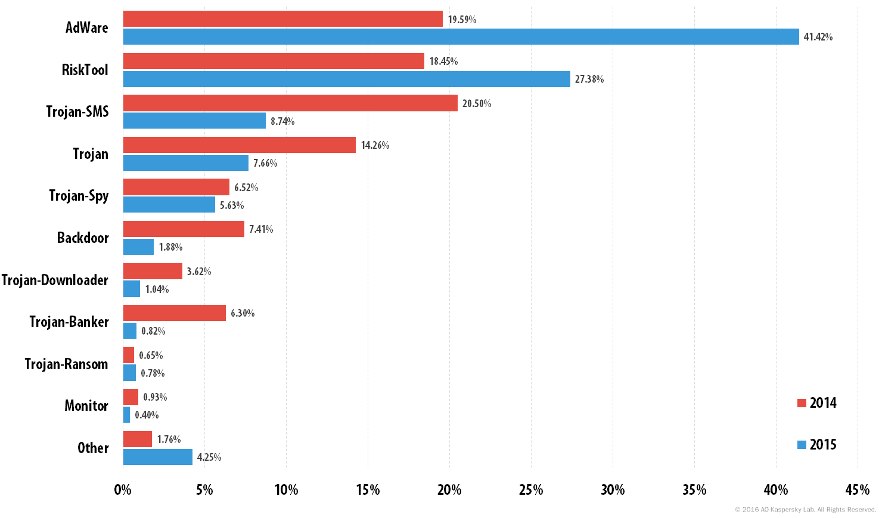
Trends 2014-15

Slide 10

Android free antivirus apps …
Comodo Security & Antivirus
CM Security Antivirus AppLock
360 Security - Antivirus Boost
Sophos Free Antivirus and Security
Malwarebytes Anti-Malware
Bitdefender Antivirus Free
http://www.androidcentral.com/top-free-antivirus-apps-android

Slide 11
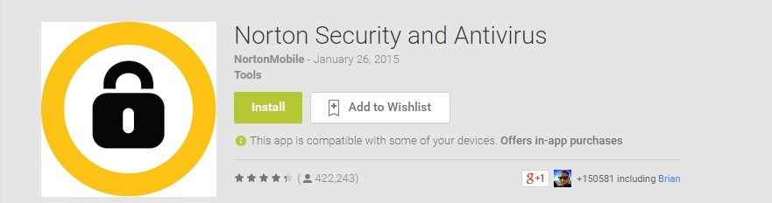
“Even security companies know the risk is low — that's why apps are packaged with other selling points.” - AndroidCentral
Kevin Haley, Symantec's Director of Symantec Security Response:
  "Symantec sees an important role to play in helping to protect data and mobile devices from being exposed to risk," …
  "While Symantec sees its purpose in the mobile landscape as providing security against malware, fraud and scams; we also protect devices against loss and theft — loss of the device itself, as well as the information on it. In addition, Symantec helps businesses protect and manage their data being stored or transmitted through the mobile devices of their employees."
http://www.androidcentral.com/antivirus-android-do-you-need-it

Slide 12
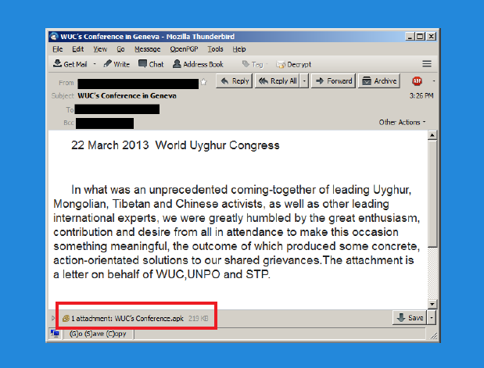
Android malware example

Slide 13
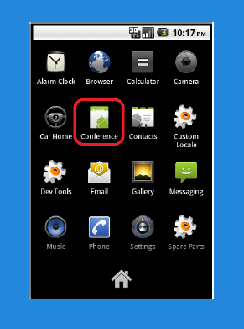

Install malicious “conference app”

Slide 14
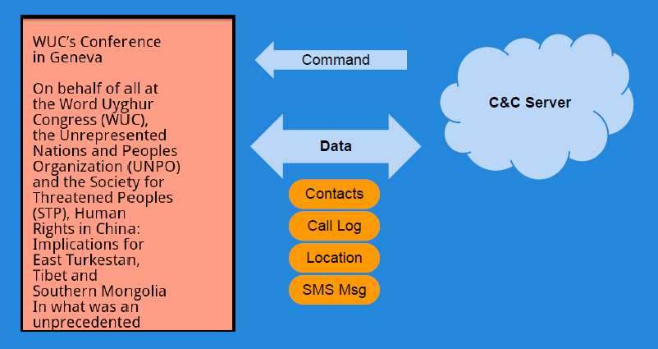
Malware behavior triggered by C&C server (Chuli)

Slide 15
Outline
Mobile malware
Identifying malware
  Detect at app store rather than on platform
Classification study of mobile web apps
  Entire Google Play market as of 2014
  85% of approx 1 million apps use web interface
Target fragmentation in Android
  Out-of-date Apps may disable more recent security platform patches

Slide 16
STAMP Admission System
Static Analysis
More behaviors, fewer details
Static
STAMP
Dynamic
Alex Aiken,
John Mitchell,
Saswat Anand,
Jason Franklin
Osbert Bastani,
Lazaro Clapp,
Patrick Mutchler,
Manolis Papadakis
Dynamic Analysis
Fewer behaviors, more details

Slide 17
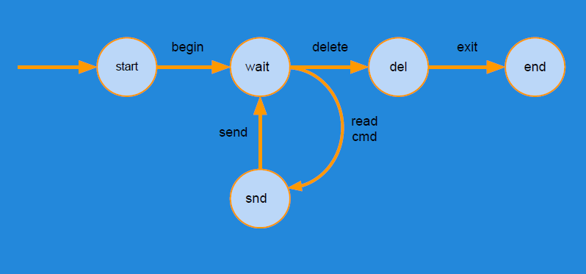
Abstract program execution
States: mapping of variable names to values
Transitions: relation on pairs of states
Traces: sequence of states or state, transition pairs

Slide 18
Analysis
Convert bytecode to intermediate format (called Quads)
Step 1
Compute call graph using Class Hierarchy Analysis
Step 2
Build an edge-labeled graph G by processing Quads of each class
Step 3
Add new edges to G as per a set of rules until no rules apply
Step 4

Slide 19
Data Flow Analysis
getLoc()
Source: Location
sendSMS()
Sink: SMS
sendInet()
Sink: Internet
Location
SMS
Location
Internet
Source-to-sink flows
  Sources: Location, Calendar, Contacts, Device ID etc.
  Sinks: Internet, SMS, Disk, etc.

Slide 20
Data Flow Analysis in Action
Malware/Greyware Analysis
  Data flow summaries enable enterprise-specific policies
API Misuse and Data Theft Detection
FB API
Source: FB_Data
Send Internet
Sink: Internet
Automatic Generation of App Privacy Policies
  Avoid liability, protect consumer privacy
Privacy Policy
This app collects your:
Contacts
Phone Number
Address
Vulnerability Discovery
Web
Source: Untrusted_Data
SQL Stmt
Sink: SQL

Slide 21
Challenges
Android is 3.4M+ lines of complex code
  Uses reflection, callbacks, native code
Scalability: Whole system analysis impractical
Soundness: Avoid missing flows
Precision: Minimize false positives

Slide 22
STAMP Approach
Too expensive!
App
App
Model Android/Java
  Sources and sinks
  Data structures
  Callbacks
  500+ models
Whole-program analysis
  Context sensitive
Android
Models
STAMP
OS
HW

Slide 23
Building Models
30k+ methods in Java/Android API
  5 mins x 30k = 2500 hours
Follow the permissions
  20 permissions for sensitive sources
    ACCESS_FINE_LOCATION (8 methods with source annotations)
    READ_PHONE_STATE - (9 methods)
  4 permissions for sensitive sinks
    INTERNET, SEND_SMS, etc.

Slide 24
Identifying Sensitive Data
android.Telephony.TelephonyManager: String getDeviceId()
Returns device IMEI in String
Requires permission GET_PHONE_STATE
@STAMP(
SRC ="$GET_PHONE_STATE.deviceid",
SINK ="@return"
)

Slide 25
Data We Track (Sources)
Account data
Audio
Calendar
Call log
Camera
Contacts
Device Id
Location
Photos (Geotags)
SD card data
SMS
30+ types of sensitive data

Slide 26
Data Destinations (Sinks)
Internet (socket)
SMS
Email
System Logs
Webview/Browser
File System
Broadcast Message
10+ types of exit points

Slide 27
Currently Detectable Flow Types
396 Flow Types
Unique Flow Types = Sources x Sink

Slide 28
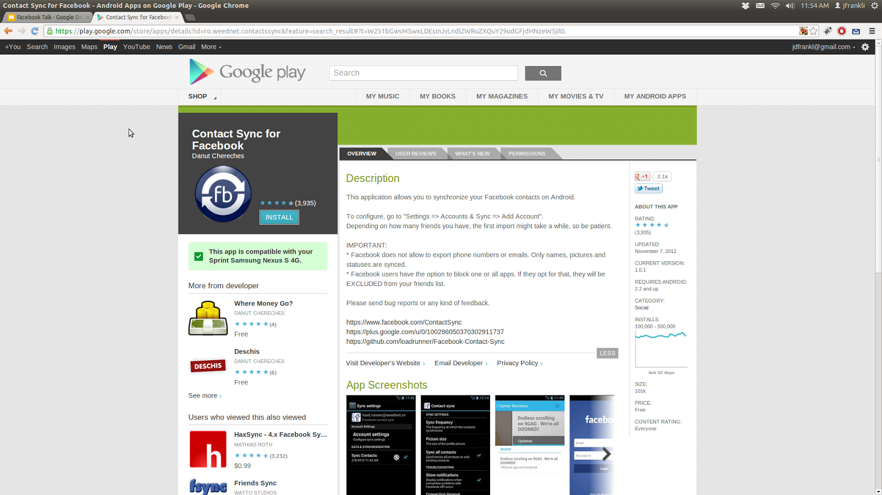
Example Analysis
Contact Sync for Facebook (unofficial)
Description:
This application allows you to synchronize your Facebook contacts on Android.
IMPORTANT:
* "Facebook does not allow [sic] to export phone numbers or emails. Only names, pictures and statuses are synced."
* "Facebook users have the option to block one or all apps. If they opt for that, they will be EXCLUDED from your friends list."
Privacy Policy: (page not found)

Slide 29
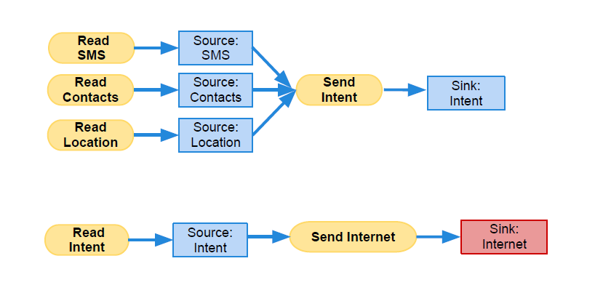
Chuli source-to-sink flows

Slide 30
Contact Sync Permissions
Category | Permission | Description
Your Accounts | AUTHENTICATE_ACCOUNTS | Act as an account authenticator
 | MANAGE_ACCOUNTS | Manage accounts list
 | USE_CREDENTIALS | Use authentication credentials
Network Communication | INTERNET | Full Internet access
 | ACCESS_NETWORK_STATE | View network state
Your Personal Information | READ_CONTACTS | Read contact data
 | WRITE_CONTACTS | Write contact data
System Tools | WRITE_SETTINGS | Modify global system settings
 | WRITE_SYNC_SETTINGS | Write sync settings (e.g. Contact sync)
 | READ_SYNC_SETTINGS | Read whether sync is enabled
 | READ_SYNC_STATS | Read history of syncs
Your Accounts | GET_ACCOUNTS | Discover known accounts
Extra/Custom | WRITE_SECURE_SETTINGS | Modify secure system settings

Slide 31
Possible Flows from Permissions
Sources
Sinks
READ_CONTACTS
INTERNET
READ_SYNC_SETTINGS
WRITE_SETTINGS
READ_SYNC_STATS
WRITE_CONTACTS
GET_ACCOUNTS
WRITE_SECURE_SETTINGS
INTERNET
WRITE_SETTINGS

Slide 32
Expected Flows
Sources
Sinks
READ_CONTACTS
INTERNET
READ_SYNC_SETTINGS
WRITE_SETTINGS
READ_SYNC_STATS
WRITE_CONTACTS
GET_ACCOUNTS
WRITE_SECURE_SETTINGS
INTERNET
WRITE_SETTINGS

Slide 33
Observed Flows
FB API
Source: FB_Data
Write Contacts
Sink: Contact_Book
Read Contacts
Source: Contacts
Send Internet
Sink: Internet

Slide 34
Outline
Mobile malware
Identifying malware
  Detect at app store rather than on platform
Classification study of mobile web apps
  Entire Google Play market as of 2014
  85% of approx 1 million apps use web interface
Target fragmentation in Android
  Out-of-date Apps may disable more recent security platform patches

Slide 35



A Large-Scale Study of
Mobile Web App Security
Patrick Mutchler, Adam Doupe,
John Mitchell, Chris Kruegel, Giovanni Vigna
Notes:
30 seconds

Slide 36

Mobile Apps

Slide 37
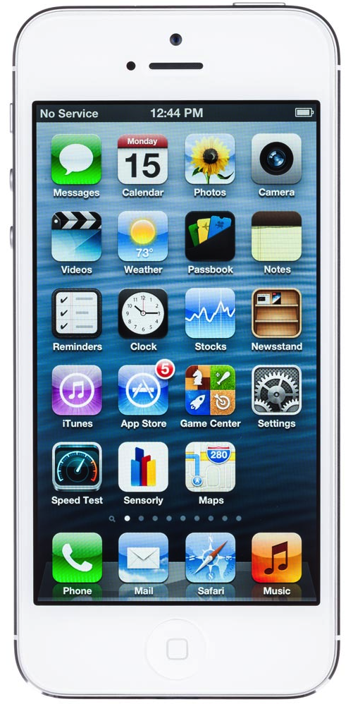
Mobile Apps

Slide 38
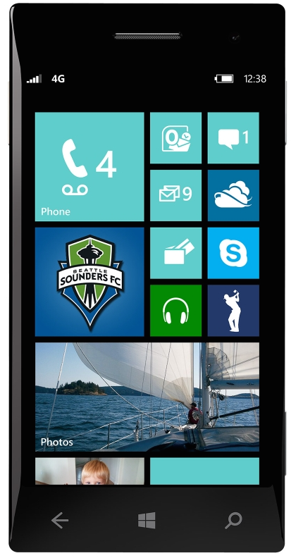
Mobile Apps

Slide 39
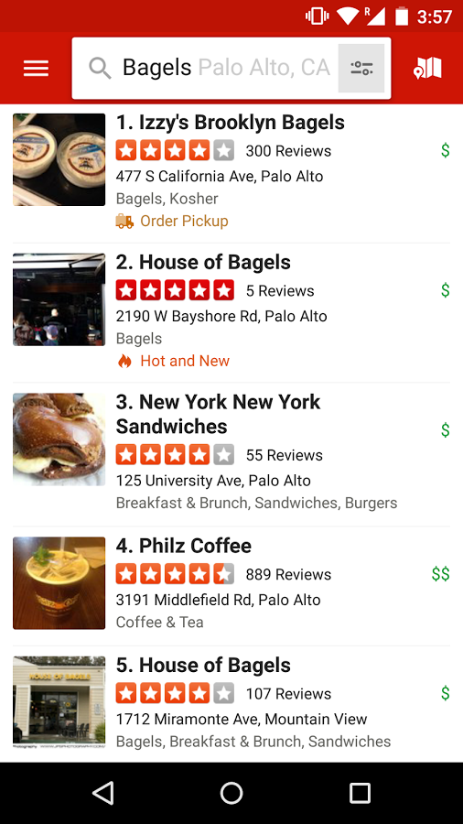
Mobile Web Apps
Mobile web app: embeds a fully functional web browser as a UI element

Slide 40


JavaScript Bridge
Obj foo = new Object();
addJavascriptInterface(foo, ‘f’);
Java
JavaScript

Slide 41
JavaScript Bridge
f.bar();
Java
JavaScript

Slide 42
Why?
Full-featured mobile web apps
Expose phone functionality to JavaScript

Slide 43
Security Concerns
Who can access the bridge?
  Everyone

Slide 44

Isolated in Browser

Slide 45

No origin distinction in WebView
f.bar();
Java
JavaScript

Slide 46
Static Analysis
How many mobile web apps?
How many use JavaScript Bridge?
How many vulnerable?

Slide 47
Experimental Results
737,828 free apps from Google Play (Oct ’13)
563,109 apps embed a browser
219,404 use the JavaScript Bridge
107,974 have at least one security violation

Slide 48
Most significant vulnerabilities
Loading untrusted web content
Leaking URLs to foreign apps
Exposing state changing navigation to foreign apps

Slide 49
Loading untrusted web content
Leaking URLs to foreign apps
Exposing state changing navigation to foreign apps

Slide 50
“You should restrict the web-pages that can load inside your WebView with a whitelist.”
- Facebook

Slide 51
“…only loading content from trusted sources into WebView will help protect users.”
- Adrian Ludwig, Google

Slide 52
1. Navigate to untrusted content
Notes:
5 minutes

Slide 53
// In app code
myWebView.loadUrl(“foo.com”);

Slide 54
// In app code
myWebView.load(“foo.com”);
<!-- In HTML -->
<a href=“foo.com”>click!</a>

Slide 55
// In app code
myWebView.load(“foo.com”);
<!-- In HTML -->
<a href=“foo.com”>click!</a>
<!-- More HTML -->
<iframe src=“foo.com”/>

Slide 56
// In app code
myWebView.loadUrl(“foo.com”);
<!-- In HTML -->
<a href=“foo.com”>click!</a>
<!-- More HTML -->
<iframe src=“foo.com”/>
// In JavaScript
window.location = “foo.com”;

Slide 57
public boolean shouldOverrideUrlLoading(
WebView view, String url){
// False -> Load URL in WebView
// True -> Prevent the URL load
}

Slide 58
public boolean shouldOverrideUrlLoading(
WebView view, String url){
String host = new URL(url).getHost();
if(host.equals(“stanford.edu”))
return false;
log(“Overrode URL: ” + url);
return true;
}

Slide 59
Reach Untrusted Content?
40,084 apps with full URLs and use JavaScript Bridge
13,683 apps (34%) can reach untrusted content

Slide 60
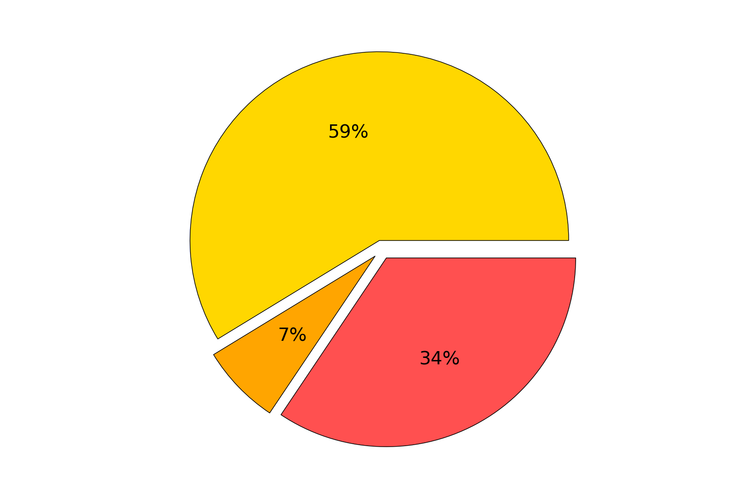
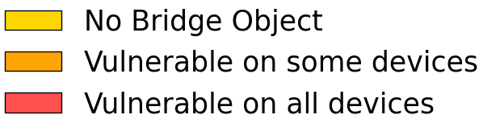
Use HTTPS?
152,706 apps with partially computed URLs
87,968 apps (57%) with HTTP URLs

Slide 61
Handling SSL Errors
onReceivedSslError
1. handler.proceed()
2. handler.cancel()
3. view.loadUrl(...)

Slide 62
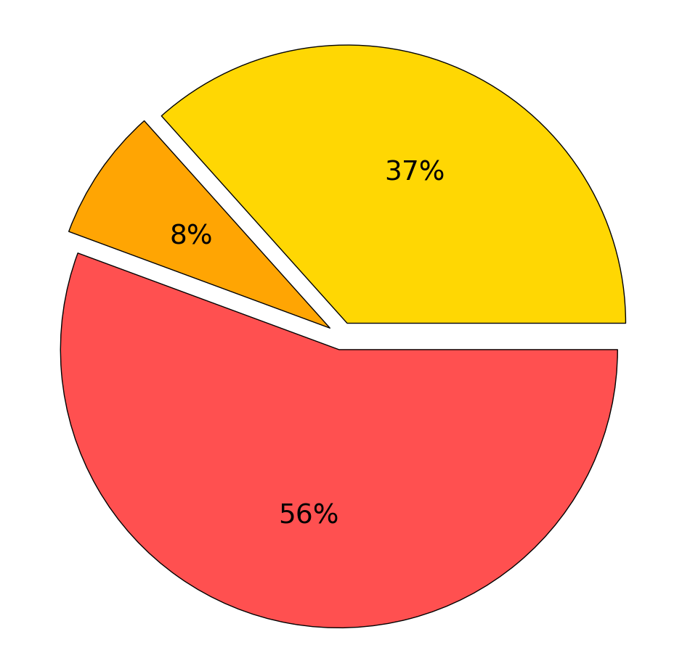
Mishandling SSL Errors
117,974 apps implement onReceivedSslError
29,652 apps (25%) must ignore errors

Slide 63
Primary results
Vulnerability | % Relevant | % Vulnerable
Unsafe Nav | 15 | 34
HTTP | 40 | 56
Unsafe HTTPS | 27 | 29

Slide 64
Popularity

Slide 65
Outdated Apps

Slide 66
29% unsafe nav
Libraries
51%
HTTP
53%
unsafe HTTPS
Notes:
29% unsafe nav
51% http
53% https

Slide 67
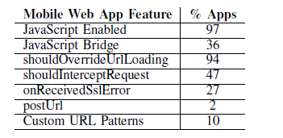
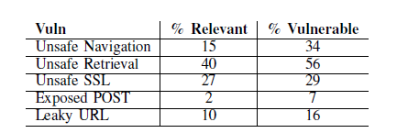
Additional security issues
Based on 998,286 free web apps from June 2014

Slide 68
Takeaways
Apps must not load untrusted content into WebViews
Able to identify violating apps using static analysis
Vulnerabilities are present in the entire app ecosystem

Slide 69
Outline
Mobile malware
Identifying malware
  Detect at app store rather than on platform
Classification study of mobile web apps
  Entire Google Play market as of 2014
  85% of approx 1 million apps use web interface
Target fragmentation in Android
  Out-of-date Apps may disable more recent security platform patches

Slide 70
Target Fragmentation in
Android Apps
Patrick Mutchler
John Mitchell
Yeganeh Safaei
Adam Doupe

Slide 71
Takeaways
Android apps can run using outdated OS behavior
- The large majority of Android apps do this
- Including popular and well maintained apps
Outdated security code invisibly permeates the app ecosystem
- “Patched” security vulnerabilities still exist in the wild
- “Risky by default” behavior is widespread

Slide 72
Roadmap
What is target fragmentation?
Target fragmentation statistics
Security consequences
Notes:
Outline

Slide 73
Roadmap
What is target fragmentation?
Target fragmentation statistics
Security consequences

Slide 74
“If the device is running Android 6.0 or higher… [the app] must request each dangerous permission that it needs while the app is running.
Android Developer Reference
Notes:
Story to explain why targetSdkVersion exists.
Requiring code changes to run on new OS versions hurts forwards compatibility.

Slide 75
“If the device is running Android 6.0 or higher and your app's target SDK is 6.0 or higher [the app] must request each dangerous permission that it needs while the app is running.
Android Developer Reference
Notes:
Story to explain why targetSdkVersion exists.
Requiring code changes to run on new OS versions hurts forwards compatibility.

Slide 76
“If the [operating system version of the device] is higher than the version declared by your app’s targetSdkVersion, the system may enable compatibility behaviors to ensure that your app continues to work the way you expect.”
Android Developer Reference
Notes:
Describe targetSdkVersion design
Not all old code is used.

Slide 77
Roadmap
What is target fragmentation?
Target fragmentation statistics
Security consequences
Notes:
Set up outdatedness here!

Slide 78
Dataset
1,232,696 Android Apps
Popularity, Category, Update, and Developer metadata
Collected between May 2012 and Dec 2015
Broken into five datasets by collection date

Slide 79
Outdatedness
Android 5.0 Released
Android 5.1 Released
Android 6.0 Released
App Collected
Notes:
We aren’t just concerned with whether an app is out of date. We are concerned with how out of date that app is.
Define outdatedness.

Slide 80
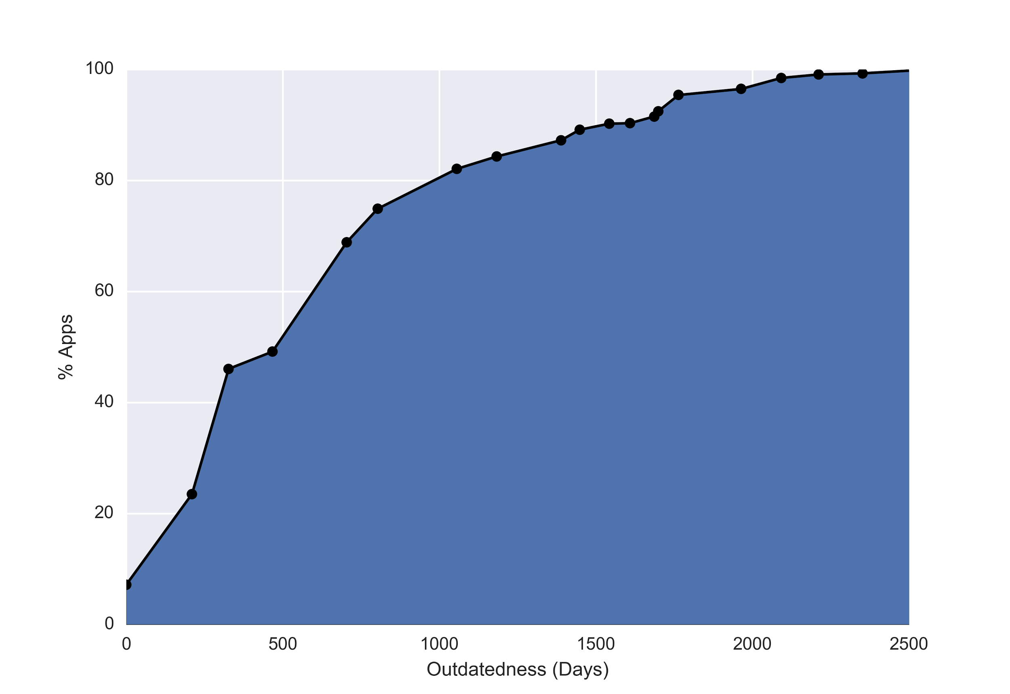
Notes:
Cumulative distribution of outdatedness for apps collected in December 2015
8% of apps target the most current version (6.0, released in October)
50% of apps target versions at least 500 days out of date
20% of apps target versions at least 1000 days out of date

Slide 81
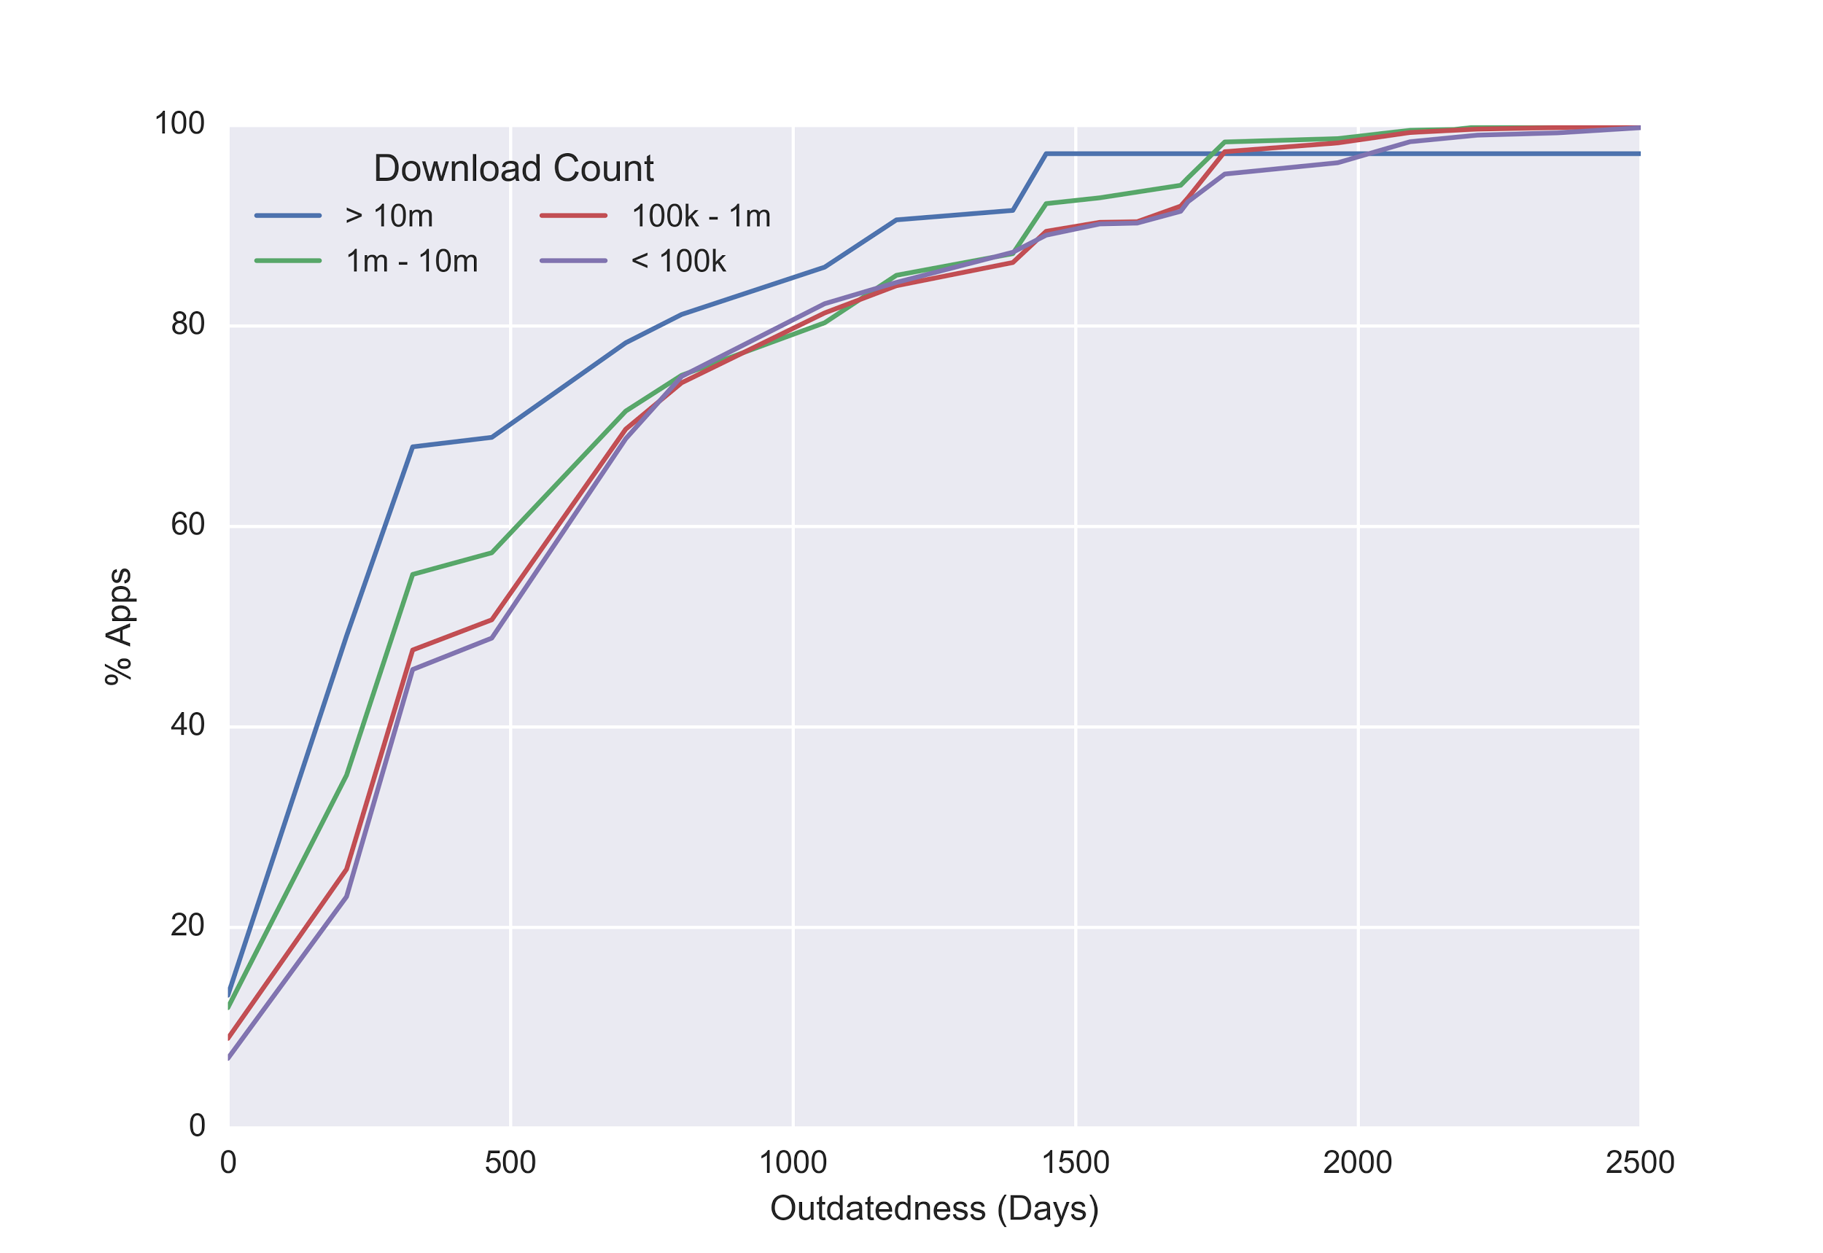
Notes:
Cumulative distributions for different install counts.
Apps installed 10m times are a bit better but target fragmentation is still a severe problem.
Fewer than 20% target 6.0. 80th percentile is still about two years out of date.

Slide 82
Negligent Outdatedness
Outdatedness
Android 5.0 Released
Android 5.1 Released
App Updated
Android 6.0 Released
App Collected
Notes:
Lets be even more generous and account for stale apps on the app store.
Define negligent outdatedness

Slide 83
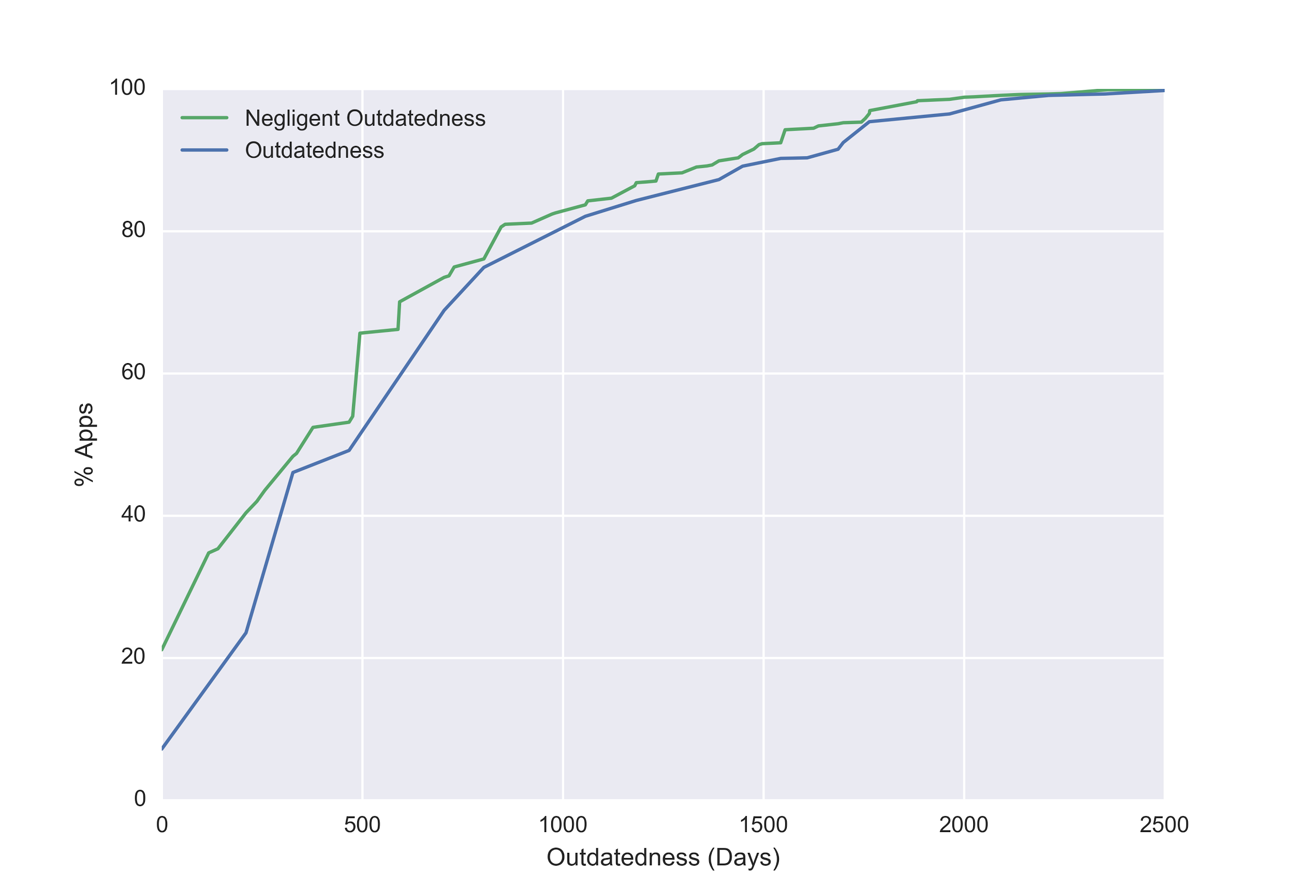
Notes:
Compare negligent outdatedness and outdatedness curves. Shows that stale apps are not the primary cause of outdatedness.

Slide 84
Roadmap
What is target fragmentation?
Target fragmentation statistics
Security consequences
Notes:
Outline

Slide 85
Fragment Injection
Vulnerable App
Malicious Intent
PreferenceActivity
Extra.SHOW_FRAGMENT “Attacked Fragment”
Extra.SHOW_FRAG_ARG
Attacked
Fragment
Data
Other
Extras
securityintelligence.com/new-vulnerability-android-framework-fragment-injection/
Notes:
Introduce and explain fragment injection attack

Slide 86
Fragment Injection
Fixed in Android 4.4
Developers implement isValidFragment to authorize fragments
// Put this in your app
protected boolean isValidFragment(String fName){
return MyFrag.class.getName().equals(fName);
}
Notes:
Describe the solution for fragment injection. Fixed on Sep 3rd 2013.
But what happens when you don’t implement isValidFragment?

Slide 87
Fragment Injection
Vulnerable if:
- Targets 4.3 or lower (31%)
- Some class inherits from PreferenceActivity (4.8%)
- That class is exported (1.1%)
- That class does not override isValidFragment (0.55%)
4.2% of apps vulnerable if no fix was ever implemented
Notes:
Vulnerability rates.
The “fix” has only reduced the vuln rate to 20% of what it would be if no fix was ever implemented.

Slide 88
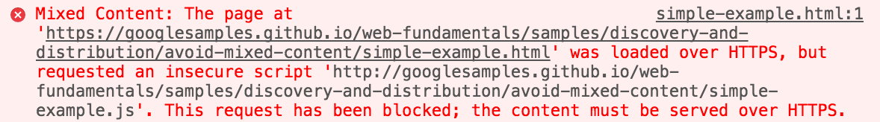
Mixed Content in WebView
Notes:
Define mixed content and explain what webview is.

Slide 89
Mixed Content in WebView
Major web browsers block Mixed Content
In Android 5.0, WebViews block Mixed Content by default
Can override default with setMixedContentMode()
Notes:
Explain mixed content changes

Slide 90
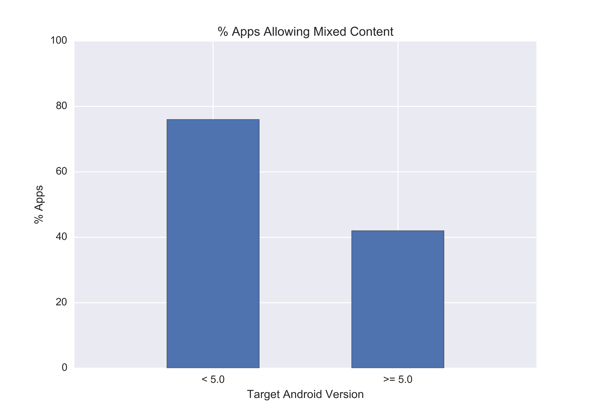
Notes:
We cannot directly measure the number of “vulnerable” apps that allow mixed content because it is possible to do so safely.
Instead we try to understand the number of apps that “accidentally” allow mixed content.

Slide 91
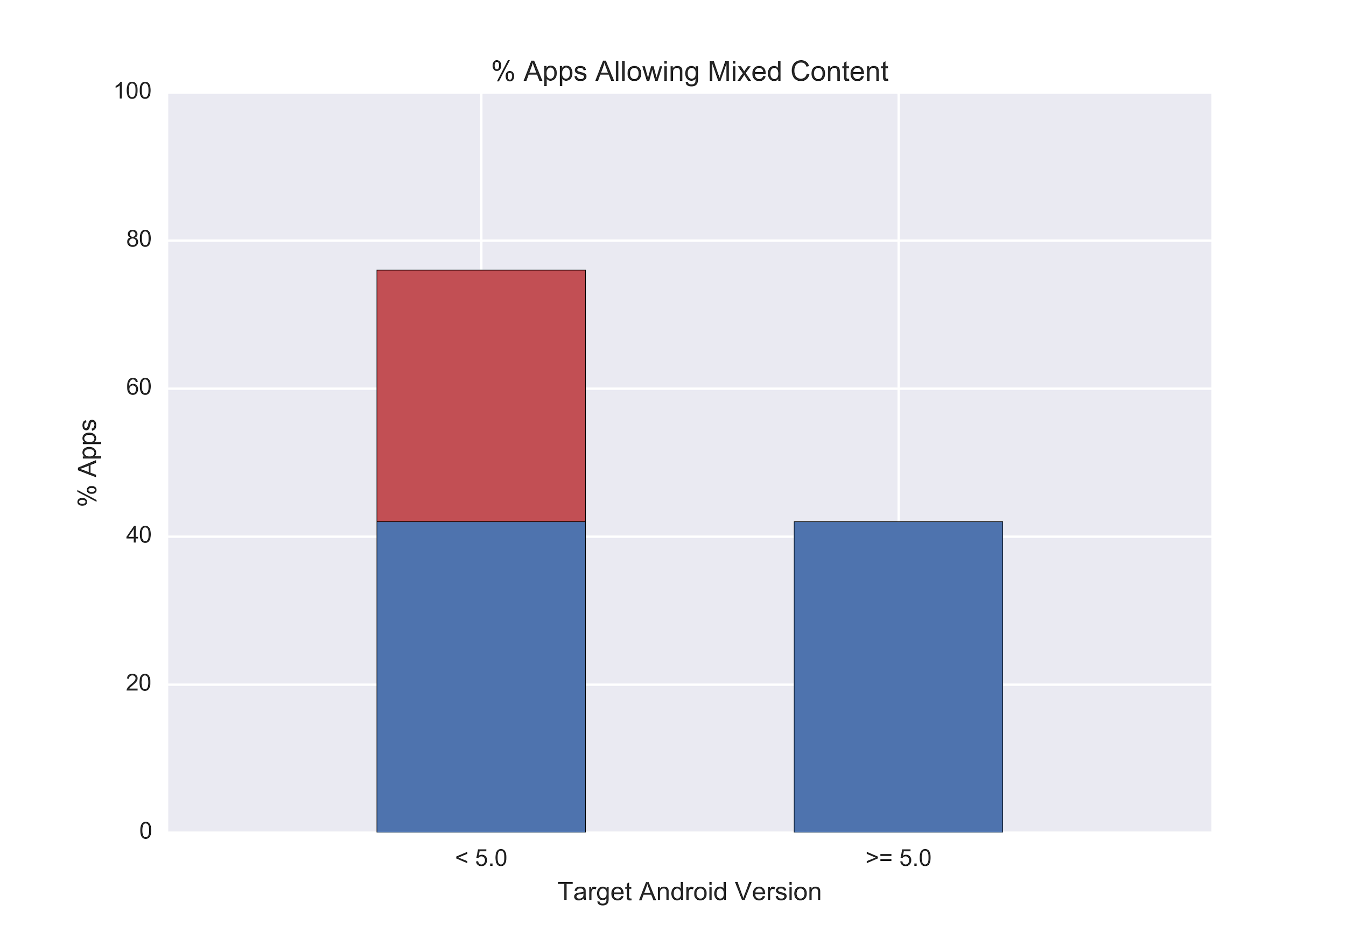
Notes:
Assume that the % of apps that want to allow mixed content is constant
Red bar are apps that allow mixed content unnecessarily
Red bar represents 18% of apps from December

Slide 92
SOP for file:// URLs in WebView
Android 4.1 separate file:// URLs are treated as unique origins
Can override with setAllowFileAccessFromFileURLs()

Slide 93
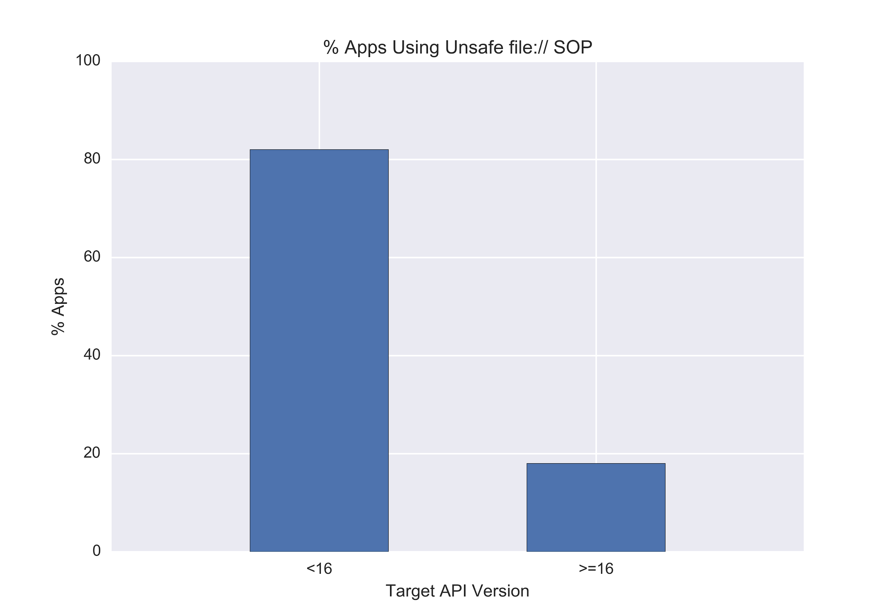
Notes:
Difference is 64%.
15% of apps target <16
9.6% of all apps

Slide 94
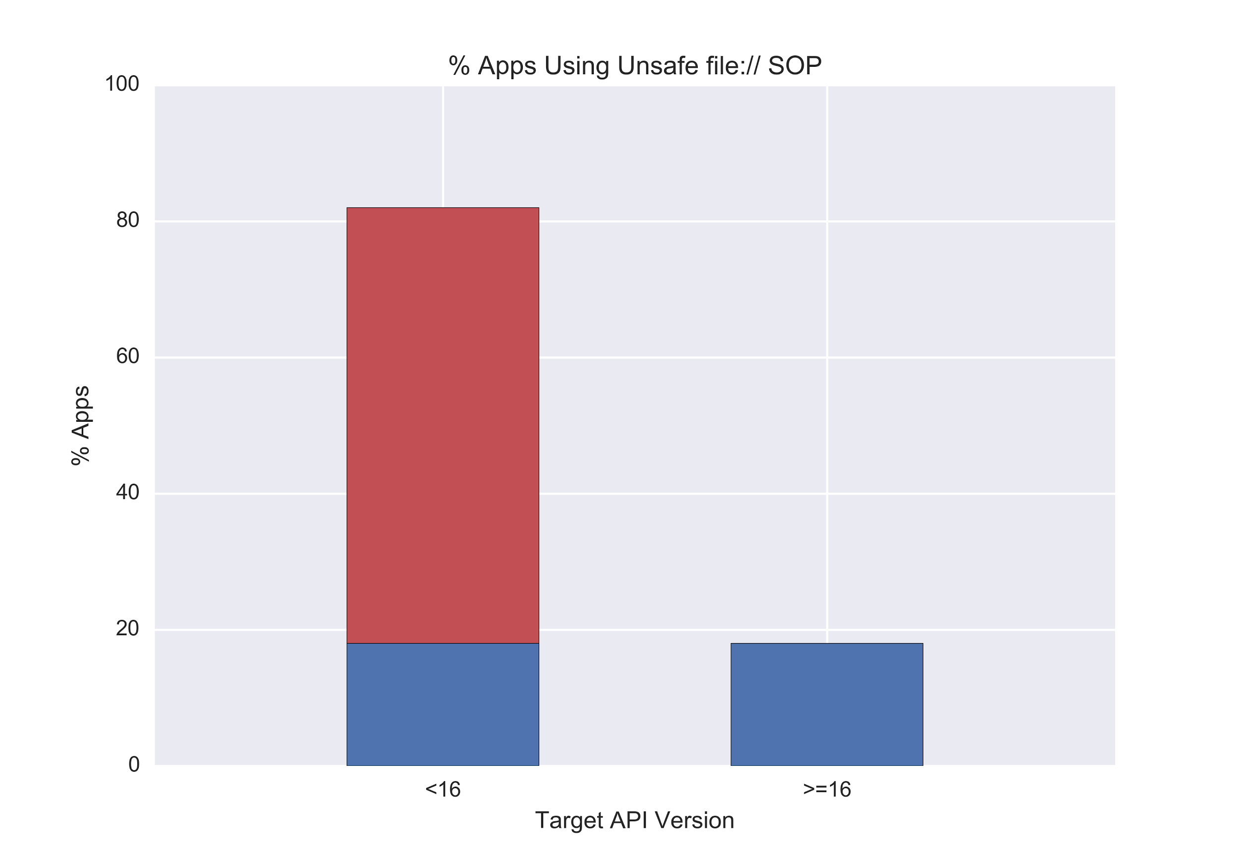
Notes:
Difference is 64%.
15% of apps target <16
9.6% of all apps
You can see this going two ways:
One is that developers who use Feature X are more likely to retarget when a security change comes to Feature X
One is that developers who use Feature X are *less* likely to retarget when a change comes to Feature X because it breaks their code
Apps that use PreferenceActivity target 19+ 66% of the time while the general population targets 19+ 69% of the time.
Apps that use WebView...
Apps that export Content Providers

Slide 95
Recap
Android apps can run using outdated OS behavior
- The large majority of Android apps do this
- Including popular and well maintained apps
Outdated security code invisibly permeates the app ecosystem
- “Patched” security vulnerabilities still exist in the wild
- “Risky by default” behavior is widespread
Notes:
Big takeaways from this paper
Make third point into a sentence
Make this last point punchier

Slide 96
Summary
Mobile malware
Identifying malware
  Detect at app store rather than on platform
Classification study of mobile web apps
  Entire Google Play market as of 2014
  85% of approx 1 million apps use web interface
Target fragmentation in Android
  Out-of-date Apps may disable more recent security platform patches

