Slide 1

CS 155
Spring 2017
Secure Architecture
Principles
Isolation and Least Privilege
Access Control Concepts
Operating Systems
Browser Isolation and Least Privilege

Slide 2
Isolation and Least Privilege
Secure Architecture
Principles

Slide 3
Principles of Secure Design
Compartmentalization
  Isolation
  Principle of least privilege
Defense in depth
  Use more than one security mechanism
  Secure the weakest link
  Fail securely
Keep it simple

Slide 4
Principle of Least Privilege
Principle of Least Privilege
  A system module should only have the minimal privileges needed for its intended purposes
What’s a privilege?
  Ability to access or modify a resource
Assumes compartmentalization and isolation
  Separate the system into isolated compartments
  Limit interaction between compartments

Slide 5
Monolithic design
System
Network
Network
User input
User device
File system
File system

Slide 6
Monolithic design
System
Network
Network
User input
User device
File system
File system

Slide 7
Monolithic design
System
Network
Network
User input
User display
File system
File system

Slide 8
Component design
Network
Network
User input
User display
File system
File system

Slide 9
Component design
Network
Network
User input
User device
File system
File system

Slide 10
Component design
Network
Network
User input
User device
File system
File system

Slide 11
Principle of Least Privilege
Principle of Least Privilege
  A system module should only have the minimal privileges needed for its intended purposes
What’s a privilege?
  Ability to access or modify a resource
Assumes compartmentalization and isolation
  Separate the system into isolated compartments
  Limit interaction between compartments

Slide 12
Example: Mail Agent
Requirements
  Receive and send email over external network
  Place incoming email into local user inbox files
Sendmail
  Traditional Unix
  Monolithic design
  Historical source of many vulnerabilities
Qmail
  Compartmentalized design

Slide 13
OS Basics (before examples)
Isolation between processes
  Each process has a UID
    Two processes with same UID have same permissions
  A process may access files, network sockets, ….
    Permission granted according to UID
Relation to previous terminology
  Compartment defined by UID
  Privileges defined by actions allowed on system resources

Slide 14
Qmail design
Isolation based on OS isolation
  Separate modules run as separate “users”
  Each user only has access to specific resources
Least privilege
  Minimal privileges for each UID
  Only one “setuid” program
    setuid allows a program to run as different users
  Only one “root” program
    root program has all privileges

Slide 15
Structure of qmail
qmail-smtpd
qmail-inject
qmail-queue
Incoming external mail
Incoming internal mail
qmail-send
qmail-rspawn
qmail-lspawn
qmail-remote
qmail-local

Slide 16
Isolation by Unix UIDs
qmailq – user who is allowed to read/write mail queue
qmaild
qmail-smtpd
qmail-inject
user
qmailq
qmail-queue
qmail-send
qmailr
qmails
root
qmail-rspawn
qmail-lspawn
setuid user
qmailr
user
qmail-remote
qmail-local

Slide 17
Structure of qmail
qmail-smtpd
qmail-inject
qmail-queue
Reads incoming mail directories
Splits message into header, body
Signals qmail-send
qmail-send
qmail-rspawn
qmail-lspawn
qmail-remote
qmail-local

Slide 18
Structure of qmail
qmail-smtpd
qmail-inject
qmail-queue
qmail-send signals
  qmail-lspawn if local
  qmail-remote if remote
qmail-send
qmail-rspawn
qmail-lspawn
qmail-remote
qmail-local

Slide 19
Structure of qmail
qmail-smtpd
qmail-inject
qmail-queue
qmail-send
qmail-lspawn
qmail-lspawn
  Spawns qmail-local
  qmail-local runs with ID of user receiving local mail
qmail-local

Slide 20
Structure of qmail
qmail-smtpd
qmail-inject
qmail-queue
qmail-send
qmail-lspawn
qmail-local
  Handles alias expansion
  Delivers local mail
  Calls qmail-queue if needed
qmail-local

Slide 21
Structure of qmail
qmail-smtpd
qmail-inject
qmail-queue
qmail-send
qmail-rspawn
qmail-remote
  Delivers message to remote MTA
qmail-remote

Slide 22
Isolation by Unix UIDs
qmailq – user who is allowed to read/write mail queue
qmaild
qmail-smtpd
qmail-inject
user
qmailq
qmail-queue
setuid
qmail-send
qmailr
qmails
root
qmail-rspawn
qmail-lspawn
root
setuid user
qmailr
user
qmail-remote
qmail-local

Slide 23
Least privilege
qmail-smtpd
qmail-inject
qmail-queue
setuid
qmail-send
qmail-rspawn
qmail-lspawn
root
qmail-remote
qmail-local

Slide 24
Android process isolation
Android application sandbox
  Isolation: Each application runs with its own UID in own VM
    Provides memory protection
    Communication limited to using Unix domain sockets
    Only ping, zygote (spawn another process) run as root
  Interaction: reference monitor checks permissions on inter-component communication
  Least Privilege: Applications announces permission
    User grants access at install time

Slide 25
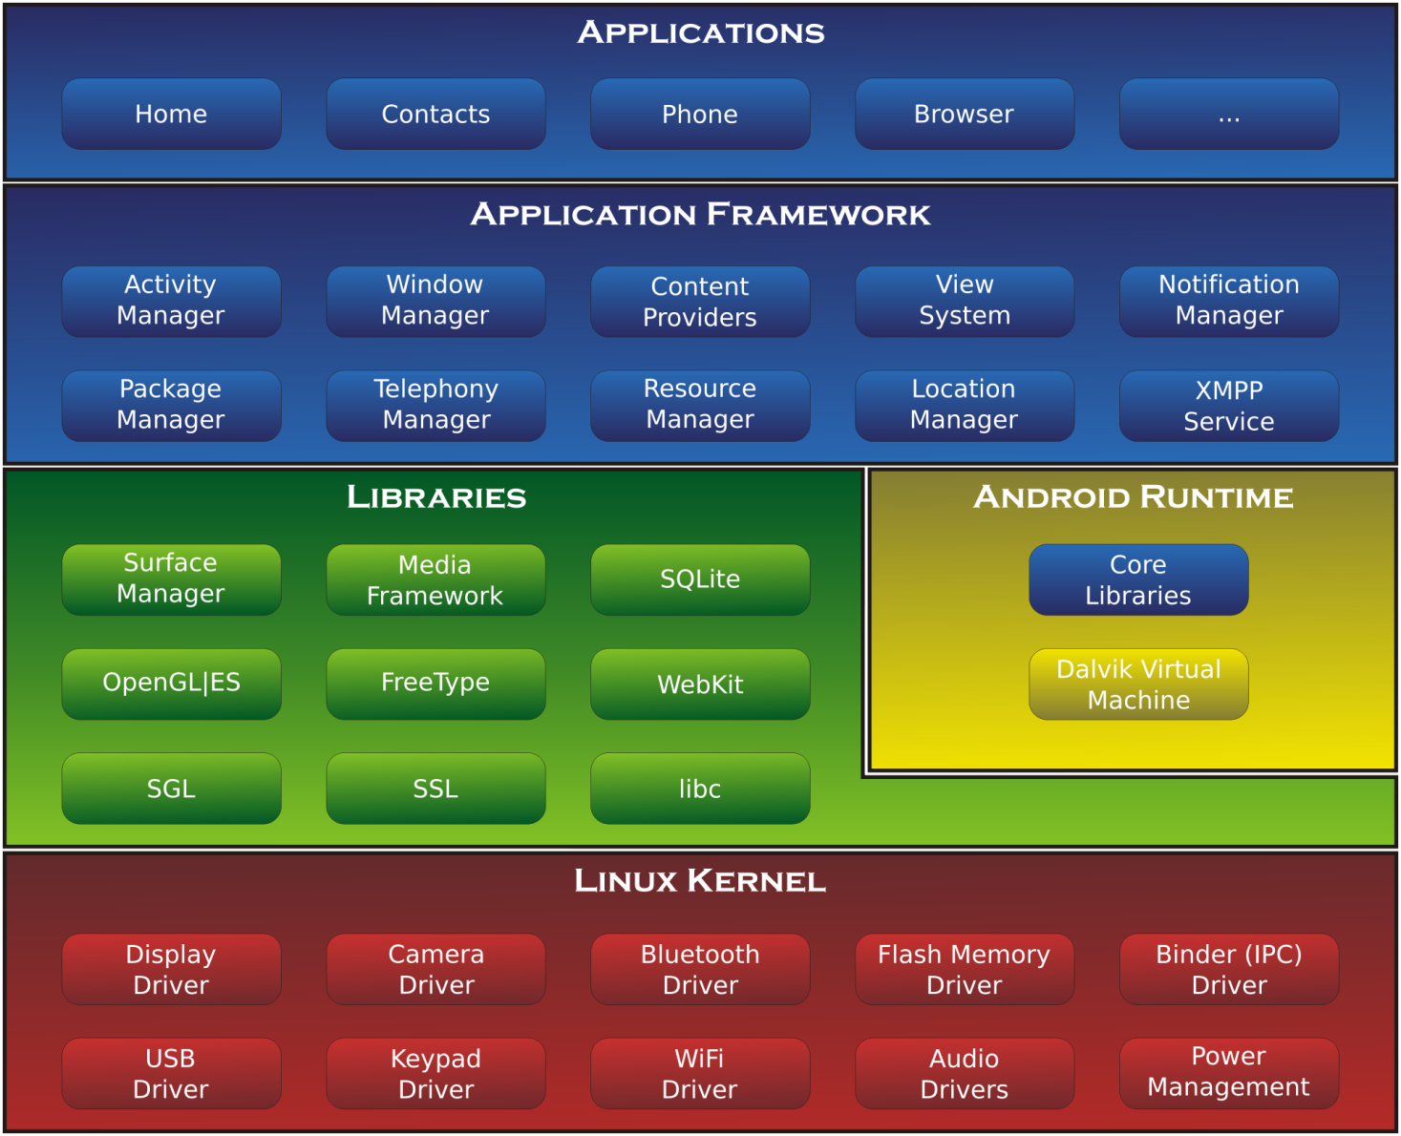

Slide 26

Isolation: different apps under different UIDs
App

Slide 27
Isolation: different apps under different UIDs
UID1
UID2
App
App

Slide 28
Privileges set at install time
UID1, priv 1, priv 2, …
UID2, priv 3, priv 4, …
App
App

Slide 29
Discussion?
Principle of Least Privilege
Qmail example
Android app sandbox example

Slide 30
Access Control Concepts
Secure Architecture
Principles

Slide 31
Access control
Assumptions
  System knows who the user is
    Authentication via name and password, other credential
  Access requests pass through gatekeeper (reference monitor)
    System must not allow monitor to be bypassed
Reference
monitor
?
Resource
User process
access request
policy

Slide 32
Access control matrix [Lampson]
Objects
 | File 1 | File 2 | File 3 | … | File n
User 1 | read | write | - | - | read
User 2 | write | write | write | - | -
User 3 | - | - | - | read | read
…
User m | read | write | read | write | read
Subjects

Slide 33
Implementation concepts
 | File 1 | File 2 | …
User 1 | read | write | -
User 2 | write | write | -
User 3 | - | - | read
…
User m | Read | write | write
Access control list (ACL)
  Store column of matrix
  with the resource
Capability
  User holds a “ticket” for
  each resource
  Two variations
    store row of matrix with user, under OS control
    unforgeable ticket in user space
Access control lists are widely used, often with groups
Some aspects of capability concept are used in many systems

Slide 34
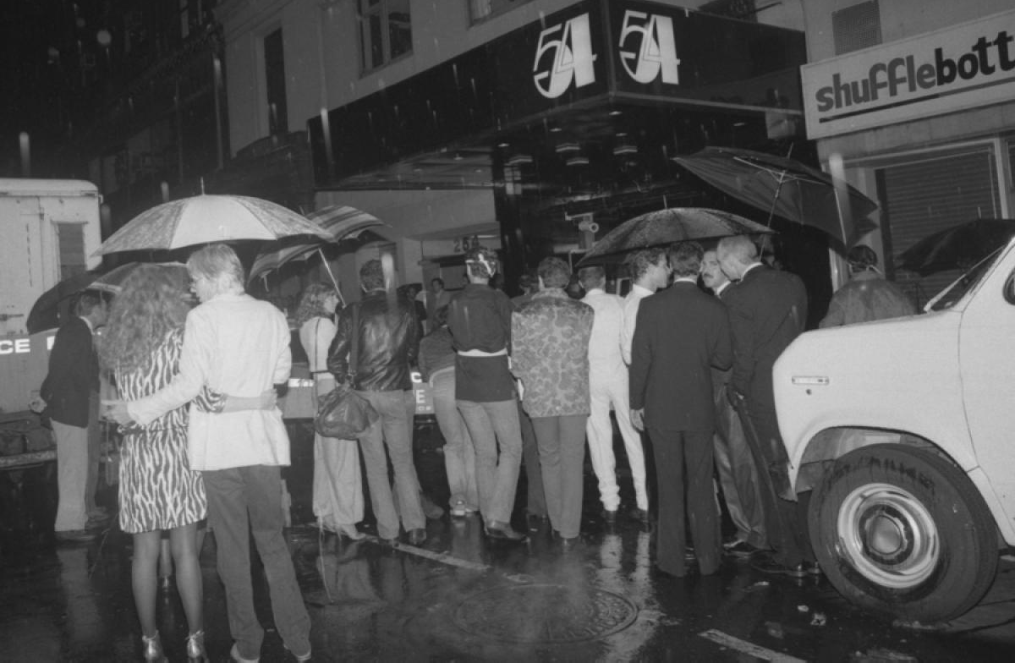
ACL: my name is on the list

Slide 35
Capability: I have a ticket

Slide 36
ACL vs Capabilities
Access control list
  Associate list with each object
  Check user/group against list
  Relies on authentication: need to know user
Capabilities
  Capability is unforgeable ticket
    Random bit sequence (or managed by OS)
    Can be passed from one process to another
  Reference monitor checks ticket
    Does not need to know identify of user/process

Slide 37
ACL vs Capabilities
Delegation
  Cap: Process can pass capability at run time
  ACL: Try to get owner to add permission to list?
    More common: let other process act under current user
Revocation
  ACL: Remove user or group from list
  Cap: Try to get capability back from process?
    Possible in some systems if appropriate bookkeeping
      OS knows which data is capability
      If capability is used for multiple resources, have to revoke all or none …
    Indirection: capability points to pointer to resource
      If C → P → R, then revoke capability C by setting P=0

Slide 38
Process creation: ACL vs Capabilities
Process P
User U
Process P
Capabilty c,d,e
Process Q
User U
Process Q
Capabilty c,e
Process R
User U
Process R
Capabilty c

Slide 39
Roles (aka Groups)
Role = set of users
  Administrator, PowerUser, User, Guest
  Assign permissions to roles; each user gets permission
Role hierarchy
  Partial order of roles
  Each role gets
  permissions of roles below
  List only new permissions
  given to each role
Administrator
PowerUser
User
Guest

Slide 40
Role-Based Access Control
Individuals
Roles
Resources
engineering
Server 1
marketing
Server 2
Server 3
human res
Advantage: users change more frequently than roles

Slide 41
Access control summary
Access control involves reference monitor
  Check permissions: ⟨user info, action⟩→ yes/no
  Important: must be no way to bypass this check
Access control matrix
  Two implementations: access control lists vs capabilities
  Advantages and disadvantages of each
Role-based access control
  Use group as “user info”; use group hierarchies

Slide 42
Discussion?
Access control matrix
  What are the advantages of access control lists (ACL)
  What are the advantages of capabilities
Role-based access control
  Why is this helpful?

Slide 43
Operating Systems
Secure Architecture
Principles

Slide 44
Unix
What access control concepts are used?
  Truncated access control list
  A form of role-based access control
 | File 1 | File 2 | …
User 1 | read | write | -
User 2 | write | write | -
User 3 | - | - | read
…
Role r | Read | write | write
 | File 1 | File 2 | …
Owner | read | write | -
Group | write | write | -
Other | - | - | read

Slide 45
Unix access control
Process has user id
  Inherit from creating process
  Process can change id
    Restricted set of options
  Special “root” id
    All access allowed
File has access control list (ACL)
  Grants permission to users
  Three “roles”: owner, group, other
 | File 1 | File 2 | …
Owner | read | write | -
Group | write | write | -
Other | - | - | read

Slide 46
Unix file access control list
Each file has owner and group
Permissions set by owner
  Read, write, execute
  Owner, group, other
  Represented by vector of
  four octal values
Only owner, root can change permissions
  This privilege cannot be delegated or shared
Setid bits – Discuss in a few slides
rwx
rwx
rwx
ownr
grp
othr

Slide 47
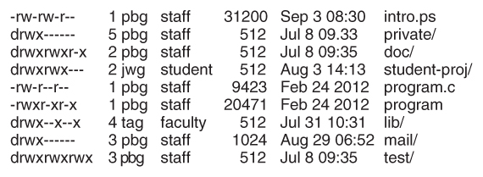
Example directory listing
access owner group size modification name

Slide 48
Process effective user id (EUID)
Each process has three Ids (+ more under Linux)
  Real user ID (RUID)
    same as the user ID of parent (unless changed)
    used to determine which user started the process
  Effective user ID (EUID)
    from set user ID bit on the file being executed, or sys call
    determines the permissions for process
      file access and port binding
  Saved user ID (SUID)
    So previous EUID can be restored
Real group ID, effective group ID, used similarly

Slide 49
Process Operations and IDs
Root
  ID=0 for superuser root; can access any file
Fork and Exec
  Inherit three IDs, except exec of file with setuid bit
Setuid system call
  seteuid(newid) can set EUID to
    Real ID or saved ID, regardless of current EUID
    Any ID, if EUID is root
Details are actually more complicated
  Several different calls: setuid, seteuid, setreuid

Slide 50
Setid bits on executable Unix file
Three setid bits
  Setuid – set EUID of process to ID of file owner
  Setgid – set EGID of process to GID of file
  Sticky
    Off: if user has write permission on directory, can rename or remove files, even if not owner
    On: only file owner, directory owner, and root can rename or remove file in the directory

Slide 51
Example
Owner 18
RUID 25
SetUID
…;
…;
exec( );
program
Owner 18
…;
…;
i=getruid()
setuid(i);
…;
…;
-rw-r--r--
file
read/write
RUID 25
EUID 18
Owner 25
RUID 25
-rw-r--r--
read/write
EUID 25
file

Slide 52
Unix access control summary
Good things
  Some protection from most users
  Flexible enough to make practical systems possible
Main limitation
  Coarse-grained ACLs – user, group, other
  Too tempting to use root privileges
  No way to assume some root privileges without all

Slide 53
Weakness in unix isolation, privileges
Network-facing Daemons
  Root processes with network ports open to all remote parties, e.g., sshd, ftpd, sendmail, …
Rootkits
  System extension via dynamically loaded kernel modules
Environment Variables
  System variables such as LIBPATH that are shared state across applications. An attacker can change LIBPATH to load an attacker-provided file as a dynamic library

Slide 54
Weakness in unix isolation, privileges
Shared Resources
  Since any process can create files in /tmp directory, an untrusted process may create files that are used by arbitrary system processes
Time-of-Check-to-Time-of-Use (TOCTTOU)
  Typically, a root process uses system call to determine if initiating user has permission to a particular file, e.g. /tmp/X.
  After access is authorized and before the file open, user may change the file /tmp/X to a symbolic link to a target file /etc/shadow.

Slide 55
Access control in Windows
Full access control lists
  Specify access for groups and users
    Read, modify, change owner, delete
Some additional concepts
  Tokens
  Security attributes
Generally, more precise, more flexible than Unix
  Can define new permissions
  Can transfer some but not all privileges (cf. capabilities)

Slide 56
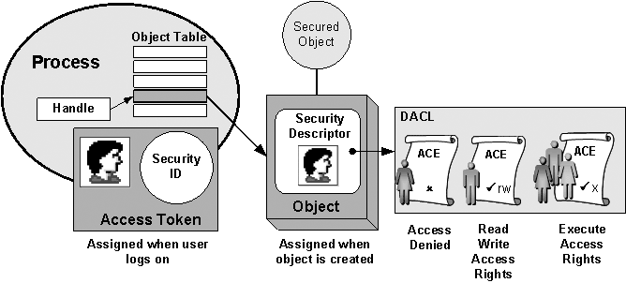

Slide 57
Process has set of tokens
Called the process “security context”
  Privileges, accounts, and groups associated with the process or thread
  Presented as set of tokens
Interesting feature: impersonation token
  Used temporarily to adopt a different security context, usually of another user (similar to use of capability/setuid)

Slide 58
Object has security descriptor
Specifies who can perform what actions on the object
  Header (revision number, control flags, …)
  SID of the object's owner
  SID of the primary group of the object
  Two attached optional lists:
    Discretionary Access Control List (DACL) – users, groups, …
    System Access Control List (SACL) – system logs, ..

Slide 59
Example access request
Access token
User: Mark
Group1: Administrators
Access request: write
Action: denied
Group2: Poets
Revision Number
User Mark requests write permission
Descriptor denies permission to group
Reference Monitor denies request
(DACL for access, SACL for audit and logging)
Control flags
Owner SID
Group SID
DACL Pointer
Security descriptor
SACL Pointer
Deny
Priority:
  Explicit Deny
  Explicit Allow
  Inherited Deny
  Inherited Allow
Poets
Read, Write
Allow
Mark
Read, Write

Slide 60
Impersonation Tokens (compare to setuid)
Process adopts security attributes of another
  Client passes impersonation token to server
Client specifies impersonation level
  Anonymous
    Token has no information about the client
  Identification
    Obtain the SIDs of client and client's privileges, but server cannot impersonate the client
  Impersonation
    Impersonate the client
  Delegation
    Lets server impersonate client on local, remote systems

Slide 61
Windows access control summary
Full access control lists
  Specify access for groups and users
    Read, modify, change owner, delete
Some additional concepts
  Tokens
  Security attributes
Generally, more precise, more flexible than Unix
  Can define new permissions
  Can transfer some but not all privileges (cf. capabilities)

Slide 62
Weakness in isolation, privileges
Similar problems to Unix
  E.g., Rootkits leveraging dynamically loaded kernel modules
Windows Registry
  Global hierarchical database to store data for all programs
  Registry entry can be associated with a security context that limits access; common to be able to write sensitive entry
Can have permissions enabled by default
  Historically, many Windows deployments also came with full permissions and functionality enabled

Slide 63
Discussion?
Unix access control
  What information is associated with a process?
  What information is associated with a resource (file)?
  How are they compared?
  What form of delegation of authority is possible?
Windows access control
  What information is associated with a process?
  What information is associated with a resource (file)?
  How are they compared?
  What form of delegation of authority is possible?
Comparison, pros and cons?

Slide 64
Browser Isolation and Least Privilege
Secure Architecture
Principles

Slide 65
Let’s look at browser example
Browser is an execution environment
  Has access control policies similar to an OS
Browser runs under control of an OS
  Use least privilege to keep the browser code secure against attacks that would break the browser enforcement of web security policy
  Topic here: implementation of browser using least privilege

Slide 66
Web browser: an analogy
Operating system
Web browser
Subject: Processes
  Has User ID (UID, SID)
  Discretionary access control
Objects
  File
  Network
  …
Vulnerabilities
  Untrusted programs
  Buffer overflow
  …
Subject: web content (JavaScript)
  Has “Origin”
  Mandatory access control
Objects
  Document object model
  Frames
  Cookies / localStorage
Vulnerabilities
  Cross-site scripting
  Implementation bugs
  …
The web browser enforces its own internal policy. If the browser implementation is corrupted, this mechanism becomes unreliable.

Slide 67
Components of security policy
Frame-Frame relationships
  canScript(A,B)
    Can Frame A execute a script that manipulates arbitrary/nontrivial DOM elements of Frame B?
  canNavigate(A,B)
    Can Frame A change the origin of content for Frame B?
Frame-principal relationships
  readCookie(A,S), writeCookie(A,S)
    Can Frame A read/write cookies from site S?

Slide 68
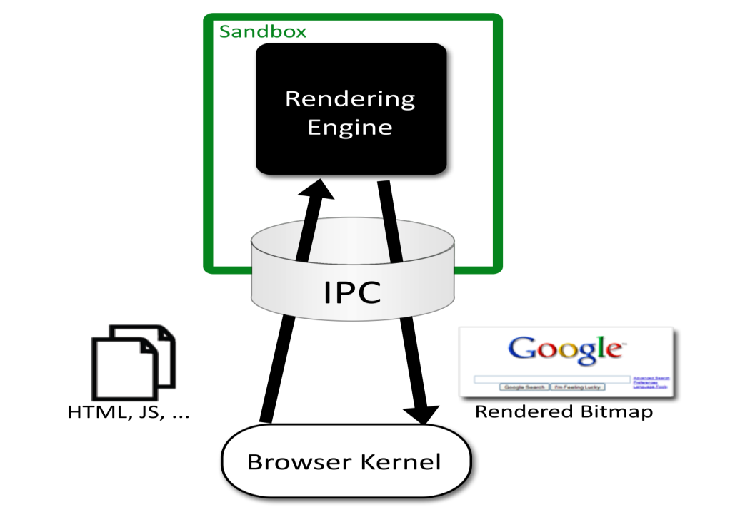

Chromium Security Architecture
Browser ("kernel")
  Full privileges (file system, networking)
Rendering engine
  Can have multiple processes
  Sandboxed
One process per plugin
  Full privileges of browser

Slide 69
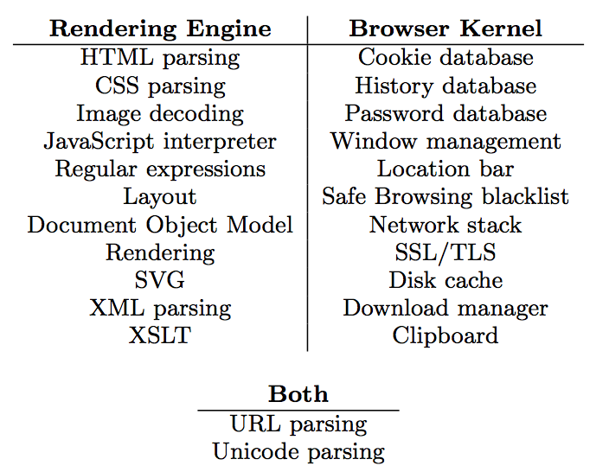
Task Allocation

Slide 70
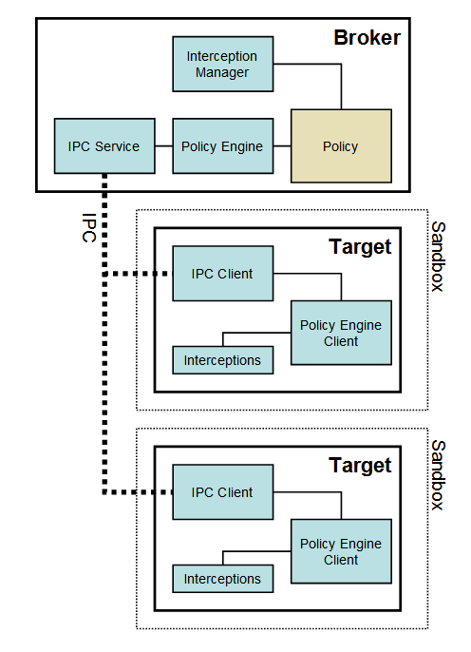
Chromium
Communicating sandboxed components
See: http://dev.chromium.org/developers/design-documents/sandbox/

Slide 71
Leverage OS Isolation
Sandbox based on four OS mechanisms (e.g., Windows)
  A restricted token
  The Windows job object
  The Windows desktop object
  Windows integrity levels
Specifically, the rendering engine
  adjusts security token by converting SIDS to DENY_ONLY, adding restricted SID, and calling AdjustTokenPrivileges
  runs in a Windows Job Object, restricting ability to create new processes, read or write clipboard, ..
  runs on a separate desktop, mitigating lax security checking of some Windows APIs
See: http://dev.chromium.org/developers/design-documents/sandbox/

Slide 72
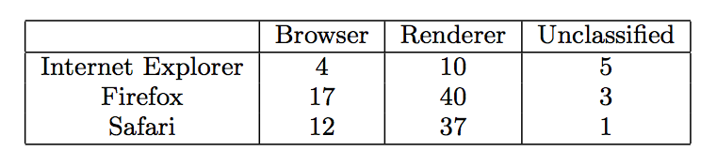
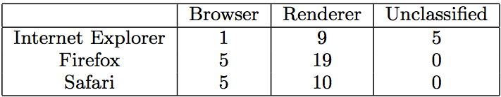
Evaluation: CVE count
Total CVEs:
Arbitrary code execution vulnerabilities:

Slide 73
Discussion?
How does Chrome architecture use principle of least privilege?
  What are the isolated modules?
  Which privileges are given to each module?
Why is this effective?
Are there other ways you could use operating system features to improve isolation and least privilege?

Slide 74
Summary
Security principles
  Isolation
  Principle of Least Privilege
  Qmail, Android examples
Access Control Concepts
  Matrix, ACL, Capabilities
OS Mechanisms
  Unix: UID, ACL, Setuid
  Windows: SID, Tokens, Security Descriptor, Impersonation
Browser security architecture
  Isolation and least privilege example

