Slide 1
Automated Tools for
System and Application Security
CS 155
Spring 2017
John Mitchell

Slide 2
Outline
General discussion of code analysis tools
  Goals and limitations of static, dynamic tools
  Static analysis based on abstract states
Security tools for traditional systems programming
  Property checkers from Engler et al., Coverity
  Sample security-related results
Web security analysis
  Black-box security tools
  Study based on these tools: security of coding
Static analysis for Android malware
  Determining whether app is malicious
  Using tools for related security studies
Slides from: S. Bugrahe, A. Chou, I&T Dillig, D. Engler, J. Franklin, A. Aiken, …

Slide 3
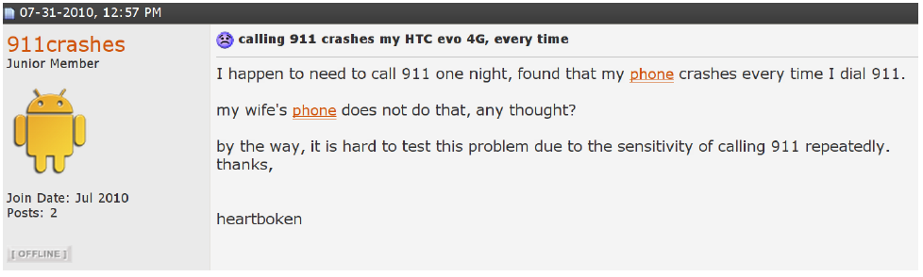
Software bugs are serious problems
Thanks: Isil and Thomas Dillig

Slide 4


Facebook missed a
single security check…
[PopPhoto.com Feb 10]
http://www.popphoto.com/news/2015/02/man-finds-easy-hack-to-delete-any-facebook-photo-album
Notes:
Facebook missed a single security check in their mobile-facing app that allowed a man to delete anybody’s photo album.
Unfortunately this is just the tip of the iceberg.
This particular bug made the news, but many more don’t. And facebook is not the only one having these kinds of problems.

Slide 5
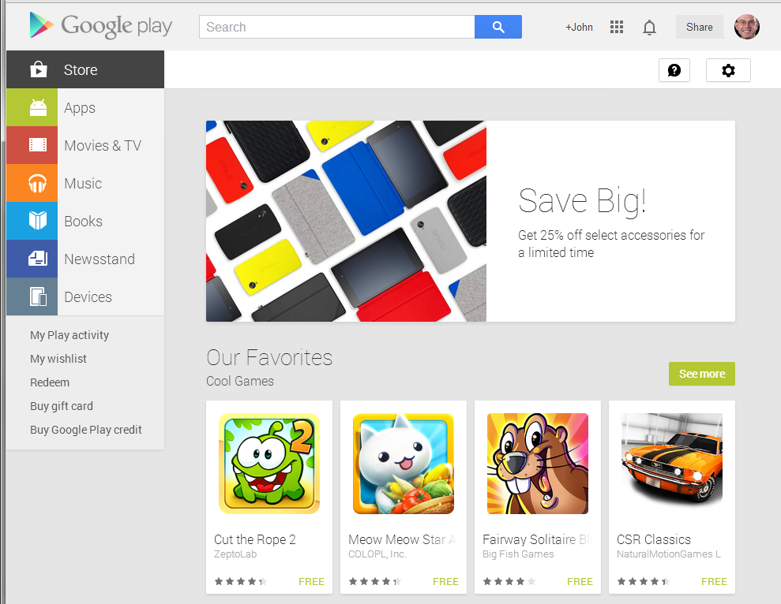
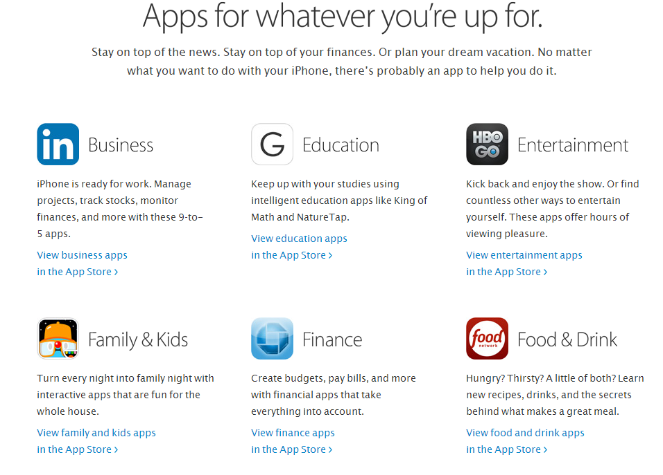
App stores

Slide 6
How can you tell whether
software you
  Develop
  Buy
is safe to install and run?

Slide 7
Cost of Fixing a Defect
Credit: Andy Chou, Coverity

Slide 8
Cost of security or data privacy vulnerability?

Slide 9
Tools to help you

Slide 10
Manual testing
only examines small subset of behaviors
Entry
Entry
1
1
2
2
4
4
1
3
4
1
1
1
2
4
1
2
4
1
2
4
1
3
4
2
2
3
1
2
3
1
2
4
1
3
4
1
2
4
1
2
3
1
3
4
4
4
1
2
3
1
2
3
1
3
4
. . .
1
2
4
1
2
4
1
3
4
Exit
Exit
Software
Behaviors
10

Slide 11
Program Analyzers
Code
Program Analyzer
Report | Type | Line
1 | mem leak | 324
2 | buffer oflow | 4,353,245
3 | sql injection | 23,212
4 | stack oflow | 86,923
5 | dang ptr | 8,491
… | … | …
10,502 | info leak | 10,921
Spec

Slide 12
Two options
Static analysis
  Automated methods to find errors or check their absence
    Consider all possible inputs (in summary form)
    Find bugs and vulnerabilities
    Can prove absence of bugs, in some cases
Dynamic analysis
  Run instrumented code to find problems
    Need to choose sample test input
    Can find vulnerabilities but cannot prove their absence

Slide 13
Static Analysis
Long research history
Decades of commercial products
  FindBugs, Fortify, Coverity, MS tools, …

Slide 14
Dynamic analysis
Instrument code for testing
  Heap memory: Purify
  Perl tainting (information flow)
  Java race condition checking
Black-box testing
  Fuzzing and penetration testing
  Black-box web application security analysis

Slide 15
Summary
Program analyzers
  Find problems in code before it is shipped to customers or before you install and run it
Static analysis
  Analyze code to determine behavior on all inputs
Dynamic analysis
  Choose some sample inputs and run code to see what happens

Slide 16
Outline
General discussion of code analysis tools
  Goals and limitations of static, dynamic tools
  Static analysis based on abstract states
Security tools for traditional systems programming
  Property checkers from Engler et al., Coverity
  Sample security-related results
Web security analysis
  Black-box security tools
  Study based on these tools: security of coding
Static analysis for Android malware
  Determining whether app is malicious
  Using tools for other security studies
Slides from: S. Bugrahe, A. Chou, I&T Dillig, D. Engler, J. Franklin, A. Aiken, …

Slide 17
Soundness, Completeness
Property | Definition
Soundness | “Sound for reporting correctness” Analysis says no bugs → No bugs or equivalently There is a bug → Analysis finds a bug
Completeness | “Complete for reporting correctness” No bugs → Analysis says no bugs
Recall: A → B is equivalent to (¬B) → (¬A)

Slide 18
Complete
Incomplete
Reports all errors
Reports no false alarms
Reports all errors
May report false alarms
Sound
Undecidable
Decidable
May not report all errors
Reports no false alarms
May not report all errors
May report false alarms
Unsound
Decidable
Decidable

Slide 19
Sound Program Analyzer
Analyze large
code bases
Code
Program Analyzer
Report | Type | Line
1 | mem leak | 324
2 | buffer oflow | 4,353,245
3 | sql injection | 23,212
4 | stack oflow | 86,923
5 | dang ptr | 8,491
… | … | …
10,502 | info leak | 10,921
false alarm
Spec
false alarm
Sound: may
report many
warnings

Slide 20
Sound
Over-approximation of Behaviors
Reported
Error
Modules
. . .
False Alarm
approximation is too coarse…
…yields too many false alarms
Behaviors
Software

Slide 21

Program execution based on abstract states

Slide 22
Does this program ever crash?
entry
X ← 0
Is Y = 0 ?
yes
no
X ← X + 1
X ← X - 1
Is Y = 0 ?
yes
no
Is X < 0 ?
exit
yes
no
crash

Slide 23
Does this program ever crash?
entry
X ← 0
Is Y = 0 ?
yes
no
X ← X + 1
X ← X - 1
Is Y = 0 ?
yes
no
Is X < 0 ?
exit
yes
no
crash
infeasible path!
… program will never crash

Slide 24
Try analyzing without approximating…
entry
X ← 0
X = 0
Is Y = 0 ?
yes
no
X = 0
X = 1
X = 2
X ← X + 1
X ← X - 1
X = 1
X = 2
X = 3
X = 1
X = 2
X = 3
Is Y = 0 ?
X = 1
X = 2
X = 3
yes
no
Is X < 0 ?
exit
yes
no
X = 1
X = 2
X = 3
crash
non-termination!
… therefore, need to approximate
Notes:
Show non-termination of symbolic execution

Slide 25
dataflow elements
X = 0
d_{in}
d_{out} = f(d_{in})
X ← X + 1
f
d_{out}
X = 1
dataflow equation
transfer function

Slide 26
X = 0
d_{in1}
X ← X + 1
f1
d_{out1} = f₁(d_{in1})
X = 1
d_{out1}
d_{out1} = d_{in2}
X = 1
d_{in2}
Is Y = 0 ?
f2
d_{out2} = f₂(d_{in2})
X = 1
d_{out2}

Slide 27
d_{out1} = f₁(d_{in1})
d_{in1}
d_{in2}
d_{out2} = f₂(d_{in2})
f₁
f₂
d_{join} = d_{out1} ⊔ d_{out2}
d_{out1}
d_{out2}
d_{join}
d_{join} = d_{in3}
d_{in3}
f₃
d_{out3} = f₃(d_{in3})
d_{out3}
least upper bound operator
Example: union of possible values
What is the space of dataflow elements, Δ?
What is the least upper bound operator, ⊔?

Slide 28
Try analyzing with “signs” approximation…
entry
X ← 0
X = 0
Is Y = 0 ?
yes
no
X = 0
X = 0
X ← X + 1
X ← X - 1
X = pos
X = neg
X = T
lost
precision
Is Y = 0 ?
X = T
yes
no
X = T
Is X < 0 ?
exit
yes
no
X = T
X = T
crash
terminates...
… but reports false alarm
… therefore, need more precision
Notes:
Run the signs analysis, show false alarm reported

Slide 29
Sound
Over-approximation of Behaviors
Reported
Error
. . .
False Alarm
approximation is too coarse…
…yields too many false alarms
Behaviors
Software

Slide 30
X = T
true
X ≠ neg
X = T
X ≠ pos
Y = 0
Y ≠ 0
X = pos
X = pos
X = 0
X = 0
X = neg
X = neg
false
X = ⊥
X = ⊥
refined signs lattice
signs lattice
Boolean formula lattice
Notes:
finite height condition

Slide 31
Try analyzing with “path-sensitive signs” approximation…
entry
X ← 0
true
X = 0
Is Y = 0 ?
yes
no
Y=0
X = 0
X = 0
Y≠0
X ← X + 1
X ← X - 1
Y=0
X = pos
X = neg
Y≠0
no precision loss
Is Y = 0 ?
Y=0
X = pos
Y≠0
X = neg
yes
no
X = neg
Y≠0
Y=0
X = pos
Is X < 0 ?
exit
refinement
yes
no
crash
X = pos
Y=0
terminates...
… no false alarm
… soundly proved never crashes
Notes:
Run the signs analysis, show false alarm reported

Slide 32
Summary of sound analysis
Sound vs Complete
  Cannot be sound and complete
  Sound: can guarantee absence of bugs
Sound analysis based on abstract states
  Symbolically execute code using a description of all possible states at this program point
  Better description: more precise, less efficient
In practice
  Use basic approach, possibly without soundness
    E.g., do not run loops to termination
  But keep the example in mind as good illustration

Slide 33
Outline
General discussion of code analysis tools
  Goals and limitations of static, dynamic tools
  Static analysis based on abstract states
Security tools for traditional systems programming
  Property checkers from Engler et al., Coverity
  Sample security-related results
Web security analysis
  Black-box security tools
  Study based on these tools: security of coding
Static analysis for Android malware
  Determining whether app is malicious
  Using tools for other security studies
Slides from: S. Bugrahe, A. Chou, I&T Dillig, D. Engler, J. Franklin, A. Aiken, …

Slide 34
Unsound Program Analyzer
analyze large
code bases
Code
Program Analyzer
Report | Type | Line
1 | mem leak | 324
2 | buffer oflow | 4,353,245
3 | sql injection | 23,212
4 | stack oflow | 86,923
5 | dang ptr | 8,491
… | … | …
false alarm
Spec
false alarm
Not sound: may miss some bugs

Slide 35
Bugs to Detect
Some examples
Crash Causing Defects
Null pointer dereference
Use after free
Double free
Array indexing errors
Mismatched array new/delete
Potential stack overrun
Potential heap overrun
Return pointers to local variables
Logically inconsistent code
Uninitialized variables
Invalid use of negative values
Passing large parameters by value
Underallocations of dynamic data
Memory leaks
File handle leaks
Network resource leaks
Unused values
Unhandled return codes
Use of invalid iterators
Slide credit: Andy Chou

Slide 36
Example code with function def, calls
#include <stdlib.h>
#include <stdio.h>
void say_hello(char * name, int size) {
printf("Enter your name: ");
fgets(name, size, stdin);
printf("Hello %s.\n", name);
}
int main(int argc, char *argv[]) {
if (argc != 2) {
printf("Error, must provide an input buffer size.\n");
exit(-1);
}
int size = atoi(argv[1]);
char * name = (char*)malloc(size);
if (name) {
say_hello(name, size);
free(name);
} else {
printf("Failed to allocate %d bytes.\n", size);
}
}

Slide 37
Callgraph
main
atoi
exit
free
malloc
say_hello
fgets
printf

Slide 38
Reverse Topological Sort
8
main
atoi
exit
free
malloc
say_hello
7
3
4
5
6
Idea: analyze function before you analyze caller
fgets
printf
2
1

Slide 39
Apply Library Models
8
main
atoi
exit
free
malloc
say_hello
7
3
4
5
6
fgets
printf
Tool has built-in summaries of library function behavior
2
1

Slide 40
Bottom Up Analysis
8
main
atoi
exit
free
malloc
say_hello
7
3
4
5
6
Analyze function using known properties of functions it calls
fgets
printf
2
1

Slide 41
Bottom Up Analysis
8
main
atoi
exit
free
malloc
say_hello
7
3
4
5
6
Analyze function using known properties of functions it calls
fgets
printf
2
1

Slide 42
Bottom Up Analysis
8
main
atoi
exit
free
malloc
say_hello
7
3
4
5
6
Finish analysis by analyzing all functions in the program
fgets
printf
2
1

Slide 43
Example: Check for missing optional args
Prototype for open() syscall:
Typical mistake:
Result: file has random permissions
Check: Look for oflags == O_CREAT without mode argument
int open(const char *path, int oflag, /* mode_t mode */...);
fd = open(“file”, O_CREAT);

Slide 44
Example: Chroot protocol checker
Goal: confine process to a “jail” on the filesystem
  chroot() changes filesystem root for a process
Problem
  chroot() itself does not change current working directory
chroot()
chdir(“/”)
open(“../file”,…)
Error if open before chdir

Slide 45
TOCTOU
Race condition between time of check and use
Not applicable to all programs
check(“foo”)
use(“foo”)

Slide 46
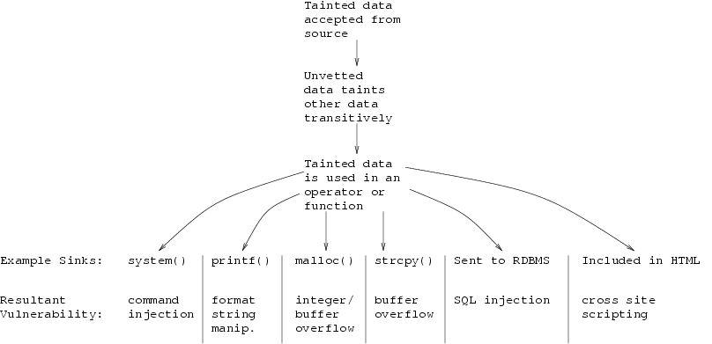
Tainting checkers

Slide 47
Application to Security Bugs
Stanford research project
  Ken Ashcraft and Dawson Engler, Using Programmer-Written Compiler Extensions to Catch Security Holes, IEEE Security and Privacy 2002
  Used modified compiler to find over 100 security holes in Linux and BSD
  http://www.stanford.edu/~engler/
Benefit
  Capture recommended practices, known to experts, in tool available to all

Slide 48
Sanitize integers before use
Warn when unchecked integers from untrusted sources reach trusting sinks
Syscall
param
Network
packet
copyin(&v, p, len)
v.tainted
any<= v <= any
v.clean
Use(v)
memcpy(p, q, v)
copyin(p,q,v)
copyout(p,q,v)
array[v]
while(i < v)
…
ERROR
Linux: 125 errors, 24 false; BSD: 12 errors, 4 false

Slide 49
Example security holes
Remote exploit, no checks
/* 2.4.9/drivers/isdn/act2000/capi.c:actcapi_dispatch */
isdn_ctrl cmd;
...
while ((skb = skb_dequeue(&card->rcvq))) {
msg = skb->data;
...
memcpy(cmd.parm.setup.phone,
msg->msg.connect_ind.addr.num,
msg->msg.connect_ind.addr.len - 1);

Slide 50
Example security holes
Missed lower-bound check:
/* 2.4.5/drivers/char/drm/i810_dma.c */
if(copy_from_user(&d, arg, sizeof(arg)))
return –EFAULT;
if(d.idx > dma->buf_count)
return –EINVAL;
buf = dma->buflist[d.idx];
Copy_from_user(buf_priv->virtual, d.address, d.used);

Slide 51
User-pointer inference
Problem: which are the user pointers?
  Hard to determine by dataflow analysis
  Easy to tell if kernel believes pointer is from user!
Belief inference
  “*p” implies safe kernel pointer
  “copyin(p)/copyout(p)” implies dangerous user ptr
  Error: pointer p has both beliefs.
Implementation: 2 pass checker
  inter-procedural: compute all tainted pointers
  local pass to check that they are not dereferenced
Notes:
Ran over exokernel code that I was involved with for my thesis. Fortunately caught this after I got my day job.

Slide 52
Environment Assumptions
Should the return value of malloc() be checked?
int *p = malloc(sizeof(int));
*p = 42;
OS Kernel:
Crash machine.
File server:
Pause filesystem.
Web application:
200ms downtime
Spreadsheet:
Lose unsaved changes.
Game:
Annoy user.
IP Phone:
Annoy user.
Library:
?
Medical device:
malloc?!

Slide 53
Statistical Analysis
Assume the code is usually right
int *p = malloc(sizeof(int));
*p = 42;
int *p = malloc(sizeof(int));
if(p) *p = 42;
int *p = malloc(sizeof(int));
*p = 42;
int *p = malloc(sizeof(int));
if(p) *p = 42;
3/4
deref
1/4
deref
int *p = malloc(sizeof(int));
*p = 42;
int *p = malloc(sizeof(int));
if(p) *p = 42;
int *p = malloc(sizeof(int));
if(p) *p = 42;
int *p = malloc(sizeof(int));
*p = 42;

Slide 54
Results for BSD and Linux
All bugs released to implementers; most serious fixed
Linux BSD
Violation Bug Fixed Bug Fixed
Gain control of system 18 15 3 3
Corrupt memory 43 17 2 2
Read arbitrary memory 19 14 7 7
Denial of service 17 5 0 0
Minor 28 1 0 0
Total 125 52 12 12

Slide 55
Outline
General discussion of code analysis tools
  Goals and limitations of static, dynamic tools
  Static analysis based on abstract states
Security tools for traditional systems programming
  Property checkers from Engler et al., Coverity
  Sample security-related results
Web security analysis
  Black-box security tools
  Study based on these tools: security of coding
Static analysis for Android malware
  Determining whether app is malicious
  Using tools for other security studies
Slides from: S. Bugrahe, A. Chou, I&T Dillig, D. Engler, J. Franklin, A. Aiken, …

Slide 56






Survey of Web Vulnerability Tools
Local Remote
>$100K total retail price

Slide 57
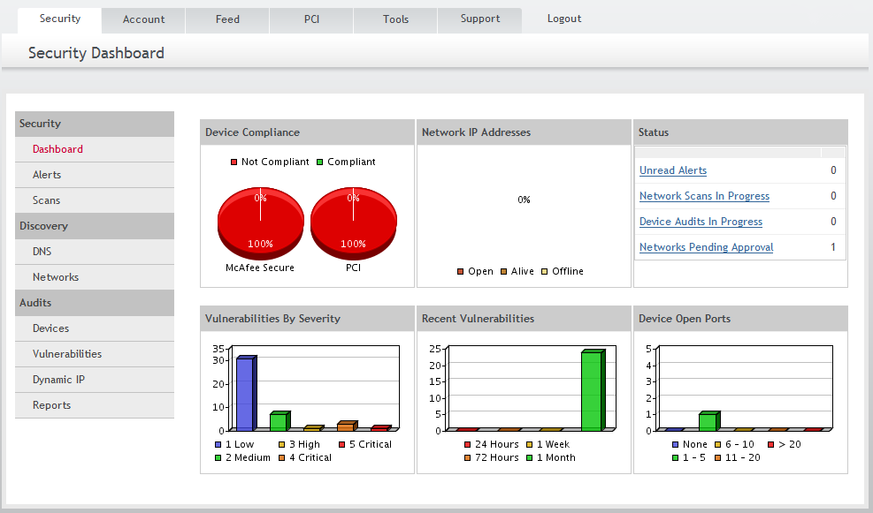
Example scanner UI

Slide 58
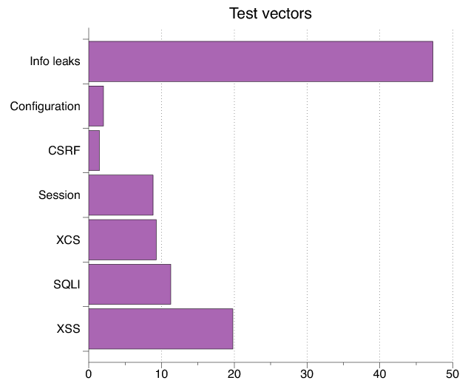
Test Vectors By Category
Test Vector Percentage Distribution

Slide 59
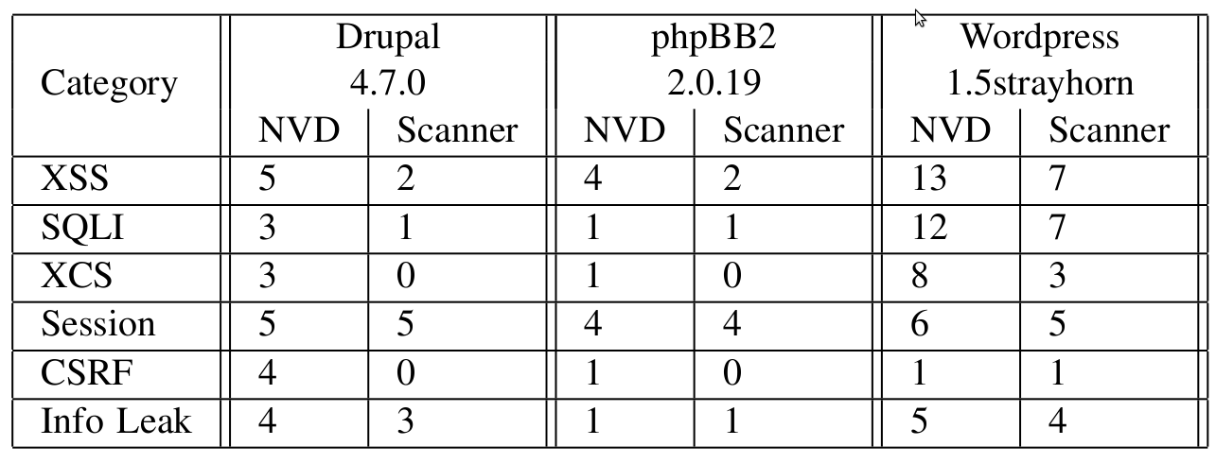
Detecting Known Vulnerabilities
Vulnerabilities for
previous versions of Drupal, phpBB2, and WordPress
Good: Info leak, Session
Decent: XSS/SQLI
Poor: XCS, CSRF (low vector count?)

Slide 60
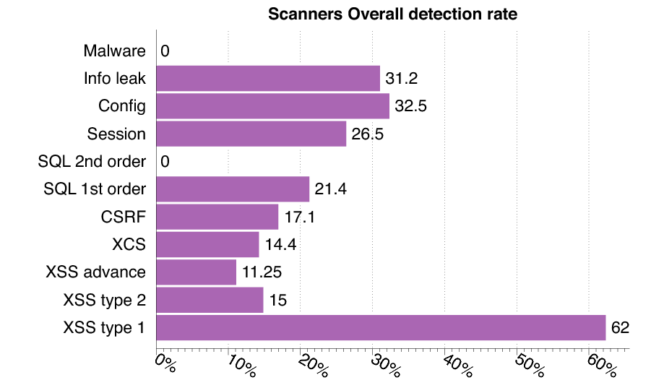
Vulnerability Detection

Slide 61
Secure development

Slide 62
Experimental Study
What factors most strongly influence the likely security of a new web site?
  Developer training?
  Developer team and commitment?
    freelancer vs stock options in startup?
  Programming language?
  Library, development framework?
How do we tell?
  Can we use automated tools to reliably measure security in order to answer the question above?

Slide 63
Approach
Develop a web application vulnerability metric
  Combine reports of 4 leading commercial black box vulnerability scanners and
Evaluate vulnerability metric
  using historical benchmarks and our new sample of applications.
Use vulnerability metric to examine the impact of three factors on web application security:
  startup company or freelancers
  developer security knowledge
  Programming language framework

Slide 64
Data Collection and Analysis
Evaluate 27 web applications
  from 19 Silicon Valley startups and 8 outsourcing freelancers
  using 5 programming languages.
Correlate vulnerability rate with
  Developed by startup company or freelancers
  Extent of developer security knowledge (assessed by quiz)
  Programming language used.

Slide 65
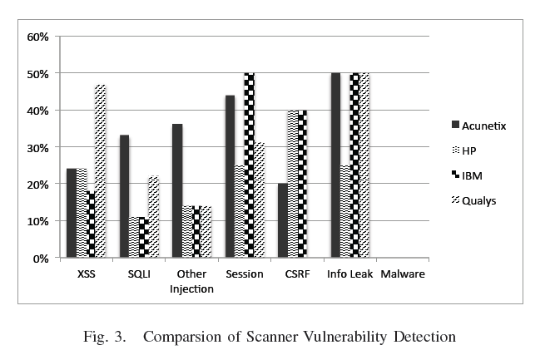
Comparison of scanner vulnerability detection

Slide 66
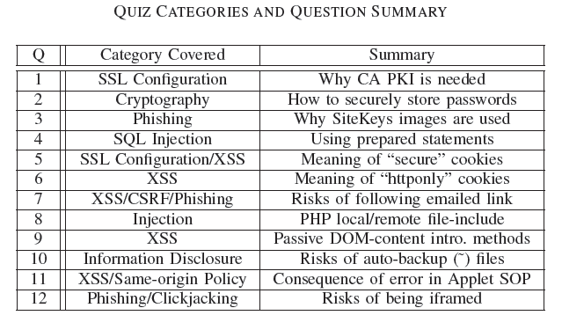
Developer security self-assessment

Slide 67
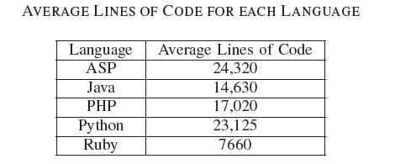
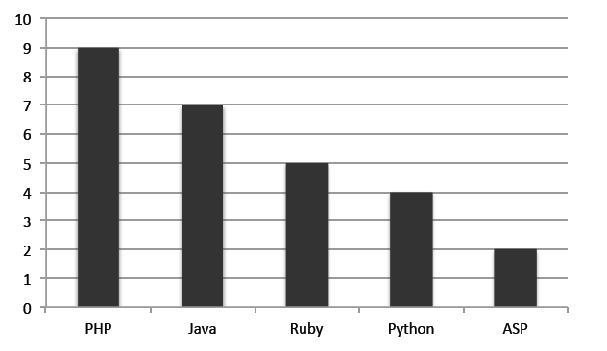
Language usage in sample
Number of applications

Slide 68
Summary of developer study
Security scanners are useful but not perfect
  Tuned to current trends in web application development
  Tool comparisons performed on single testbeds are not predictive in a statistically meaningful way
  Combined output of several scanners is a reasonable comparative measure of code security, compared to other quantitative measures
Based on scanner-based evaluation
  Freelancers are more prone to introducing injection vulnerabilities than startup developers, in a statistically meaningful way
  PHP applications have statistically significant higher rates of injection vulnerabilities than non-PHP applications; PHP applications tend not to use frameworks
  Startup developers are more knowledgeable about cryptographic storage and same-origin policy compared to freelancers, again with statistical significance.
  Low correlation between developer security knowledge and the vulnerability rates of their applications
Warning: don’t hire freelancers to build secure web site in PHP.

Slide 69
Outline
General discussion of code analysis tools
  Goals and limitations of static, dynamic tools
  Static analysis based on abstract states
Security tools for traditional systems programming
  Property checkers from Engler et al., Coverity
  Sample security-related results
Web security analysis
  Black-box security tools
  Study based on these tools: security of coding
Static analysis for Android malware
  Determining whether app is malicious
  Using tools for other security studies
Slides from: S. Bugrahe, A. Chou, I&T Dillig, D. Engler, J. Franklin, A. Aiken, …

Slide 70
STAMP Admission System
Static Analysis
More behaviors, fewer details
Static
STAMP
Dynamic
Alex Aiken,
John Mitchell,
Saswat Anand,
Jason Franklin
Osbert Bastani,
Lazaro Clapp,
Patrick Mutchler,
Manolis Papadakis
Dynamic Analysis
Fewer behaviors, more details

Slide 71
Data Flow Analysis
getLoc()
Source: Location
sendSMS()
Sink: SMS
sendInet()
Sink: Internet
Location
SMS
Location
Internet
Source-to-sink flows
  Sources: Location, Calendar, Contacts, Device ID etc.
  Sinks: Internet, SMS, Disk, etc.

Slide 72
Applications of Data Flow Analysis
Malware/Greyware Analysis
  Data flow summaries enable enterprise-specific policies
API Misuse and Data Theft Detection
FB API
Source: FB_Data
Send Internet
Sink: Internet
Automatic Generation of App Privacy Policies
  Avoid liability, protect consumer privacy
Privacy Policy
This app collects your:
Contacts
Phone Number
Address
Vulnerability Discovery
Web
Source: Untrusted_Data
SQL Stmt
Sink: SQL

Slide 73
Challenges
Android is 3.4M+ lines of complex code
  Uses reflection, callbacks, native code
Scalability: Whole system analysis impractical
Soundness: Avoid missing flows
Precision: Minimize false positives

Slide 74
STAMP Approach
Too expensive!
App
App
Model Android/Java
  Sources and sinks
  Data structures
  Callbacks
  500+ models
Whole-program analysis
  Context sensitive
Android
Models
STAMP
OS
HW

Slide 75
Building Models
30k+ methods in Java/Android API
  5 mins x 30k = 2500 hours
Follow the permissions
  20 permissions for sensitive sources
    ACCESS_FINE_LOCATION (8 methods with source annotations)
    READ_PHONE_STATE - (9 methods)
  4 permissions for sensitive sinks
    INTERNET, SEND_SMS, etc.

Slide 76
Identifying Sensitive Data
android.Telephony.TelephonyManager: String getDeviceId()
Returns device IMEI in String
Requires permission GET_PHONE_STATE
@STAMP(
SRC ="$GET_PHONE_STATE.deviceid",
SINK ="@return"
)

Slide 77
Data We Track (Sources)
Account data
Audio
Calendar
Call log
Camera
Contacts
Device Id
Location
Photos (Geotags)
SD card data
SMS
30+ types of sensitive data

Slide 78
Data Destinations (Sinks)
Internet (socket)
SMS
Email
System Logs
Webview/Browser
File System
Broadcast Message
10+ types of exit points

Slide 79
Currently Detectable Flow Types
396 Flow Types
Unique Flow Types = Sources x Sink

Slide 80
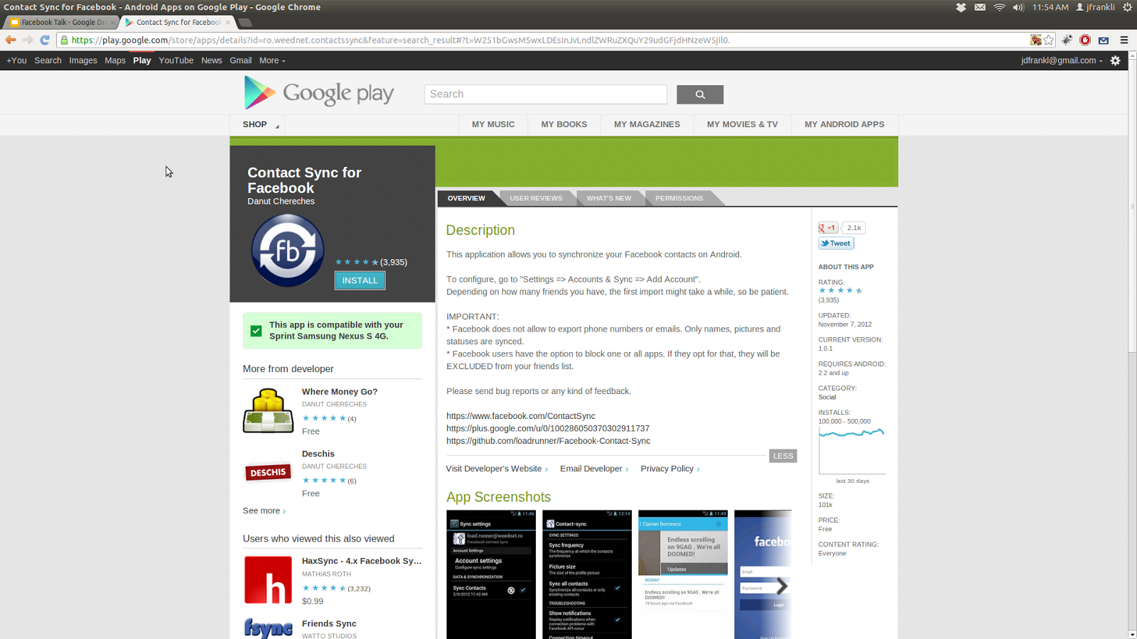
Example Analysis
Contact Sync for Facebook (unofficial)

Slide 81
Contact Sync Permissions
Category | Permission | Description
Your Accounts | AUTHENTICATE_ACCOUNTS | Act as an account authenticator
 | MANAGE_ACCOUNTS | Manage accounts list
 | USE_CREDENTIALS | Use authentication credentials
Network Communication | INTERNET | Full Internet access
 | ACCESS_NETWORK_STATE | View network state
Your Personal Information | READ_CONTACTS | Read contact data
 | WRITE_CONTACTS | Write contact data
System Tools | WRITE_SETTINGS | Modify global system settings
 | WRITE_SYNC_SETTINGS | Write sync settings (e.g. Contact sync)
 | READ_SYNC_SETTINGS | Read whether sync is enabled
 | READ_SYNC_STATS | Read history of syncs
Your Accounts | GET_ACCOUNTS | Discover known accounts
Extra/Custom | WRITE_SECURE_SETTINGS | Modify secure system settings

Slide 82
Possible Flows from Permissions
Sources
Sinks
READ_CONTACTS
INTERNET
READ_SYNC_SETTINGS
WRITE_SETTINGS
READ_SYNC_STATS
WRITE_CONTACTS
GET_ACCOUNTS
WRITE_SECURE_SETTINGS
INTERNET
WRITE_SETTINGS

Slide 83
Expected Flows
Sources
Sinks
READ_CONTACTS
INTERNET
READ_SYNC_SETTINGS
WRITE_SETTINGS
READ_SYNC_STATS
WRITE_CONTACTS
GET_ACCOUNTS
WRITE_SECURE_SETTINGS
INTERNET
WRITE_SETTINGS

Slide 84
Observed Flows
FB API
Source: FB_Data
Write Contacts
Sink: Contact_Book
Read Contacts
Source: Contacts
Send Internet
Sink: Internet

Slide 85
Example Study: Mobile Web Apps
Goal
  Identify security concerns and vulnerabilities specific to mobile apps that access the web using an embedded browser
  Technical summary
    WebView object renders web content
    methods loadUrl, loadData, loadDataWithBaseUrl, postUrl
    addJavascriptInterface(obj, name) allows JavaScript code in the web content to call Java object method name.foo()

Slide 86
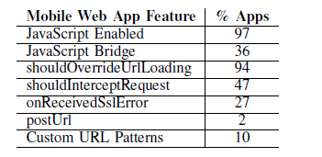
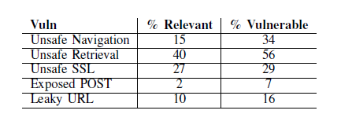
Sample results
Analyze 998,286 free web apps from June 2014

Slide 87
Summary
General discussion of code analysis tools
  Goals and limitations of static, dynamic tools
  Static analysis based on abstract states
Security tools for traditional systems programming
  Property checkers from Engler et al., Coverity
  Sample security-related results
Web security analysis
  Black-box security tools
  Study based on these tools: security of coding
Static analysis for Android malware
  Determining whether app is malicious
  Using tools for other security studies
Slides from: S. Bugrahe, A. Chou, I&T Dillig, D. Engler, J. Franklin, A. Aiken, …

